Slide 1
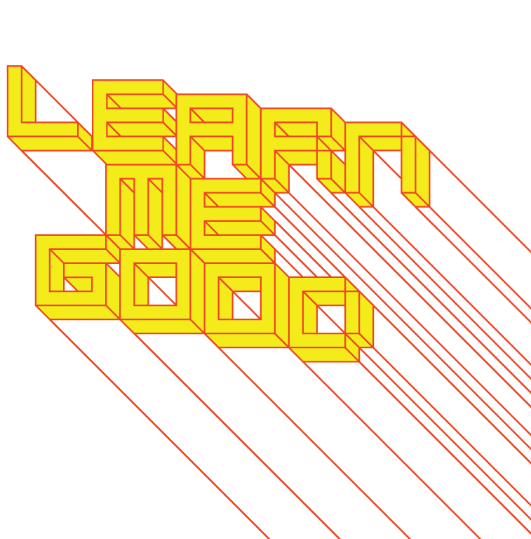
WEEK 1

Slide 2
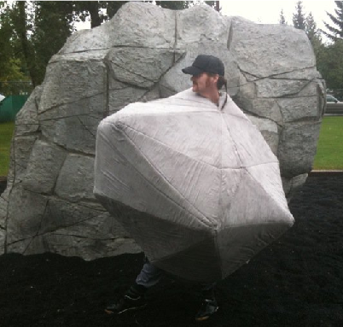
week 1: welcome to dart 261!
+ Who are You?
+ Christopher Moore, Associate Professor [call me Chris!]
+ Introduction/Biography
+ Ontario College of Art and Design [Communication
Design - Illustration]
+ Nova Scotia College of Art and Design [MFA - Design]
+ Freelance Illustration and Design
+ Simon Fraser University, Vancouver [School of
Interactive Arts and Technology]
+ University of Lethbridge [Chair, New Media]
+ Current Research and Creative Practice
+ Humour and art activism
+ Speculative play / design fictions
+ Contemporary souvenir and tourist culture
+ Teaching Assistants: Patrizio McLelland, Emily Bain

Slide 3
week 1: welcome to dart 261!
+ Design is Ordinary:
+ “Culture is ordinary: that is the first fact. Every human society has its own shape, its own purposes, its
own meanings. Every human society expresses these, in institutions, and in arts and learning. The
making of a society is the finding of common meanings and directions, and in its growth is an active
debate and amendment under the pressures of experience, contact, and discovery, writing
themselves into the land. The growing society is there, yet it is also made and remade in every
individual mind.”
—Raymond Williams, “Culture is Ordinary” (1958)
+ The interactions between people, objects, and imagery form the basis of personal and social identity
+ Culture is "made and remade" in the popular realm
+ Design artifacts and experiences weave complex narratives that connect politics, religion, ethics, and
cultural histories into aesthetic concerns

Slide 4
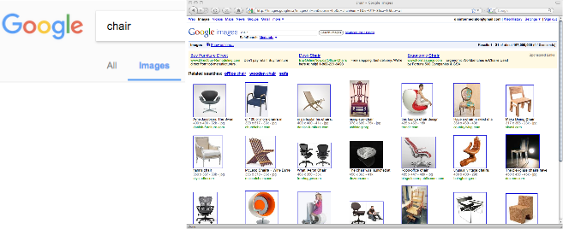
week 1: welcome to dart 261!
+ Design is a Lifecycle:
+ “I don’t really call design problem-solving anymore because I think that we’ve solved all of the
problems. It’s beyond that. You could always argue that there are “problems.” But if you make a
chair that’s uncomfortable, you should be shut down. Ever since the advent of computer-aided
machinery, we’re not making that many advances in the physical production world. There are no
excuses to put out a bad product anymore.”
—Karim Rashid
+ So, what purpose does design serve if all “practical” problems have already been solved?
+ We must reconsider design as the conception, creation, production and utilization of cultural artifacts
+ How do they reflect and activate the society to which they belong?

Slide 5
week 1: welcome to dart 261!
+ Design is Significant:
+ “The tricky part of design is that we’re perpetually revisiting the archetype. Sometimes we need to do
away with the archetype. Or ask, “Do we need to add that product category?” Originality is also a
way to change the product landscape, to become the catalyst for change and inspiration.”
—Karim Rashid
+ We must acknowledge that all things designed by humans are worthy of attention—not just
monumental or canonical designs
+ We will examine the potential of the artifact as a pivotal basis for discovery and interpretation
+ History is told through the residue and artifacts of cultural production
+ Artifacts are not neutral—replete with narrative and social resonance

Slide 6
week 1: welcome to dart 261!
+ Ron Arad, "No Discipline" (Museum of Modern Art, New York)

Slide 7
week 1: welcome to dart 261!
+ Course Overview + General Objectives:
+ We will consider design as a subset of material culture studies:
+ It intersects with many disciplinary areas:
+ Cognitive science, anthropology, sociology, media studies, and semiotics (among others)
+ Your design education in DART 261 (and Concordia, in general) will address:
+ The broad strokes of design history—the influential (Henry Ford’s assembly line), sustainable
(Dixon’s 2nd Cycle project with Artek), beautiful (Guimard’s Paris Metro entrances),
propagandistic (Stepanova’s athletic clothing design), modern (Miedinger and Hoffman’s
Helvetica typeface), etc.
+ Cultural studies of design—helping you to discover what constitutes successful design, what
inspires you, and how design activates and reflects the culture of its time and place
+ Design from a contextual perspective—recognizing that an artifact’s identity, value, and usefulness
is directly affected by its setting, and by the historical/cultural/geographical world
+ Acute sensitivity to the surroundings in which your design will exist—understanding the relationship
between creation, dissemination, interaction, and reception
+ How? The Laboratories for Learning:
+ Classroom: readings, lectures, discussions, and contact time with the instructor and TA
+ Placement of artifacts within a broader context
+ Lived Reality: observation, documentation, experimentation
+ Study of how objects interface with daily life

Slide 8
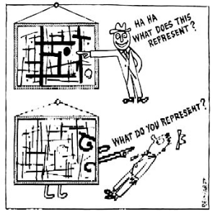
week 1: welcome to dart 261!
+ What Do You Represent?
+ Teaching Philosophy:
+ No fun is no fun
+ Fun and hard work are not mutually exclusive
+ Facilitate dialogue, exchange
+ Welcome constructive debate and critique
+ We are all equal, but different
+ Respect for all individuals: safe environment for
self-expression
+ Course Approach:
+ Theory, technical skills, and the application of the two
+ Recognize diverse academic backgrounds
+ Thematic subject for assignments allow for creative
exploration within constraints
+ Methodologies for lifelong learning and upgrading
+ Introduce foundations upon which to further your development
+ Share your skills, knowledge, critique, ideas with your classmates
+ Ad Reinhardt, How to Look at Art

Slide 9
week 1: welcome to dart 261!
+ Rules, Rules, Rules!
+ Site: www.learnmegood.ca
+ Weekly Presentations: www.learnmegood.ca/261/x/presentation.pptx
+ Contact: christopher.moore@concordia.ca
+ Office Hours: Wed. 13:00 - 16:00 (best to email for an appointment)
+ Teaching Assistant Roles:
+ First contact for questions regarding course content, assignment specifications
+ Conduct tutorial sessions
+ TA: ta@learnmegood.ca
+ Texts:
+ There are no required texts for this course
+ All readings will be available online through the Learn Me Good portal or online sources

Slide 10
week 1: welcome to dart 261!
+ Rules, Rules, Rules!
+ Other Requirements:
+ Notebook + writing implement(s); USB drive
+ Intelligence, personality, thoughtfulness, and opinions
+ Attendance:
+ In general, 3 absences constitutes an automatic failure (Department policy)
+ Notify me if you are sick or there are extenuating circumstances
+ Participation:
+ Contribution to discussions, helpfulness, provision of relevant resources
+ Overall demeanour, professionalism, and decorum
+Emails:
+ Please format subject titles accordingly; include course number
+ Example: DART 261: Assignment 2 Draft
+ Assignments:
+ Completed at beginning of class; be prepared to discuss and critique
+ Submitted to Moodle
+ Specific requirements will be detailed in assignment guidelines and in-class sessions

Slide 11
week 1: welcome to dart 261!
+ Rules, Rules, Rules!
+ Academic Integrity and Copyright:
+ All sources must be properly documented (audio, visual, written, etc.)
+ Suggestion: use MLA style guide for citations (just be consistent)
+ You are required to disclose any materials which are copyright protected
+ Use of AI is generally prohibited
+ Under certain circumstances it may be used if fully credited (best to check with instructor first)
+ Misrepresentation is a serious offense, which could result in disciplinary action, including
University expulsion
+ Assistance is available through the Writing Centre
+ John Latour (Fine Arts Librarian) is also available to assist with research assignments
+ Late Policy: -5% per day (contact ahead of due date, if problems arise)
+ Personal Security:
+ Every student has an equal right to learn
+ University policy forbids harassment or intimidation based on gender, ethnicity,
sexual orientation or any other forms of intolerance
+ Department Syllabus:
+ Standardized codes of conduct and academic regulations applicable to all DART/CART courses

Slide 12
week 1: welcome to dart 261!
+ Rules, Rules, Rules!
+ Evaluation:
+ 15% Readings / Participation / Attendance
+ 15% Reflective Summaries (three, each worth 5%)
+ 70% Major Assignment (two parts)
+ 30% Research
+ 40% Integration
+ Overview of Weekly Expectations:
+ Readings / websites / video screenings
+ Links for weekly materials at the end of the course outline
+ Reflective Summaries:
+ Every three weeks
+ Select artifact to illustrate or contradict salient concept/theme
+ Tutorials Section AA: Tuesdays 11:00-12:00
+ Tutorials Section BA: Tuesdays 15:30-16:30
+ Unless otherwise noted
+ Overview of Major Assignment:
+ Two parts: Research and Integration
+ "Real world" study, plus scholarly/academic research
+ Case Study: Common Artifacts
+ You will become anthropologists of the everyday

Slide 13
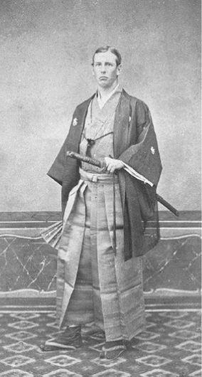
week 1: welcome to dart 261!
+ Everything is "Hunky-Dory" (A Case Study)
+ 1872:
+ Who is this man?
+ Why is he dressed this way?

Slide 14
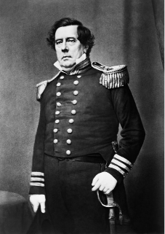
week 1: welcome to dart 261!
+ Everything is "Hunky-Dory" (A Case Study)
+ U.S. Commodore Matthew Perry opened up trade with Japan
in 1850s
+ Frequent trips between countries
+ Two stories:
+ "Honcho-dori": Japanese term for main street
+ U.S. soldiers stationed in Japan knew term "hunky"
(safe or strong), and were likely familiar with the word
"dori" (Japanese for "road")
+ Allusion to "easy street" or "easy virtue"
+ "Hunkidori": translates loosely to "superlatively good"
+ Also, the name of a street and bazaar in Yeddo (Tokyo)
+ Because of increasing trade/travel, the term began to be
adopted in the West
+ Location of safety, familiarity for Western visitors/military
+ Beginning of colonization
+ Meiji Restoration (1868): Japan no longer under protectionist
rule of Tokugawa Shogunate + Matthew Perry (ca. 1850s)
+ Last pre-modern feudal military government
+ Rise of tourist industry and trade

Slide 15
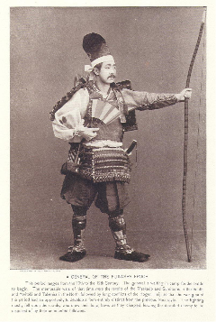
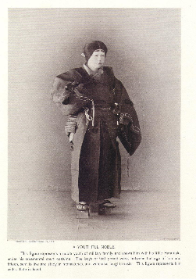
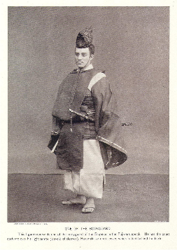
week 1: welcome to dart 261!
+ Cultural Cross-Dressing
+ Carte de Visite:
+ Early form of postcards/calling cards
+ American and European photographers established studios in Japan
+ Geared towards Western tourist market
+ Despite period of modernization/industrialization (Enlightenment?), visitors dressed in "exotic"
costumes of previous eras
+ The realism and newness of photography legitimized the "authenticity" of the image
+ Presented as contemporary documentation

Slide 16
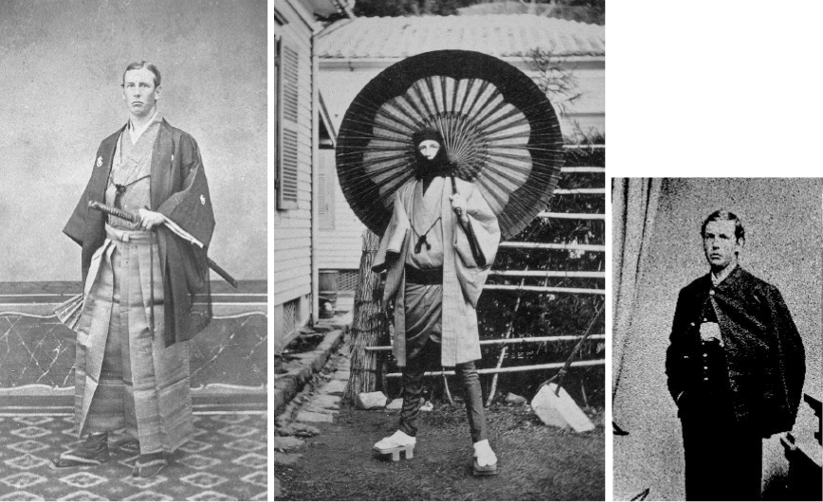
week 1: welcome to dart 261!
+ Cultural Cross-Dressing
+ Charles A. Longfellow
(1872)
+ "Japan craze"

Slide 17
week 1: welcome to dart 261!
+ The Birth of Commercial Photography: W.E.L. Keeling Tourists’ Guide

Slide 18
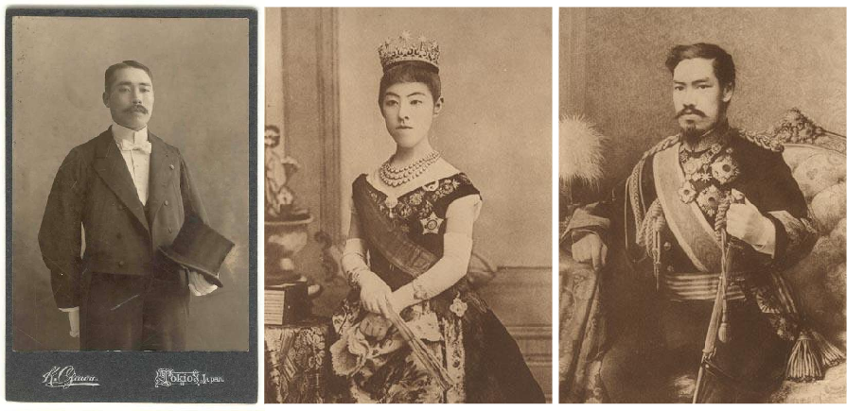
week 1: welcome to dart 261!
+ Inter-Cultural Exchange
+ In Meiji era, wealthy Japanese citizens explored Western forms of dress, as well:
+ K. Ogawa, Japanese Man in Formal Attire (1890s) / Emperor Mutsuhito and Empress Shoken (1900)

Slide 19
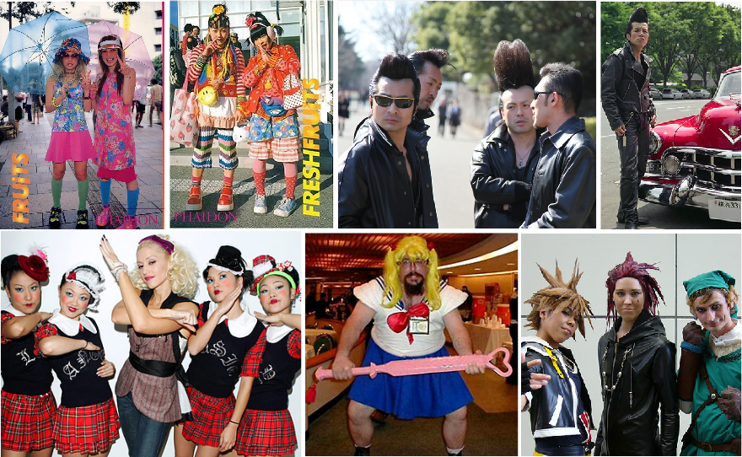
week 1: welcome to dart 261!
+ Inter-Cultural Exchange (What Does it All Mean?)

Slide 20
week 1: welcome to dart 261!
+ Ready, Set, Go!
+ Tutorials Today:
+ Getting to know you...
+ AA: Tuesday 11:00-12:00
+ BA: Tuesday 15:30-16:30
+ For Next Week:
+ Read: "William Morris--Art and Idealism" (PDF)
+ View short video: Hector Guimard, Cité entrance, Paris Métropolitan, c.1900
+ Review PowerPoint presentation for week 2
+ Social:
+ Participate in welcome events
+ Get to know your peers - you will be spending a lot of time with them!
+ Speed Greeting Sign-Up (Voluntary):
+ Wednesday/Thursday
+ Edutainment:
+ Cunk on Earth – Episode 4 “Rise of the Machines” (Netflix)

