Slide 1
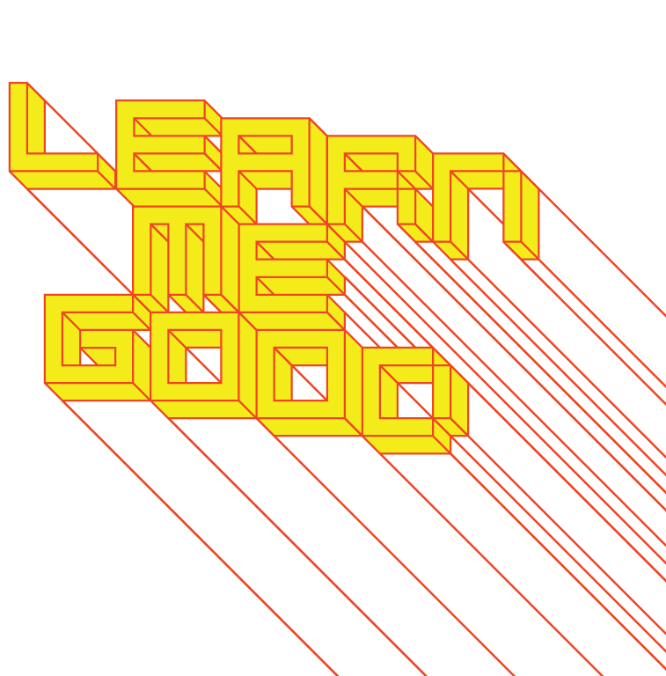
WEEK 11

Slide 2
week 11: what is “good” design?
+ Class Schedule:
+ Presentation and Discussion:
+ Material culture, object narratives
+ The political and social role of design
+ Ethics and engagement in design practice
+ Strategies for evaluating the relative effectiveness of design (case studies)
+ Major Assignment Part 2: Due November 28 December 5
+ Please use tutorial session and office hours to address questions and request feedback

Slide 3
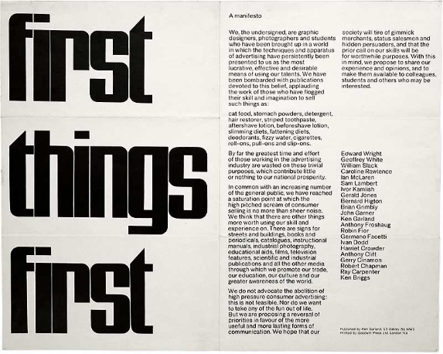
week 11: what is “good” design?
+ First Things First
+ Ken Garland (1964)
+ First Things First 2000 (1999)
+ First Things First 2014 (2014)

Slide 4
week 11: what is “good” design?
+ First Things First
+ "We, the undersigned, are graphic designers, photographers and students who have been brought
up in a world in which the techniques and apparatus of advertising have persistently been
presented to us as the most lucrative, effective and desirable means of using our talents ... [Our
time has been] wasted on these trivial purposes, which contribute little or nothing to our national
prosperity." --Ken Garland
+ Original manifesto reinstated in 1999, signed by 33 leading design professionals (22 original)
+ Renewed again in 2014
+ A rejection of the hyper-capitalist drive behind design practice (at the mercy of industry/the market)
+ Return design to its place as a means to resolving larger social/cultural issues
+ Not merely an aesthetic practice based on changing styles or trends
+ Investigate the influence and ubiquity of designed artifacts in everyday experience
+ Make meaningful changes in the world
+ A pledge to educate new generation of designers to become leaders in this practice
+ "We think that there are other things more worth using our skill and experience on ... We hope that
our society will tire of gimmick merchants, status salesmen and hidden persuaders, and that the
prior call on our skills will be for worthwhile purposes." --Ken Garland

Slide 5
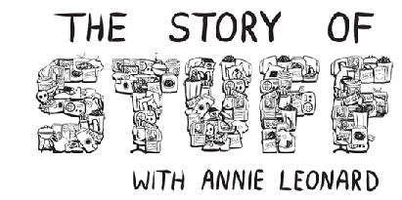
week 11: what is “good” design?
+ The Story of Stuff
+ Annie Leonard (2009)
+ Examine the entire lifecycle of artifacts to understand:
+ Cycle: Extraction > Production > Distribution > Consumption > Disposal
+ Environmental impacts (sourcing/harvesting/extraction of materials, process of manufacture,
byproducts, labour/outsourcing, design efficiency, energy usage, reuse/reinvention/disposal)
+ Responsibility of putting design into the world (social consequences, usefulness, resolution of
existing problem or creation of another, ethical implications)
+ Public acceptance (expansion of production, feedback/iteration of design, modification or
application of technology to other scenarios, shifts in other artifacts/processes as a result of
introduction, rejection)
+ Afterlife (disposal, reuse, processing, consumption, obsolescence, myth/archetype/historical
record)
+ Reassess the role of "stuff" in our lives
+ How much do we need? How much is enough?
+ What purpose does it serve? (functional, aesthetic, connotative, symbolic)

Slide 6
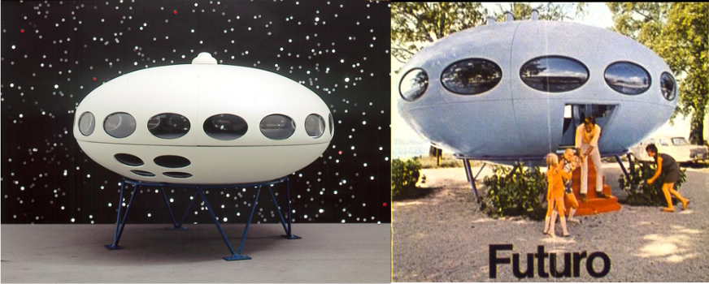
week 11: what is “good” design?
+ Case Study: The Futuro
+ Matti Suuronen (1968)

Slide 7
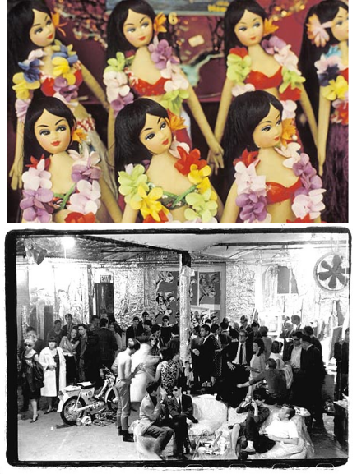
week 11: what is “good” design?
+ Case Study: The Futuro
+ Historical/Political Context:
+ Apex of consumerism in the West; outward displays
of wealth/status/disposable income
+ Keeping up with the Joneses
+ Leisure culture, travel/tourism
+ Sexual liberation, swingers, free love, peace/
anti-war movement, hippies, rise of drug culture
+ Revolution in legislation of equality for many
disempowered groups
+ Rise in media culture, connection to larger world
within the domestic environment
+ Aesthetic Context:
+ Kitsch, Pop Art, acid-psychedelic colours and form
+ Shapes, patterns, typography reference the space
race (Neil Armstrong lands on moon, 1969)
+ Themes of utopia, future, sex, and leisure
(all facilitated by machines - relieve drudgery)
+ Technological and market dominance of American
manufacturing
+ Strong sense of nationalism: rhetoric of progress

Slide 8
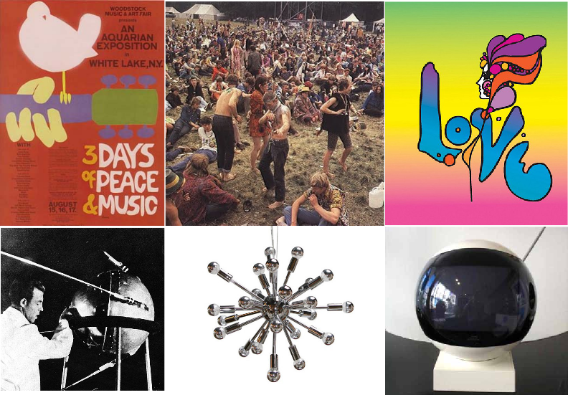
week 11: what is “good” design?
+ Case Study: The Futuro

Slide 9
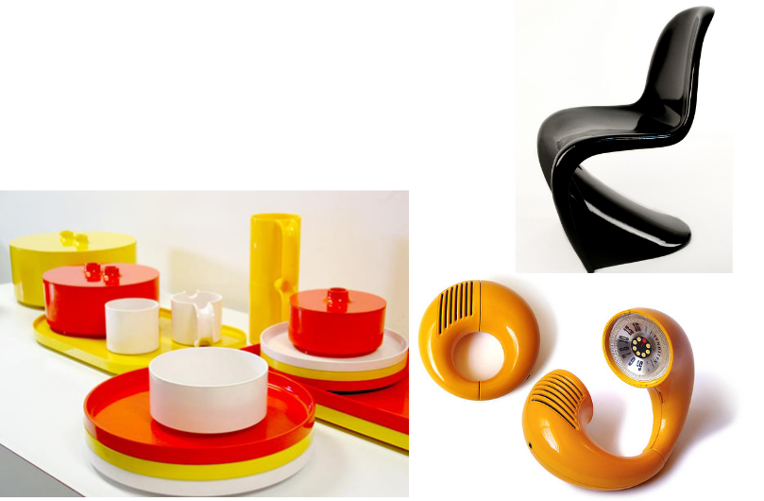
week 11: what is “good” design?
+ Case Study: The Futuro
+ Material Advancements:
+ Experimentation and advancements in man-made materials (plastics, etc.)
+ Allowed for casting, bending, forming of materials into new shapes,
not previously attainable
+ Cheaper manufacturing costs than natural materials
+ Glossy surfaces, with extreme machine precision
+ Another signifier of progress
+ Why was the Futuro a Failure?
+ It appeared to meet all the criteria of a changing culture in the late 1960s

Slide 10
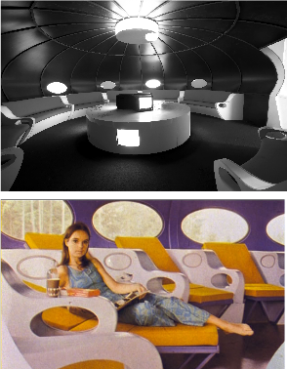
week 11: what is “good” design?
+ Case Study: The Futuro
+ The Oil Crisis/Embargo and Stock Market Crash (1973-1974), Vietnam War (ends 1975)
+ Escalating prices for petroleum create shortage of reserves and prices skyrocket
+ One of the key factors preventing Futuro's adoption in the US
+ Previously, there was staggering interest in the possibilities that this concept signified
+ Price Versus Size
+ Extremely pricey to manufacture, limiting the market of buyers
+ Those with the means to afford, would prefer something larger
+ Suitable, however, to a cottage/chalet or temporary dwelling
+ Aesthetics
+ Appealed to a wealthy/connoisseur demographic, not average taste
+ Most Americans preferred the Colonial revival and neo-Victorian
aesthetic (cabinet televisions, avocado green/harvest gold)
+ Too outrageous for most conservative individuals: deviated too
far from the vision of Americana and white picket fences
+ Too simple: like living in a work of art or science fiction
(not "homey")

Slide 11
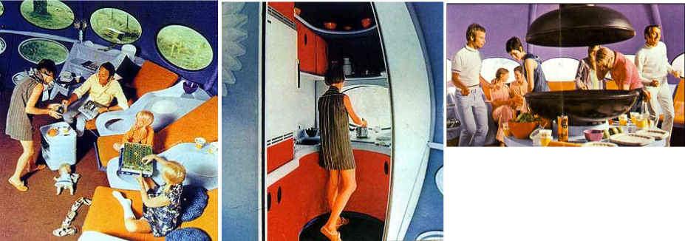
week 11: what is “good” design?
+ Case Study: The Futuro
+ Lifestyle
+ Communal living in close quarters is not the norm in North America
+ More prudish, and demanded privacy: not "family-friendly"
+ Mom and dad could not pull their twin beds together in the evening!
+ Lacked storage and display for the American obsession with domestic appliances, bric-a-brac,
and mementoes

Slide 12
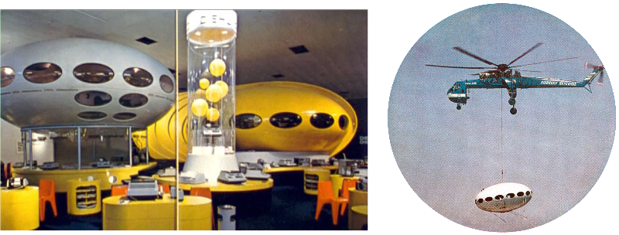
week 11: what is “good” design?
+ Case Study: The Futuro
+ Bad Luck and Bad Timing
+ A series of chance events seemed to prevent the public from gaining access: even if they wanted
to buy one
+ With every failure, the company tried to appeal to a different demographic
+ Marketing
+ Lacked focus: sent a product to market without a clear understanding of how it might be used
+ Initially targeted a general consumer, then began to pitch it as a luxury item for jet-setters
+ Have multiple "ports" to airlift and drop the Futuro in far-flung destinations
+ Sought out manufacturing contracts in many nations, expanding too quickly
+ Began proposing ludicrous applications: stacked hotels, towers, etc.

Slide 13
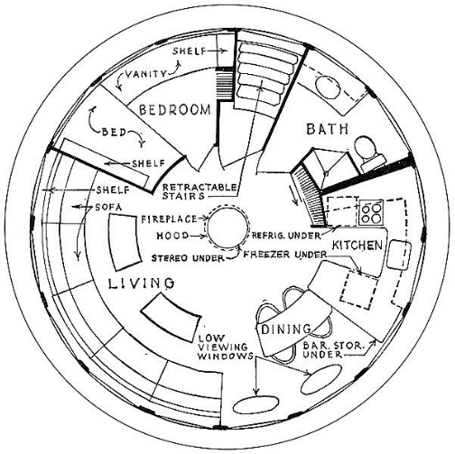
week 11: what is “good” design?
+ Case Study: The Futuro
+ Design
+ Flawed from the beginning: designed on a mathematical
formula for a theoretical use
+ Primacy of the concept and process, with
little regard to actual use /functionality
+ Cat-corner analogy
+ Lacked a fundamental understanding of
what makes individuals comfortable
and at ease in day-to-day living
+ Imposed a standard of lifestyle that did
not reflect the majority of the population
making a major purchase
+ Not the same as buying a kitschy vase,
with limited personal use
+ Home is a container with very complex
social and pragmatic functions

Slide 14
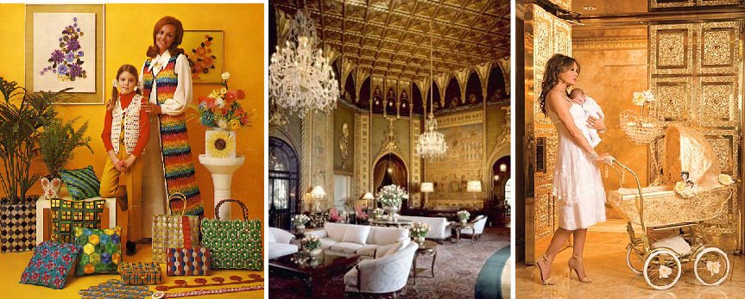
week 11: what is “good” design?
+ Case Study: The Futuro
+ Postscript
+ Following the end of the oil crisis and Vietnam war, values shifted
+ Seriousness, focus on restoring the US economy
+ Overt displays of wealth viewed negatively
+ Aesthetics reflected more crafty, handmade processes (macrame, etc.)
+ By the 1980s "Me Generation"/"Baby Boomers": the economy saw another upswing with Reagan
+ The "power tie," preppies, greed and affluence were the dominant trends
+ Aesthetics reverted to classical notions of prestige: precious metals, marble, gold, ivory
+ Donald Trump is an iconic figure...

Slide 15
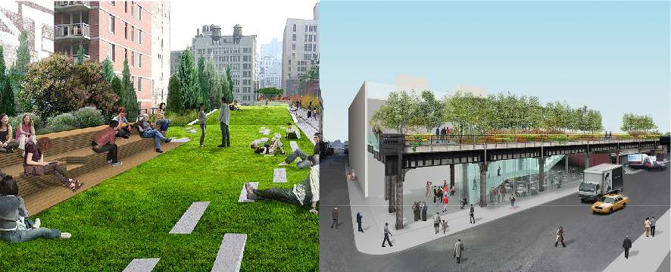
week 11: what is “good” design?
+ Case Study: The High Line, New York City
+ Friends of the High Line (Opened June 2009)
+ Landscape: James Corner Field Operations
+ Architects (Fixtures/Furniture/Environment): Diller Scofidio + Renfro
+ Graphics/Wayfinding: Pentagram
+ Urban revitalization project of the high rail line, along Manhattan's west side (between the
Rail Yards and the Meatpacking District, 2.33 km)

Slide 16
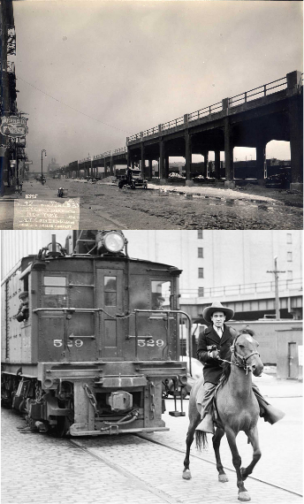
week 11: what is “good” design?
+ Case Study: The High Line, New York City
+ Video: History of the High Line
+ Project
+ Rail tracks built in 1930s: effort to raise freight traffic above
street in largest industrial area of Manhattan
+ Street-level trains too dangerous: "Death Avenue" (10th)
+ Raised above the street 30 feet
+ Diverts from passenger traffic that goes underground
to Penn Station
+ Abandoned since 1980, but largely disused since 1950s
+ Used to be for moving supplies and goods
into/out of NYC
+ Rise of interstate trucking: manufacturing and heavy
industry disappeared
+ 1999: Group formed to save High Line from demolition
+ Gentrification of area as a hotspot for art, entertainment,
fashion (galleries moved from Soho to Chelsea)
+ Tracks used to be populated by vagrants, drugs, etc.
+ Cheap housing for area workers now being converted
into pricey (and small!) condos
+ Major architectural projects underway/completed by
Frank Gehry, Norman Foster, Renzo Piano, etc.
+ Community-initiated venture: raised capital for a
competition/bid (720 teams, 36 countries)

Slide 17
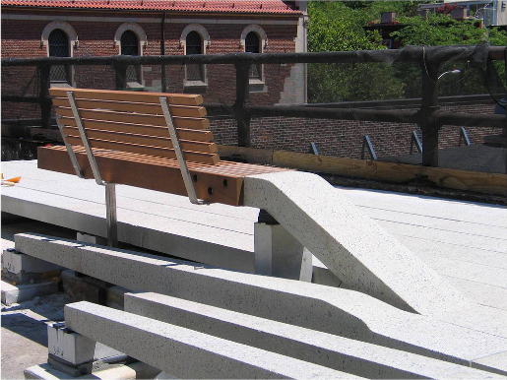
week 11: what is “good” design?
+ Case Study: The High Line, New York City
+ Video: Fly-Through Animation of Design
+ Urban Oasis
+ Serves a similar function to Central Park: escape from the intensity of the city
+ Elevated path presents new vantage on the city (water tanks on roofs, vistas between buildings)
+ Beauty cutting through the industrial architecture
+ All aspects reflect the historical roots of the area and the track
+ Fixtures blend seamlessly into the existing structures
+ Use of native plants and ornamental grasses that transition into concrete
+ Preservation of "patina" and partial tracks
+ Signage is clear and unobtrusive
+ Public art commissioned to capture the spirit of
the history
+ Raked amphitheatre accommodates performances,
musical acts, and readings
+ Volunteers serve as cultural guides and interpreters
+ Free from commercial interests: strictly public project
+ Seamless story that is being presented in an immersive,
multi-sensory environment
+ Feels like a natural extension and not a
postmodern attachment

Slide 18
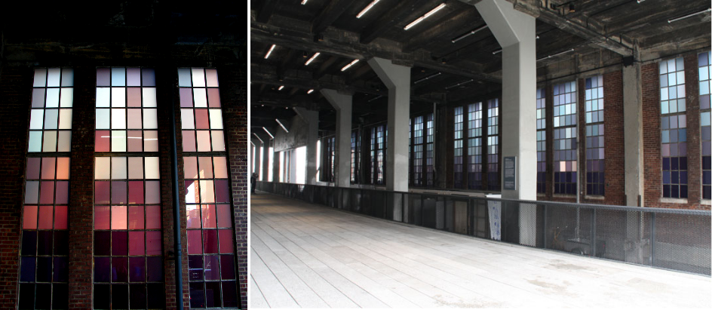
week 11: what is “good” design?
+ Case Study: The High Line, New York City
+ Spencer Finch, "The River That Flows Both Ways" (700 minutes, 700 glass panels)

Slide 19
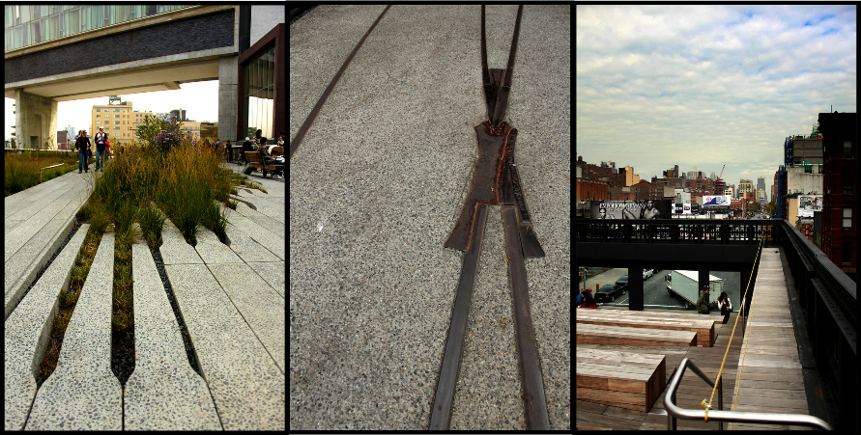
week 11: what is “good” design?
+ Case Study: The High Line, New York City

Slide 20
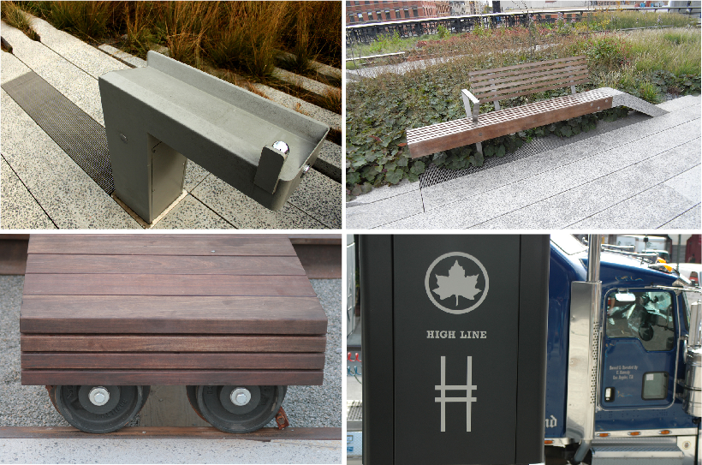
week 11: what is “good” design?
+ Case Study: The High Line, New York City

Slide 21
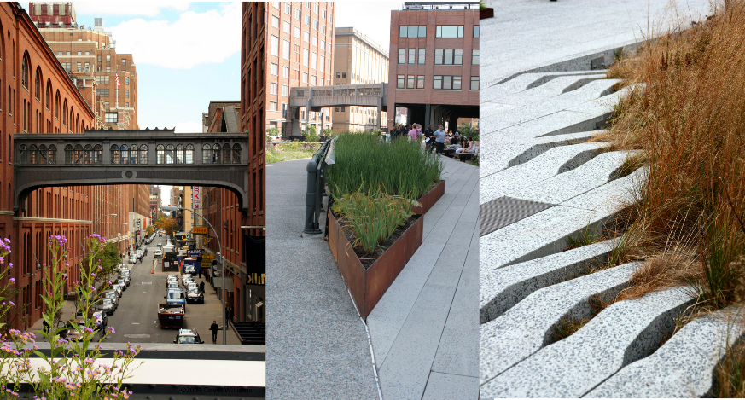
week 11: what is “good” design?
+ Case Study: The High Line, New York City

Slide 22
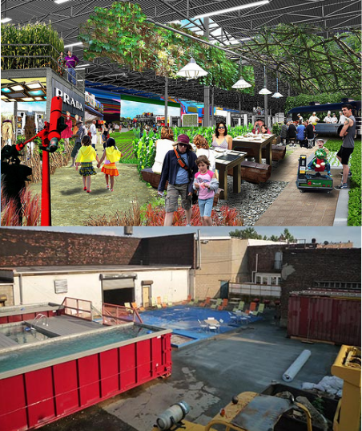
week 11: what is “good” design?
+ Case Study: Macro-Sea
+ Strip Malls (2009)
+ Urban renewal project for abandoned strip malls
+ Fragmentation of life into discrete functions
(requiring private transportation) failed
+ Mixed-use: work, educational, commercial,
residential, cultural
+ Reunited in a more holistic way: based on
traditional growth of cities/towns
+ Re-purposing of a space left violated by the
suburbanization and "big-boxing" of most cities
+ Pools (Ongoing)
+ Transformation of dumpsters into portable pools
+ Building community in urban centers
+ Mobile community pools in Manhattan

Slide 23
week 11: what is “good” design?
+ Case Study: Le Quartier Concordia Phase 1: ENCS/VA Integrated Complex
+ KPMB Architects (2005)
+ Designed as a "smart" building to control energy use and limit impact on environment
+ Earnest attempt, using industry-recognized processes/technologies
+ Vast expanses of glass and concrete surfaces heat up and retain heat energy
+ Office
+ Controlled by a sensor to detect presence and control the environmental qualities
+ Flaws:
+ Ignores individual differences in preference, use and patterns of occupation
+ Human judgment replaced by computerized control for an ideal scenario/person
+ HVAC anecdote
+ Lighting system detects presence (or lack thereof), but doesn't account for periods of inactivity
+ So too, the temperature is based on this activity
+ Does not account for the fact that the space is shared by several occupants (i.e. windows
left open)

Slide 24
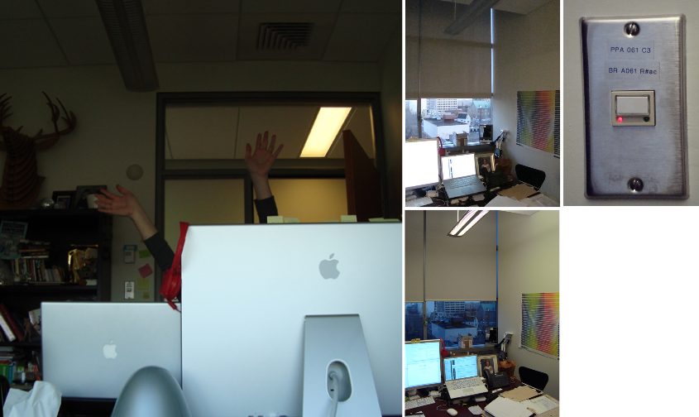
week 11: what is “good” design?
+ Case Study: Le Quartier Concordia Phase 1: ENCS/VA Integrated Complex

Slide 25
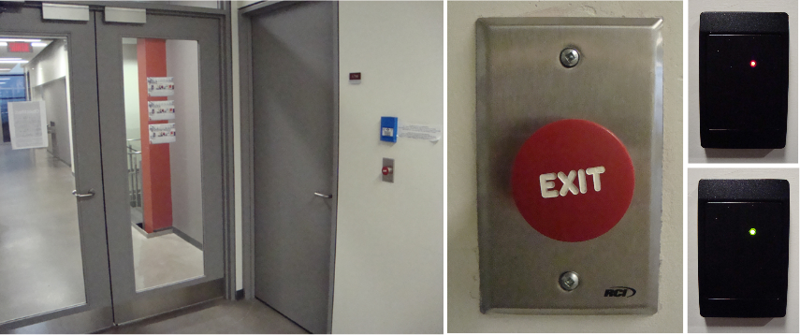
week 11: what is “good” design?
+ Case Study: Le Quartier Concordia Phase 1: ENCS/VA Integrated Complex
+ Controlled Access
+ After-hours access is controlled by an RFID pass card
+ Button must be pushed from inside to exit the controlled space
+ Button design is counter-intuitive
+ Appears to be an emergency alert signal
+ Placement of button, in relation to door
+ Too far from door (greater than arm span; limited time window for passage)
+ Placement on opposite side of hall to access door (requiring two-handed operation)

Slide 26
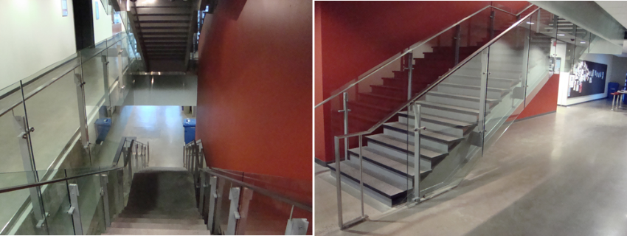
week 11: what is “good” design?
+ Case Study: Engineering and Visual Arts Building, Concordia
+ Stairways
+ Do not connect consistently between floors
+ Segregates and segments areas
+ Discourages use of stairs as an alternative to the elevators
+ Emergency stairs are narrow, with double-doors on each end; loud; unpleasant
+ Certain floors that have natural relationships are separated (7th and 8th levels)
+ Results in greater reliance on elevators
+ Increased energy use defeats some of the other positive improvements
+ Quality of experience diminished: slow waiting times, cramped cars, increased possibility of
infection, mood/demeanour affected

Slide 27
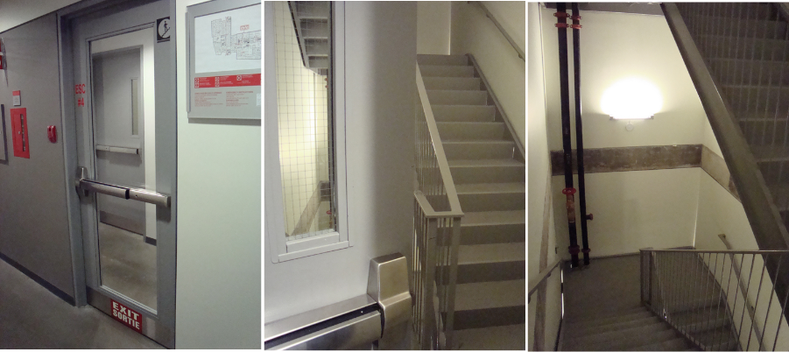
week 11: what is “good” design?
+ Case Study: Engineering and Visual Arts Building, Concordia

Slide 28
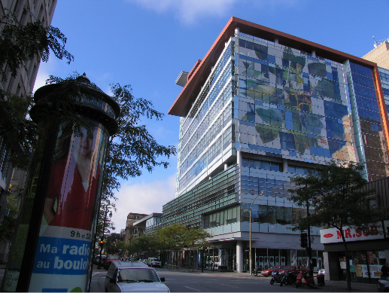
week 11: what is “good” design?
+ Case Study: Engineering and Visual Arts Building, Concordia
+ Building Maintenance
+ Specific crew contracted to maintain the architectural integrity of the original design
+ Causes individuals to conform to an established set of rules for inhabitation: lack of settling-in
+ In a creative field, this hermetic approach can appear cold and unwelcoming
+ Difficult to establish a sense of community/culture when all traces of use and human activity
get cleared away

Slide 29
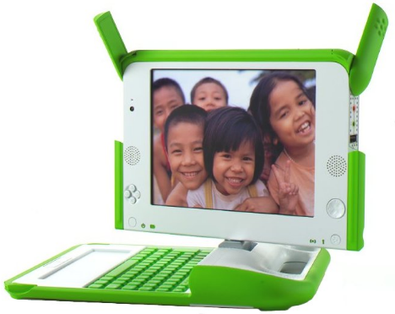
week 11: what is “good” design?
+ Case Study: One Laptop Per Child ($100 Laptop)
+ Nicholas Negroponte, MIT / Quanta Computer (2006)
+ The spirit is genuine, but the logic and methodology is flawed
+ Assumptions and Problems
+ There is a need for other developing nations to
"raise themselves up" to standards of first-world
+ Imposition of a model for independent "progress"
+ Sense of cultural imperialism guised as humanitarianism
+ Instead of working with existing models of commerce and
community (consulting directly with representatives),
the research and development uses information from
secondary sources
+ Prove technological prowess by constructing a
cheaply-made device that is "accessible" to the
needy
+ Sadly, many of the benefactors could
be those involved in manufacturing the
computer and/or disposing of the toxic remnants

Slide 30
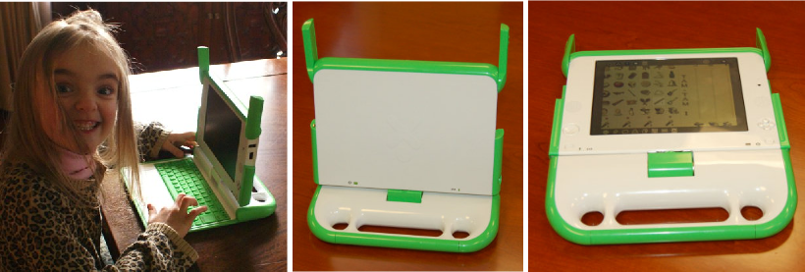
week 11: what is “good” design?
+ Case Study: One Laptop Per Child ($100 Laptop)
+ Assumes that Western forms of HCI are relevant or equivalent experiences in other areas
+ Are trackpads, mice, and keyboards the best choice for cultures that are predominantly based
on oral or pictographic traditions?
+ Requires support for developing literacy skills
+ Assumes that similar operating system software and graphical interfaces will translate directly
+ Denies the everyday realities of life and subsistence
+ Resources misdirected: a laptop is useless if one does not have access to the necessities
+ Maslow's Hierarchy of Needs (Physiological/Safety): clean water, food, shelter, medicine
+ Rejected by India's government
+ Postscript
+ The laptops sold primarily to Western consumers as a novelty (at twice the price)

Slide 31
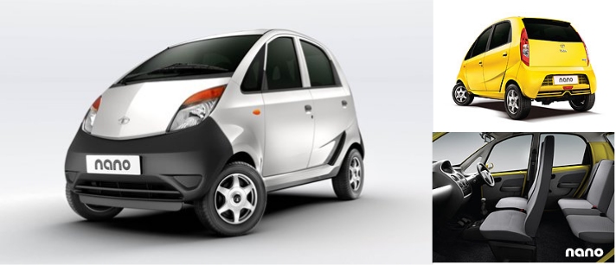
week 11: what is “good” design?
+ Case Study: Nano (The $2200 Car)
+ Tata Motors, India (2009)
+ About the size of a Smart car: 10' long, 5' wide; 600 kg
+ Fuel efficiency: 23.6 km/L (highest for any car in India)
+ Engine: 2-cylinder engine, top speed 105 km/h
+ Emissions: 101 gm/km (lowest CO2 emission among cars in India)
+ Safety: far exceeds India's standards
+ "The Nano will start at $2,200 after taxes and dealer costs, while the more expensive CX and LX
models with heat, air conditioning and power brakes will go for as much as $3,800."

Slide 32
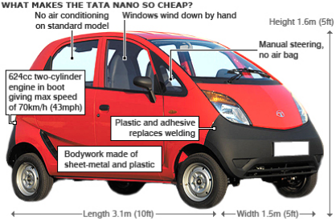
week 11: what is “good” design?
+ Case Study: Nano (The $2200 Car)
+ Differences From the $100 Laptop
+ Self-initiated program to resolve national problems
+ Population overcrowding, pollution, expensive import of automobiles
+ Means of improving national economy, without reliance on external support (i.e. outsourcing
from other nations)
+ Benefits
+ Generates employment
+ Provides a model to correct social and environmental issues
+ Opportunities for citizens to have access to safer, cheaper modes of transportation
+ Raises the national image on a global stage
+ How can they produce
this product at such a cut-rate price?
+ Demonstrates that the West does not
have a monopoly on creativity
and progress
+ India does not have to follow extant
rules for manufacture, nor buy into
luxury aspirations
+ Tata has since expanded into 50+ countries
+ $52 billion USD

Slide 33
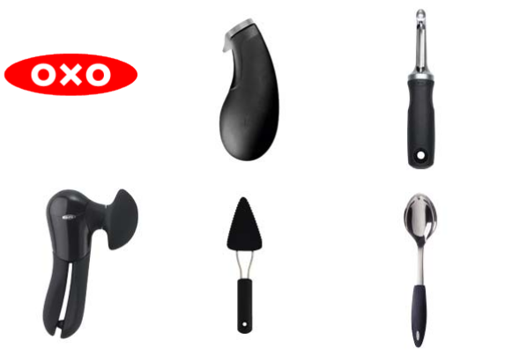
week 11: what is “good” design?
+ Case Study: OXO Good Grips "Tools You Hold On To"
+ Sam Farber (1990)
+ When Farber retired, he pursued design to aid his wife Betsey's arthritis
+ Consulted with gerontologist Patricia Moore
+ Identification of a market need for those with physical/motor impairments (arthritis, etc.)
+ Released first range of 15 products in 1990, now more than 500 products

Slide 34
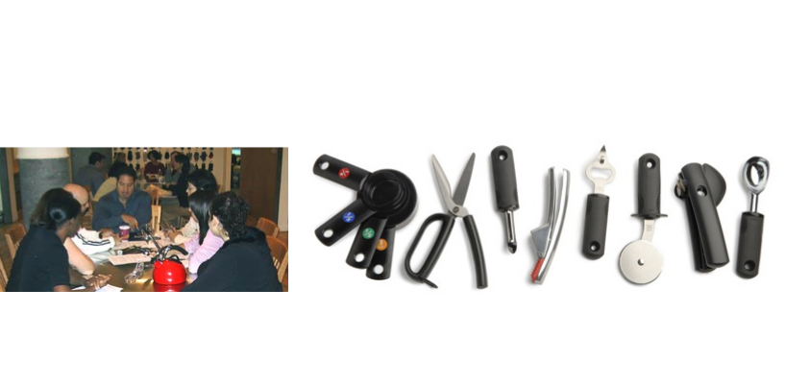
week 11: what is “good” design?
+ Case Study: OXO Good Grips "Tools You Hold On To"
+ Design Methodology/Philosophy
+ Not about creating a new, quirky, or stylish item with compromised function
+ Reinventing what we know to be the dominant forms
+ Not accepting what exists: changing lives in a meaningful way
+ Have become an icon of Universal Design:
+ Making things usable by as many people as possible (young/old, male/female, left/right-
handed, special needs)
+ Examples: access for all, not separate entrance for those with mobility issues, inclusive
washrooms to care for children's needs, graphics that transcend language
+ Re-imagine the paradigm for common household items by using ergonomic studies
+ Involve users at each stage of development and testing
+ Therefore, services the broadest spectrum of individuals
+ Chris Downey, blind architect

Slide 35
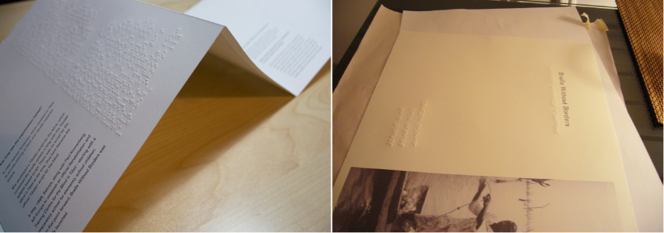
week 11: what is “good” design?
+ Case Study: Braille/Phonetic Typeface for Braille Without Borders
+ Mike Withers, Sean Yendrys, Kyosuke Nishida (Concordia Design)
+ Creation of a hybrid Braille/Roman typeface for a community organization
+ "The right to be blind without being disabled"
+ Based on a course project to work with a deserving group to apply design skills/training
+ Each character contains both systems to create a shared communication/identity
+ Benefits
+ Production costs could be limited through single run of combined formats
+ Normalization of impairments in everyday society
+ Education: make individuals more conscious of their "sight privilege"

Slide 36
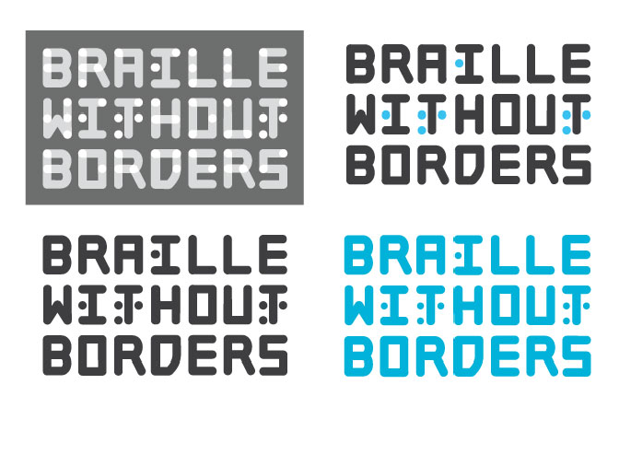
week 11: what is “good” design?
+ Case Study: Braille/Phonetic Typeface for Braille Without Borders

Slide 37
week 11: what is “good” design?
+ Case Study: Braille/Phonetic Typeface for Braille Without Borders

Slide 38
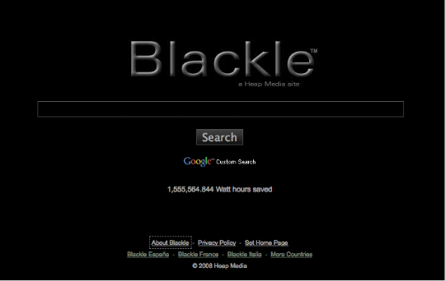
week 11: what is “good” design?
+ Case Study: Blackle ("Black Google")
+ Heap Media (2008)
+ An inversion of Google's interface to create a low-energy output
+ Tracks number of Watt hours saved (10,528,314.804, as of 10:25am 15/11/2023)
+ Reducing the number of illuminated pixels could theoretically save energy over time
+ "Image displayed is primarily a function of the user's color settings and desktop graphics, as
well as the color and size of open application windows; a given monitor requires more power
to display a white (or light) screen than a black (or dark) screen."
+ Not as relevant with contemporary monitors
+ 1980s monochrome systems are a model for this project

Slide 39
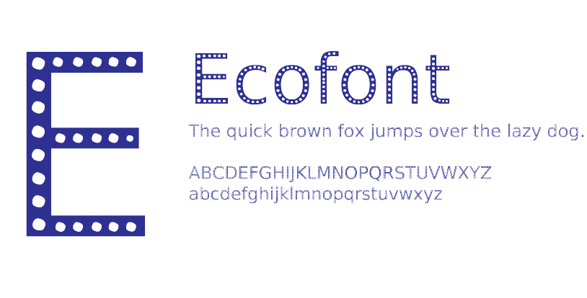
week 11: what is “good” design?
+ Case Study: Ecofont
+ SPRANQ Creative Communications (2008)
+ Average cost of wasted page=$0.06; average waste/day=6 pages; waste per year=1410 pages
+ Ink cartridges take ~450 years to decompose
+ Ecofont contains small "perforations" to reduce the amount of toner placed on the printed page
+ Reduces ink by up to 20%
+ Ecofont Professional: type in any font, but print in Ecofont
+ Based on TrueType font Vera Sans
+ Designed for print, not necessarily intended for display type applications
+ Actual data on effectiveness and legibility yet to be determined
+ More likely to be used for draft communications (memos, etc.), rather than finished texts
+ Another conceptual model, challenging the established conventions of typeface design/use

Slide 40
week 11: what is “good” design?
+ Case Study: Montreal Metropolitan Community Logo and Branding
+ Co Création et Gestion de Marque Inc. (2006-2008)
+ New branding strategy commissioned to represent the 5 regions of Montreal
+ "... a branding that will clearly and cohesively present the metropolitan region’s features on the
international scene."
+ 2-year project; $487,000 budget (additional $200,000 to promote), funded by municipal taxpayers
+ Concept and Controversy
+ Various parts could be replaced with different colours, images, patterns
+ Reflect cultural diversity and geographic specificity
+ Suggest Montreal's legacy as a design capital, by making reference to Expo 67
+ Many felt that this was too big of a leap from the previous aesthetic strategy
+ "Brutalist" structure does not present a sense of warmth/friendliness
+ Selection of proposed colours did not reflect the culture
+ Suggested fragmentation/division, rather than inclusivity and cooperation
+ Too corporate, and the design could be applied to any generic organization starting with "M"
+ Public announcement of fee was a primary controversy
+ Poor communication of visual strategy and theme in layman's terms
+ L'espace pour se réaliser

Slide 41
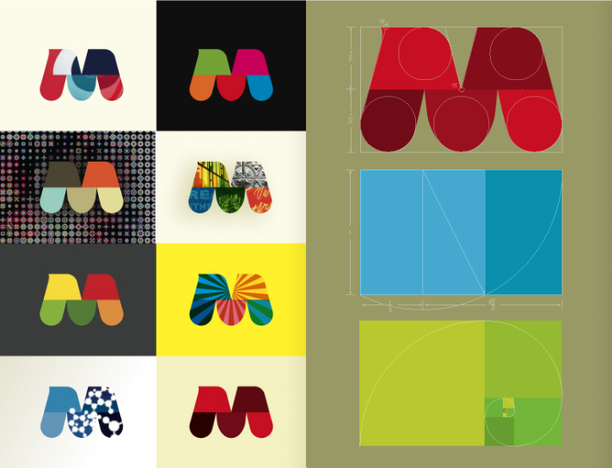
week 11: what is “good” design?
+ Case Study: Montreal Metropolitan Community Logo and Branding

Slide 42
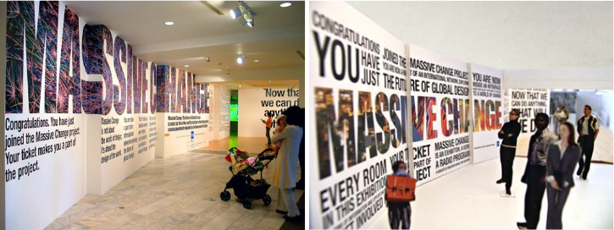
week 11: what is “good” design?
+ Case Study: Massive Change
+ Bruce Mau (2006)
+ "Massive Change is not about the world of design. It's about the design of the world."
+ Curated exhibition surveying global trends/approaches deemed to be creating change in the world
+ "Massive Change is dramatic, engaging and critical, immersing visitors in a series of powerful
encounters with the latest innovations in the fields of urban design, transportation, information
design, revolutionary material and more."
+ Themes of technological advancements, computer modeling/data visualization, design for the
medical industry, military design
+ Key theme was sustainability
+ Paradox: gallery walls (and some floors/ceilings) skinned with floor-to-ceiling adhesive vinyl
+ Single-use, printed with non-water-based inks, repeated in each venue the show traveled to
+ Does the message outweigh the consequences of its means of delivery?

Slide 43
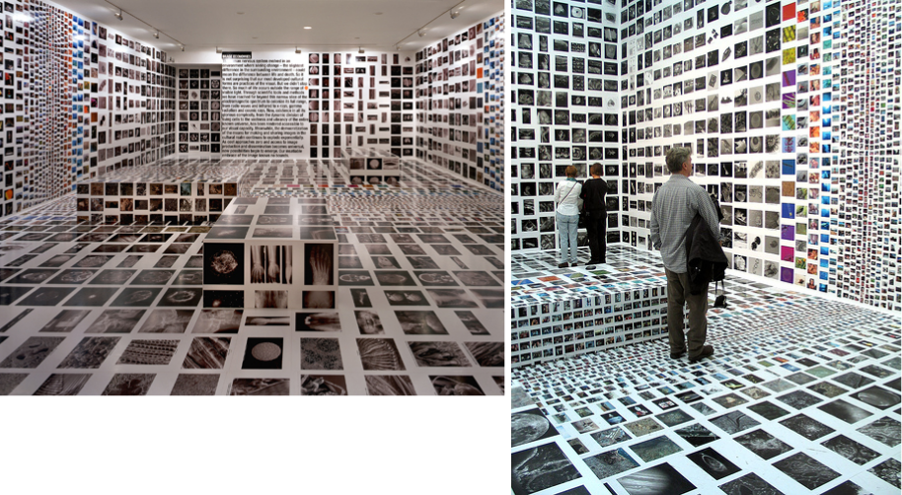
week 11: what is “good” design?
+ Case Study: Massive Change

Slide 44
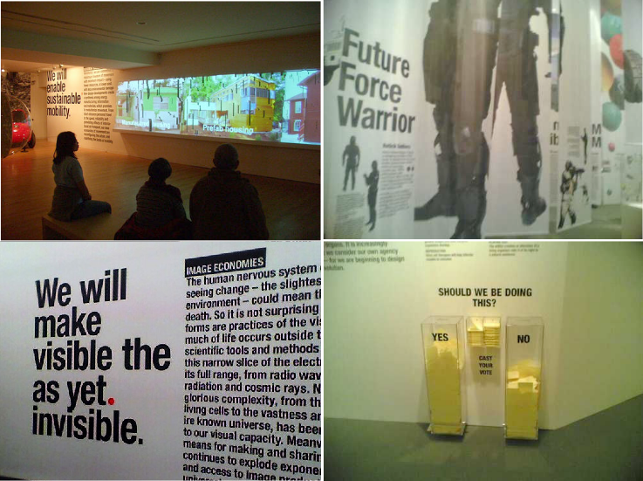
week 11: what is “good” design?
+ Case Study: Massive Change

Slide 45
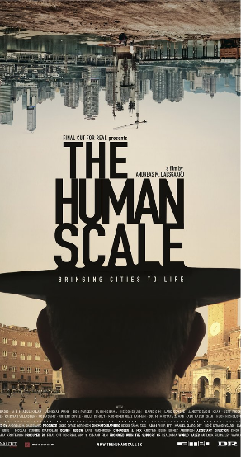
week 11: what is “good” design?
+ The Human Scale (dir. Andreas Møl Dalsgaard, 2013)
+ "50% of the world’s population lives in urban areas. By 2050
this will increase to 80%. Life in a mega city is
both enchanting and problematic. Today we face peak oil,
climate change, loneliness and severe health
issues due to our way of life. But why? The Danish architect
and professor Jan Gehl has studied human
behavior in cities through 40 years. He has documented how
modern cities repel human interaction, and
argues that we can build cities in a way, which takes human
needs for inclusion and intimacy into account.”
+ Jane Jacobs, The Death and Life of Great American Cities
+ Jane’s Walk

Slide 46
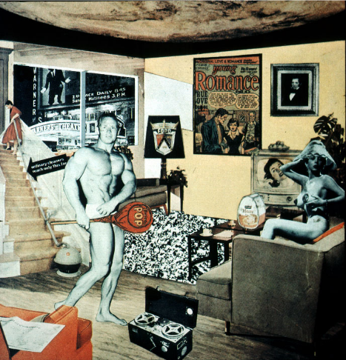
week 11: what is “good” design?
+ Major Assignment: "Just What is it That Makes Today’s Homes So Different, So Appealing?”
+ Part 2: Integration (40%, Due November 28 December 5)
+ Richard Hamilton (1956)

Slide 47
week 12: what is “good” design?
+ Major Assignment: "Just What is it That Makes Today’s Homes So Different, So Appealing?”
+ Part 2: Integration (40%; due November 28 December 5)
+ Determine how your artifact influences, and is influenced by the culture/world in which it operates
+ Connect object to broader culture and theoretical/historical/social framework
+ How does it reflect the values and cultural attitudes of its time and place?
+ Section 1 (20%; approx. 1500 words):
+ Locate and evaluate at least 6 sources of information about object
+ Wikipedia and Google do not count!
+ At least 1 library book (any library)
+ At least 1 scholarly article (from a metasearch or online database)
+ At least 1 reference from a popular media source (magazines, websites, advertisements)
+ Discuss how your artifact relates predominant cultural values/ideals (be specific about the time,
location, community, user, etc.)
+ Example - Starbucks cup: rise of café culture or throwaway culture or brandism or the nomadic
workplace
+ For each reference, provide a 250-word description of what the article contributes to your
understanding of the artifact
+ Provide proper citations; credit all borrowed thoughts and references

Slide 48
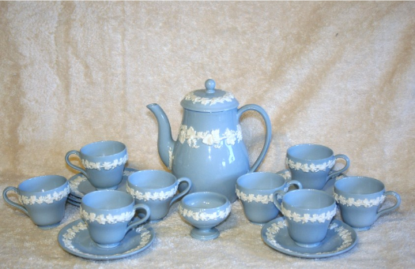
week 11: what is “good” design?
+ Major Assignment: "Just What is it That Makes Today’s Homes So Different, So Appealing?”
+ Section 2 (15%; approx. 250-500 words):
+ Choose one historical artifact (pre-1960) to compare or contrast with your artifact
+ Do not use any artifacts that were a central subject of one of the lectures
+ Describe how it reflected its time/culture and how it relates to your contemporary example
+ Elaborate on how it expresses similar or very different values than your original artifact
+ Example - Starbucks cup: Compared with Wedgewood Queen's Ware
+ Popularity due in part that the Queen of England requested a full set for personal use
+ Early form of brandism ("By appointment to...")

Slide 49
week 11: what is “good” design?
+ Major Assignment: "Just What is it That Makes Today’s Homes So Different, So Appealing?”
+ Section 3 (5%; approx. 250 words):
+ Conclusion
+ How does this study help you to better understand contemporary culture, and your role as a
designer?
+ Format:
+ Approximately 2000-words, with appropriate citations, title page, etc.
+ Provide digital copy of text (upload to Moodle)
+ Include relevant illustrations/photos/captions
+ Citations should follow guidelines, as detailed on the Concordia Library site (MLA)
+ Assessment:
+ Adhesion to guidelines (article sources, length, formatting)
+ Correlation between article selections and artifact (innovation, relevance)
+ Interesting selection of comparative artifact (relation to dominant themes)

Slide 50
week 11: what is “good” design?
+ Heads-Up:
+ Tutorial
+ Major Assignment Part 2: Due November 28 December 5
+ Please use tutorial session and office hours to address questions and request feedback

