Slide 1
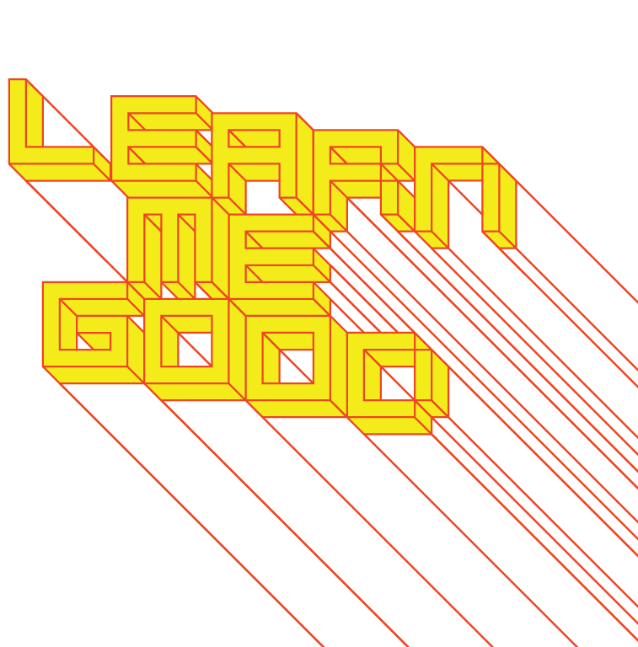
WEEK 12

Slide 2
week 12: where do we go from here?
+ Class Schedule:
+ Major Assignment Part 2: Due December 5
+ Please ensure that you have submitted a copy on Moodle
+ Presentation and Discussion:
+ What does it all mean?
+ A design manifesto and a call to arms
+ Rethinking the design process, emergent practices and interdisciplinary approaches

Slide 3
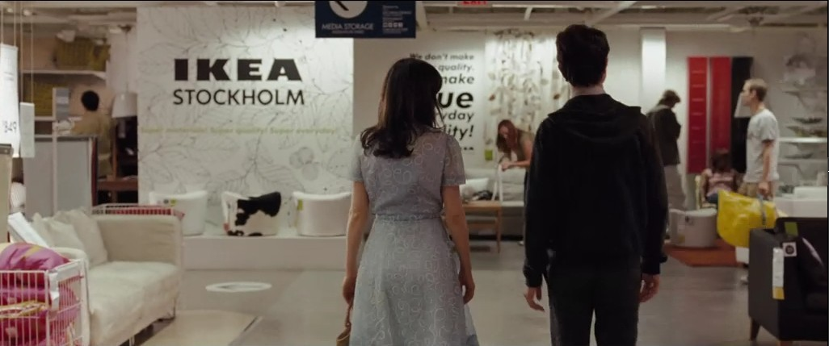
week 12: where do we go from here?
+ "Just What is it That Makes Today’s Homes So Different, So Appealing?”
+ "500 Days of Summer" (2009, dir. Mark Webb)

Slide 4
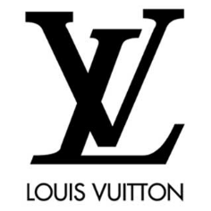
week 12: where do we go from here?
+ Design Communicates:
+ Semiotics and "The Rhetoric of Images"
+ The study of signs and sign-systems
+ A sign is something that stands in for something else, to somebody in some way, shape, or form
+ Contains:
+ Object: what the sign stands for
+ Interpretant: the representation created in the mind of the perceiver
+ "The entire universe is perfused with signs, if it is not composed entirely of signs."
(Charles Sanders Peirce, 1903)
+ Design tells the stories of people, places and things
+ We are all authors of our personal life narratives
+ Crafted through the "constellation" of signs in our everyday lives
+ Objects and images have become a currency in contemporary culture
LUXURY
AFFLUENCE
PRESTIGE
WEALTH
LUGGAGE
QUALITY
CELEBRITY
OSTENTATIOUS
COUNTERFEIT
ETC.
Started in 1854, Louis Vuitton is
not only one of the oldest, but
also one of the most legendary
houses of fashion in the world.
Specializing in trunks, leather
goods, ready-to-wear, shoes,
watches, jewelry, accessories,
sunglasses, and books, the
company is known the world over
for its iconic LV monogram and logo
==
==
==

Slide 5
week 12: where do we go from here?
+ Design Communicates:
+ Who we are:
+ Denotes geography/location
+ Time period/era
+ Personal and familial history
+ Age, gender(?), ethnicity(?)
+ Occupation or role in society, etc.
+ Denotation: a semiotic term from linguistics studies
+ Literal, obvious, commonplace meaning
+ Representation that is more "universally" understood; cross-cultural

Slide 6
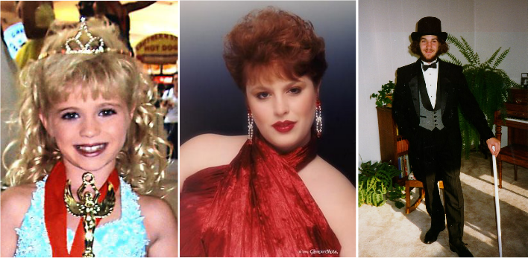
week 12: where do we go from here?
+ Design Communicates:
+ Who we think we are:
+ Connotes self-image
+ Value/worth
+ Class/affluence; social status
+ Role-playing
+ Connotation: What is implied by the representation
+ Culturally-specific: socio-cultural and personal interpretations (ideological, emotional)

Slide 7
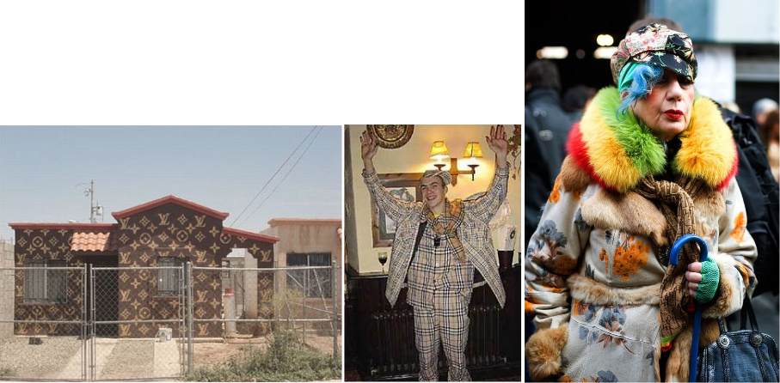
week 12: where do we go from here?
+ Design Communicates:
+ Who we aspire to be:
+ Signifies our goals/dreams
+ Suggests not only who we think we are, but who we feel we should be
+ "Keeping up with the Jones'"
+ Cultural expectations, social norms
+ Outward expression that communicates to others through signs

Slide 8
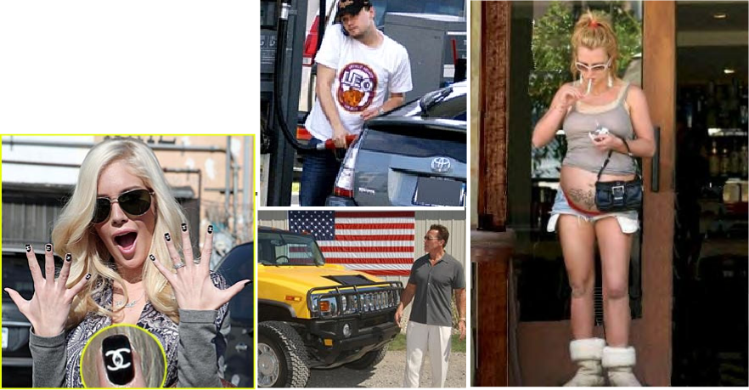
week 12: where do we go from here?
+ Design Communicates:
+ Who others believe us to be:
+ Value judgments based on signification through externalized expressions
+ Very present in media and
celebrity culture

Slide 9
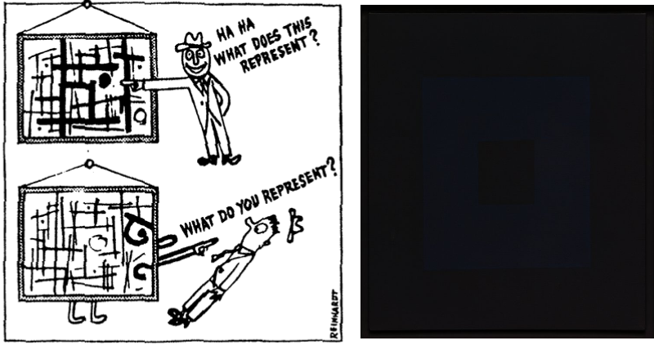
week 12: where do we go from here?
+ Ad Reinhardt, "How to Look at Art" (1947) / "Black" Paintings (aka "Ultimate" 1960s)
+ Philosophy of "Art-as-Art"
+ The "last paintings" that anyone can paint

Slide 10
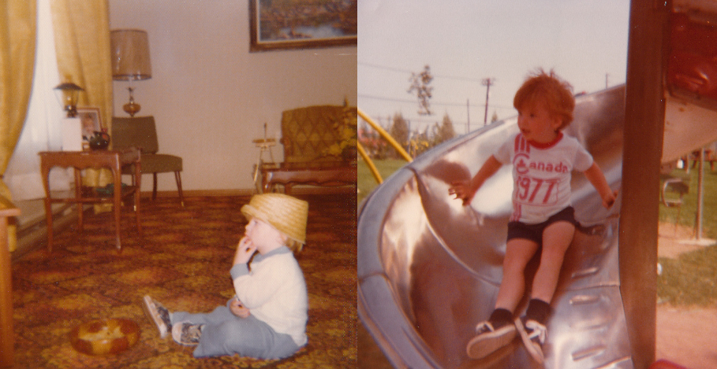
week 12: where do we go from here?
+ What Do You Represent?

Slide 11
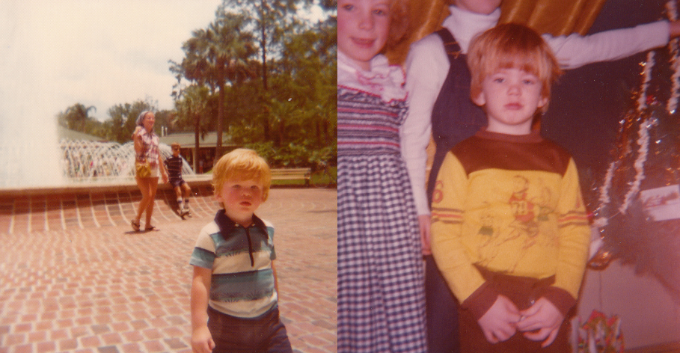
week 12: where do we go from here?
+ What Do You Represent?

Slide 12
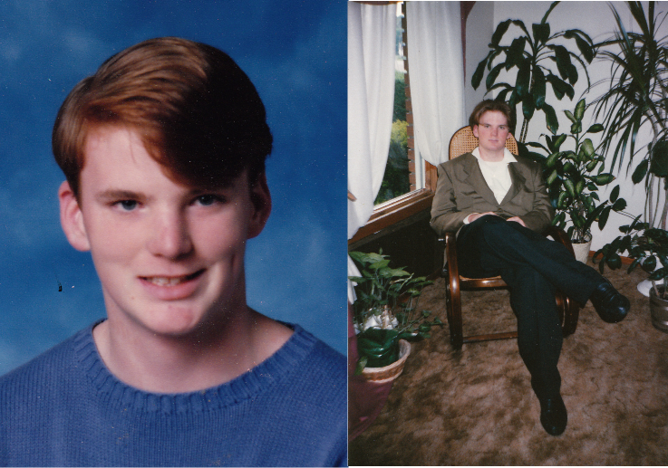
week 12: where do we go from here?
+ What Do You Represent?

Slide 13
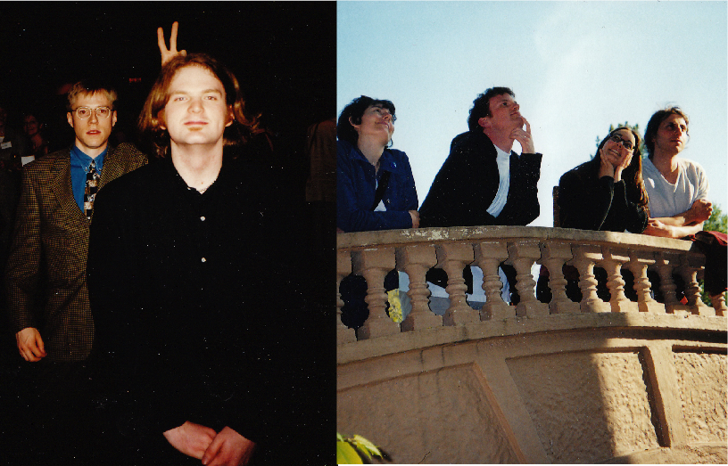
week 12: where do we go from here?
+ What Do You Represent?

Slide 14
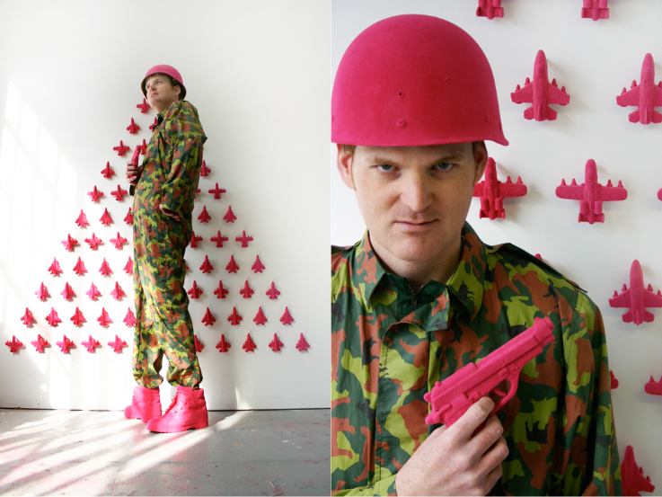
week 12: where do we go from here?
+ What Do You Represent?

Slide 15
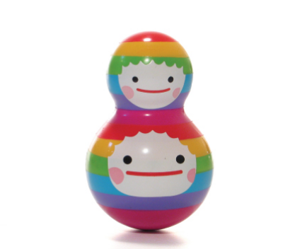
week 12: where do we go from here?
+ Welcome to the FUTURE...
+ Design Seduces
+ We own our objects, but our objects also own us
+ Design Dictates
+ Design Controls
+ Design Constrains
+ Design Shackles
+ Design Liberates
+ Artifacts can remove constraints on daily life struggles
+ Design Affords
+ Design Frees
+ Design Uplifts
+ Design Challenges
+ Question the assumptions of "the one right way"
+ Design Researches
+ Design Innovates
+ Design Critiques

Slide 16
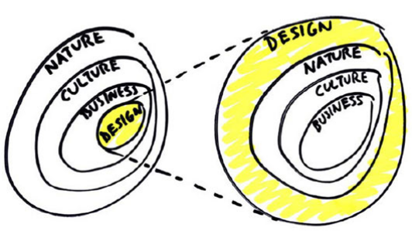
week 12: where do we go from here?
+ Design is Everywhere!
+ Bruce Mau, "Massive Change"
+ Mau: "Design has emerged as one of the world's most powerful forces. It has placed us at the
beginning of a new, unprecedented period of human possibility, where all economies and ecologies
are becoming global, relational, and interconnected.
In order to understand and harness these emerging forces, there is an urgent need to articulate
precisely what we are doing to ourselves and to our world."

Slide 17
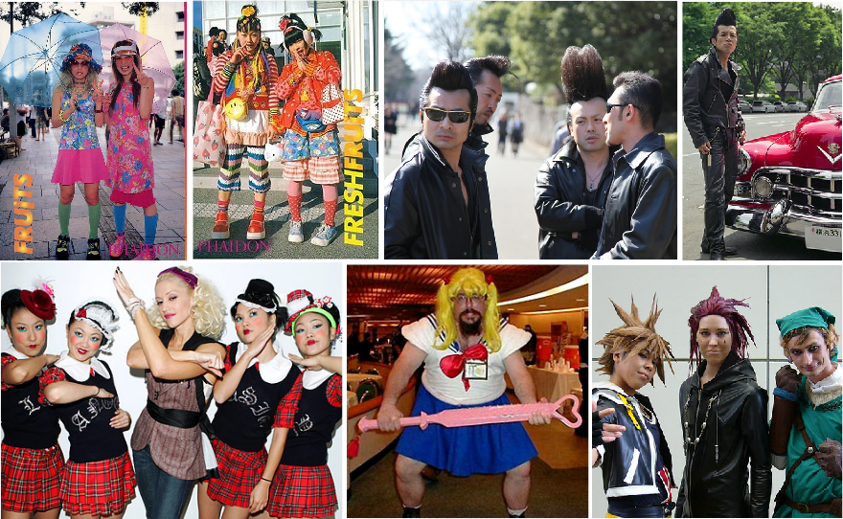
week 12: where do we go from here?
+ But What Does it All Mean?

Slide 18
week 12: where do we go from here?
+ A Call to Arms
+ Design is on the Cusp (But not "of the Moment")
+ Your task is to sort out the future of design
+ ...as a discipline, as an area of research, as a philosophical approach to life
+ Design is Engagement
+ Design is Giving a Damn
+ Design is Thoughtful
+ Design is Responsible
+ Design is Commitment
+ Design is Relevant
+ Design is Purposeful
+ Design is Legitimate
+ Design is Social
+ It fulfills a broader vision
+ It operates among people and for people
+ Design is Community
+ Design is Culture
+ Design is Observation
+ Design is Relational
+ Design is Exploring the World
+ Design is Interconnected
YOU
ME
WE
THEM
US

Slide 19
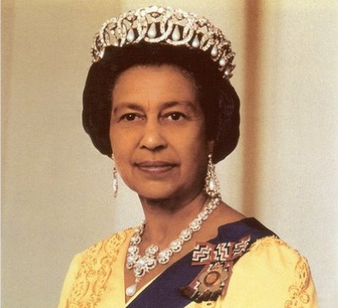
week 12: where do we go from here?
+ A Call to Arms
+ Tibor Kalman, "Fuck Committees (I Believe in Lunatics)" (1998):
+ "It's about the struggle between individuals with jagged passion in their work and today's faceless corporate committees, which claim to understand the needs of the mass audience, and are removing the idiosyncrasies, polishing the jags, creating a thought-free, passion-free, cultural mush that will not be hated
nor loved by anyone. By now, virtually all media, architecture, product and graphic design have been freed from ideas, individual passion, and have been relegated to a role of corporate servitude, carrying out corporate strategies and increasing stock prices. Creative people are now working for the bottom line. [...]
I offer a modest solution: find the cracks in the wall.
There are a very few lunatic entrepreneurs who will
understand that culture and design are not about fatter
wallets, but about creating a future. They will
understand that wealth is a means, not an end.
Under other circumstances they may have turned out
to be like you, creative lunatics. Believe me, they're
there and when you find them, treat them well and use
their money to change the world.”
+ Happy Holidays - I Will See You in the FUTURE!

