Slide 1
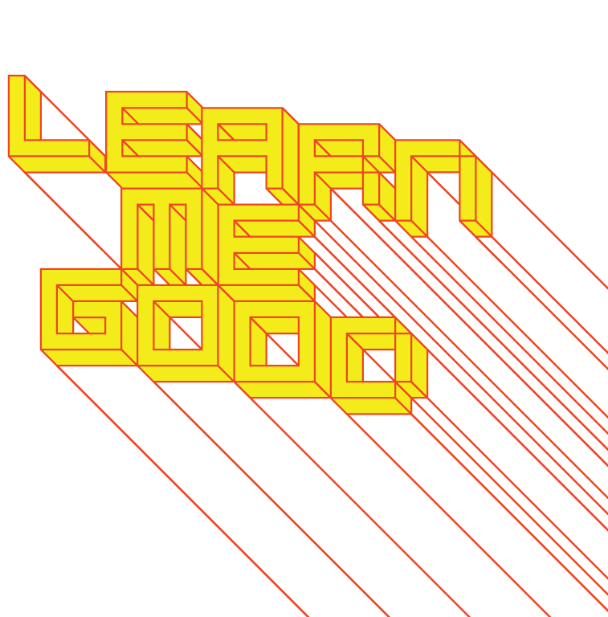
WEEK 4

Slide 2
week 4: domestic labour and the rise of female consumers
+ Overview + Heads-Up:
+ First Article Summary Due Today!
+ Upload PDF to Moodle
+ Presentation and Discussion:
+ Coffin, Judith. “Credit, Consumption, and Images of Women’s Desires: Selling the Sewing
Machine in Late Nineteenth-Century France.” French Historical Studies. vol. 18, no. 3, 1994.
+ Domestic labour, home economics, women as consumers, designing for female consumers
+ Library Orientation with John Latour
+ Meet in LB-322
+ Presentation documentation

Slide 3
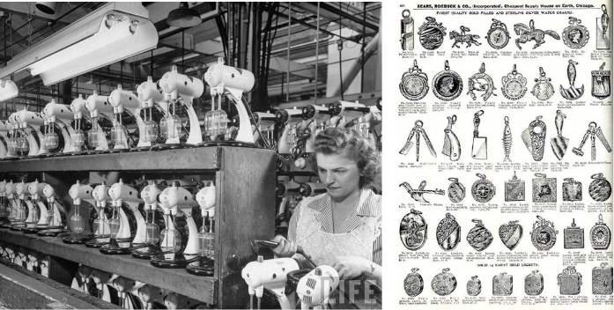
week 4: domestic labour and the rise of female consumers
+ Looking Back and Moving Forward
+ Mass Production Leads to Mass Consumption
+ Moving assembly line, Fordism, Taylorism
+ Division of labour results in faster production of manufactured goods
+ New categories of items that are cheaply manufactured, less ornate (due to automation)
+ Available to a wider audience (transportation and infrastructure)
+ Workers have greater disposable income to spend on goods and services
+ Leads to the concept of a middle class

Slide 4
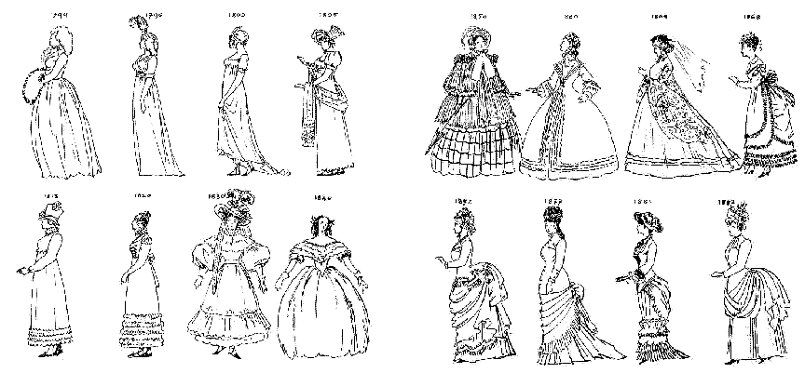
week 4: domestic labour and the rise of female consumers
+ Development of New Market Segments to Promote Goods
+ Rejection of Early Victorian Aesthetic
+ Industrialization leads to fetishization of the machine age
+ The "modern" aesthetic sensibility
+ Streamlined and simplified: a result of mechanical assembly and mass production
+ Fashions become less formal
+ Corsets become less popular
+ Women entering into sport and business

Slide 5
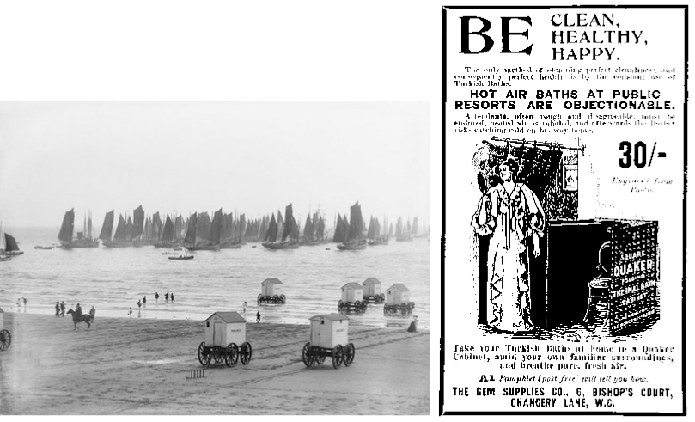
week 4: domestic labour and the rise of female consumers
+ Purity and Danger
+ Public Health and Welfare
+ A result of move to cities and urban centers
+ Prevent spread of infectious diseases
+ Focus on cleanliness, hygiene and sanitation

Slide 6
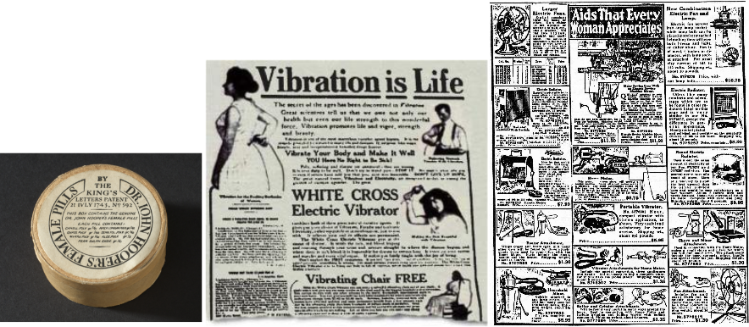
week 4: domestic labour and the rise of female consumers
+ Purity and Danger
+ Female Hysteria
+ Common diagnosis discussed in Victorian-era medical literature
+ Symptoms: faintness, nervousness, insomnia, fluid retention, heaviness in abdomen, muscle
spasm, shortness of breath, irritability, loss of appetite for food or sex
+ "...a tendency to cause trouble"
+ Treatment: pelvic massage, leading to "hysterical paroxysm"
+ "A sudden attack or violent expression of a particular emotion or activity"
+ Range of products designed to combat hysteria
+ Early method of social/political control
+ Relationship to contemporary advertising

Slide 7
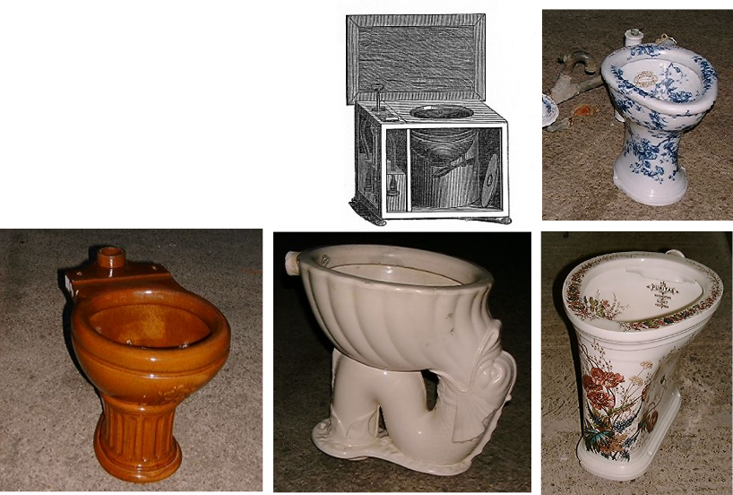
week 4: domestic labour and the rise of female consumers
+ Domestic Labour Becomes a New Concern
+ Bathing Aesthetics
+ Result of indoor plumbing and running water
+ Changes in bathing habits and the attendant decor
+ Previously, more akin to furniture
+ Thomas Crapper popularizes flushing toilet in
late 19th C.

Slide 8
week 4: domestic labour and the rise of female consumers
+ Domestic Labour Becomes a New Concern
+ Bathing Aesthetics
+ White, pure, pared-down, anti-Victorian
+ 1883: Standard Sanitary Manufacturing Company and Kohler Company
+ Production of cast-iron bathtubs without ornate claw feet
+ Easy to clean surfaces, no hidden dust or dirt

Slide 9
week 4: domestic labour and the rise of female consumers
+ Industrial Manufacturing Processes Extend to the Domestic Environment
+ Evolution of a Middle-Class
+ Rise of suburbia; migration from urban centers
+ Influence of the automobile
+ "Domestics" less prevalent in middle America
+ Tendency towards traditional, conservative values/politics
+ Modern women take charge of the home management
+ Family and Consumer Science (Home Economics)
+ Initiated by Ellen Swallow Richards, the first female graduate from MIT
+ Popularized by Catherine Beecher (mid-1800s)
+ "Women's science"
+ One of the first academic fields appealing to modern women
+ Includes:
+ Nutrition + Fashion Design + Interior Decorating
+ Finance + Child Development + Spirituality
+ Chemistry + Health + Creativity
+ Agriculture + Manufacturing + Sanitation
+ Economics + Relationship Psychology
+ Influence of Frederick Taylor
+ Economize, budget, maintain order, optimize
+ Belief: discipline and management could improve lives
+ Within the purview of the feminine

Slide 10
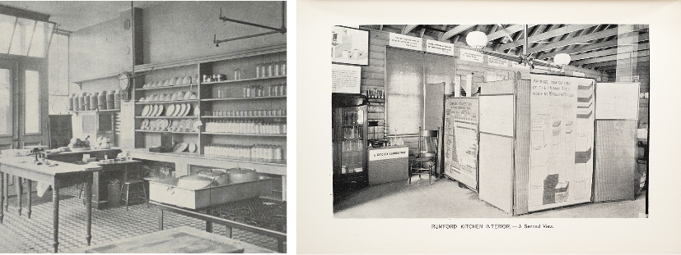
week 4: domestic labour and the rise of female consumers
+ Industrial Manufacturing Processes Extend to the Domestic Environment
+ Rumford Kitchen (1893 World's Columbian Exposition, Chicago)
+ Ellen Swallow Richards applied her science foundation
+ Served meals and provided nutrition education: put principles into action
+ Turned down invitation to participate in the Women’s Pavilion - information for all, not
just women's work
+ Suffrage
+ Home economics as a progressive, empowering practice: value education for women
+ Strong association with League of Women Voters (Suffragettes)
+ Unfortunately, it has become demonized, misrepresented, and exploited for capital gain

Slide 11
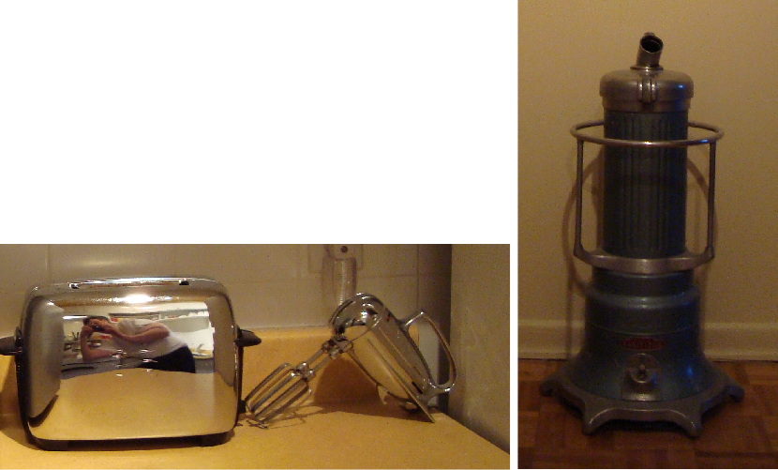
week 4: domestic labour and the rise of female consumers
+ New Products Designed for Women's Labour
+ Home Appliances for Sanitation
+ Novelty of electricity
+ Vacuum cleaners and other devices to maintain order and
cleanliness
+ Application of industrial process to domestic sphere
+ Speed and aesthetic of the machine; repetitive motion/action
+ Reflection of shifting cultural values
+ Creation of a female consumer market
+ Industrial products redesigned for secondary market
(i.e. sewing machine)

Slide 12
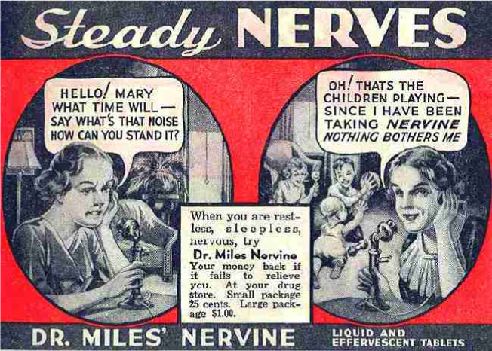
week 4: domestic labour and the rise of female consumers
+ New Products Designed for Women's Labour
+ Nerve tonic: a mixture of opium, cannabis, chloroform

Slide 13
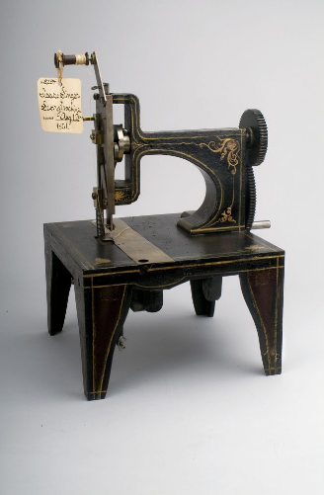
week 4: domestic labour and the rise of female consumers
+ The Sewing Machine
+ Singer Company: First Lock-Stitch Sewing Machine (1851)
+ A result of the industrial revolution, led by the
textile industry
+ A "miracle of technology"
+ More compact, designed to appeal to a more
"feminine" sensibility
+ Fit into fashionable Victorian home decor
+ A consequence of the home economics movement
+ Women could save money by making clothes,
interior furnishings, and mending for the family
+ Destined to become the "docile companion of any
working woman"
+ Allowed women to earn additional wages as
seamstresses in the home setting
+ Take care of children and domestic chores while
supplementing family's income
+ Sexual division of labour reinforced through product mythology
+ Manufacturers had to engage and interpret women's desires
+ Accompanied by the rise of advertising post-1850

Slide 14
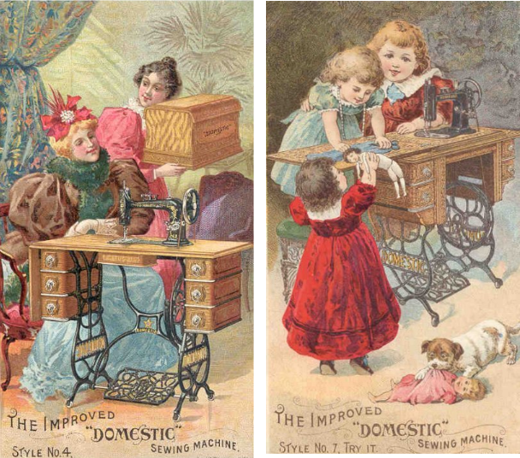
week 4: domestic labour and the rise of female consumers
+ The "Domestic" Brand Sewing Machine

Slide 15
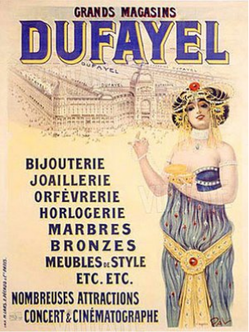
week 4: domestic labour and the rise of female consumers
+ The Evolution of a Credit System
+ Consumer Culture Goes into Overdrive
+ Few individuals could afford to buy goods outright at the end of the 1800s
+ Development of a retail credit system allowed average consumers access to products
+ Previously, industrial machines (like the sewing machine) were not common in domestic sphere
+ Live beyond means (1870s Singer cost about 225 Francs; 1/5-1/2 of yearly seamstress wage)
+ Credit essential to a working-class market for Singer
+ Credit system expanded beyond local businesses to larger corporations
through installment plans
+ Change relationship between manufacturers and consumers
+ Georges Dufayel (1856)
+ Dufayel was the first department store to offer all goods on credit
+ Sewing machine was one of the most widely advertised products
+ Promise of fortune and further luxury consumption
+ Sewing machine as a gateway to other products (clocks, art,
elegant furnishings displayed in store windows)
+ Location of conspicuous consumption and declaration of status
+ Allowed working-class access to the same goods as their
middle-class counterparts
+ Dufayel: "Advertising is the soul of commerce"

Slide 16
week 4: domestic labour and the rise of female consumers
+ The Evolution of a Credit System
+ Credit and the Sewing Machine
+ Manufacturers tried to reach the public directly, circumventing retail interlopers
+ Offered women independence as "freelancers"
+ Trade-off was indebtedness
+ Women's labour was cheap, non-unionized, replaceable
+ Treated like a mechanized process: extension of the assembly line
+ Contemporary sweatshops directly tied to the 19th C. garment trade
+ Marketing the Machine
+ Challenges:
+ Prohibition of machine labour in the home
+ Taboo of labour/toil disrupting tranquility of the home
(sentimentalization of privacy, family life)
+ The stereotypes of "femininity" and "women's work"
+ Advertisers sought new ways of promoting distinctly "female"
ways of working
+ Focus on the artistry of women's work, as opposed to craft
and technical skill (male traits)
+ Dexterity, taste, intuition
+ Sometimes involved themes of romantic dreaming/fantasies
+ Diminish relationship between women and the machine
+ Differentiation of gendered models ("all purpose" masculine; "family" model feminine)

Slide 17
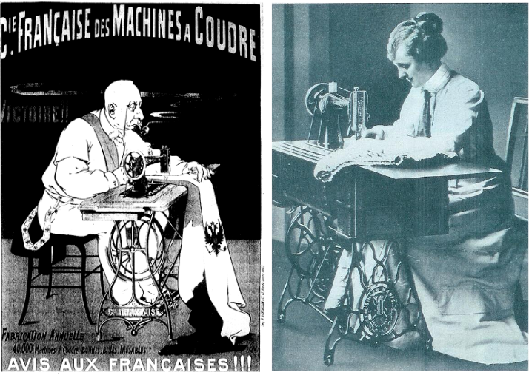
week 4: domestic labour and the rise of female consumers
+ Marketing the Machine
+ Differentiation of Gendered Models ("all purpose" masculine; "family" model feminine)

Slide 18
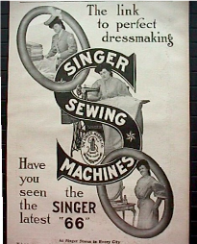
week 4: domestic labour and the rise of female consumers
+ Marketing the Machine
+ Characteristics of Male Models
+ Clumsy, thick legs, exposed gears, functional aesthetic, little ornamentation
+ Characteristics of Female Models
+ More ornate, polished surfaces, wrought iron stands, decorative "bonnets", rounded/tapered legs,
gilded embellishments
+ Rounded to represent curves of the female body
+ Upscale models available in rosewood and more expensive materials
+ Sometimes included sculptural elements and iconic motifs (squirrels, golden scissors, etc.)
+ Advertising
+ Tended to gloss over actual use of the machine
+ Vague messages, as a result of changing cultural mores
+ "The Sewing Girl"
+ A recurring muse-like figure in the advertisements from several
manufacturers
+ "Half fairy princess...half gigolette"
+ Domestic toil presented as a vehicle for self-expression
+ Yet, machine forced women into static positions and repetitive tasks
+ Signifier of modernity and the "new woman"
+ Advertising considered a developing "science" of symbols and signs
+ Often paired with other symbols of mass production (bicycles, trains, etc.)
+ Connote speed and efficiency

Slide 19
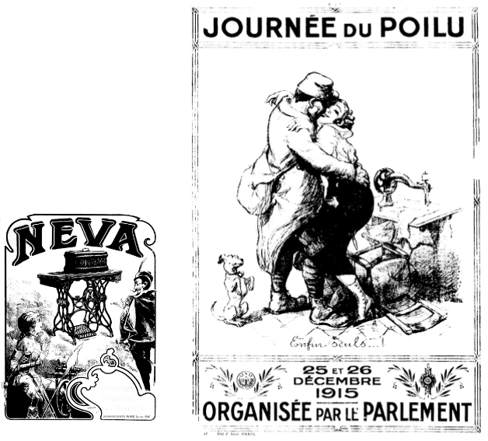
week 4: domestic labour and the rise of female consumers
+ Marketing the Machine
+ Advertising
+ Other examples delved more deeply into the fantasy life of the
operator
+ Frequent images of magicians and mysterious strangers
+ The erotic nature of the rhythmic machine is often referenced
+ Debated in medical literature, much like hysteria
+ Rubbing of legs together via use of the treadle was
"unhygienic"
+ Presented both a challenge and an opportunity for marketing
+ Duality of Victorian society
+ Female automation: images of "autonomy, emancipation,
exhilaration, and autoeroticism"

Slide 20
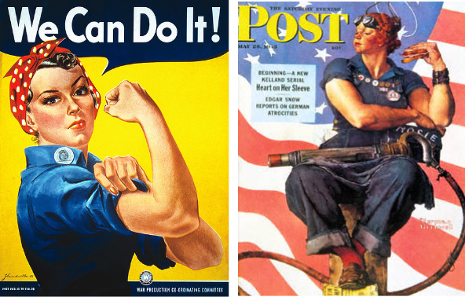
week 4: domestic labour and the rise of female consumers
+ War Labour
+ Rosie the Riveter
+ American feminist icon representing women who served in the WWII effort
+ Women took up new jobs and often replaced men in traditional roles
+ Generally worked in the trades
+ Also expected to complete traditional domestic tasks in the evenings
+ Pay almost always less than male counterparts
+ Increased the number of working women to 20 million in 1944 in US (57% increase from 1940)
+ Some moved into clerical/
administrative roles after the
war, but most returned to
home labour

Slide 21
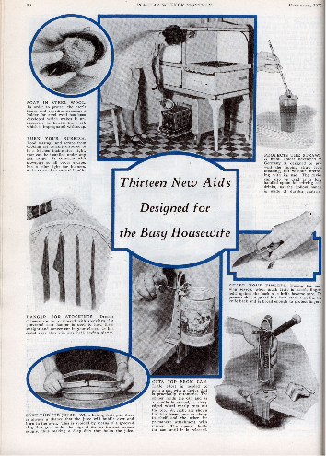
week 4: domestic labour and the rise of female consumers
+ Post-War Return to Domesticity
+ Consumption on the Rise (Again)
+ Boom economy; diversion of capital from the war effort
+ Proliferation of products and disposable culture
+ Outward displays of affluence (rarely seen during WWII)
+ The home as a centre of display and consumption
+ Products designed specifically to fit in with the ideals of
this period
+ "Two car families" suburbs and drive-ins
+ Women Return to the Domestic Sphere
+ Readopt traditional roles as suburban housewives
+ Betty Friedan, The Feminine Mystique (1963)
+ “...the problem that had no name”
+ Unhappiness among a generation of affluent largely
educated women
+ Well-appointed houses, new cars, bright children,
hard-working husbands
+ "Stepford Wives"
+ Our stereotypes of femininity are still largely influenced by
this period

Slide 22
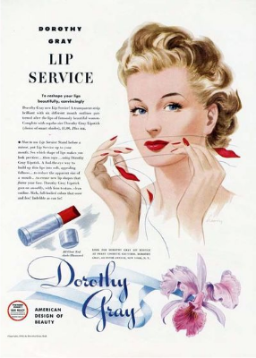
week 4: domestic labour and the rise of female consumers
+ The Rise of Women's Magazines (Ladies’ Home Journal, Good Housekeeping etc.)
+ Shifting Focus
+ Pre-War: used to be about patterns/home economics
+ Post-War: unbridled consumption and endless parade of aspirational products (fashion,
cosmetics dominate)
+ Dissonance between appearance of "having it all" and the ideals found in magazines
+ Sense of failure, guilt, lack of fulfillment
+ Friedan: a "crisis in women's identity"
+ Women’s magazines have operated as implements of
power and social control to present day
+ Today, influencers and targeted marketing fulfill this role
+ Fulfillment Through Consumption
+ New (rebranded) market for consumer goods
+ Focus of most advertisements directed towards women
+ Promoted through women's magazines
+ New forms of female labour: Tupperware, Avon, etc. (cyclical)

Slide 23
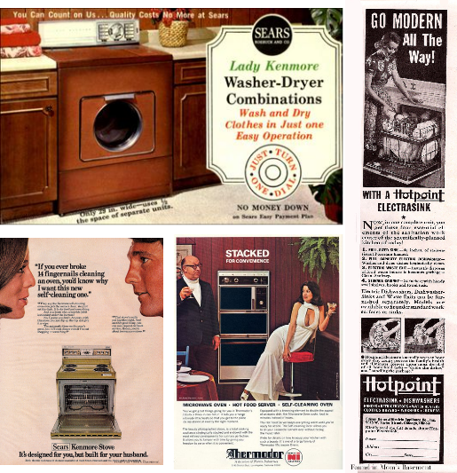
week 4: domestic labour and the rise of female consumers
+ Further Examples

Slide 24
week 4: domestic labour and the rise of female consumers
+ Contemporary Examples of Designing for Women?
+ Flight of the Conchords, Femident Toothpaste
+ Bic "For Her": Amazon Reviews
+ "Lady-Friendly" Doritos
+ Unnecessarily Gendered Products
+ Gendered Marketing

Slide 25
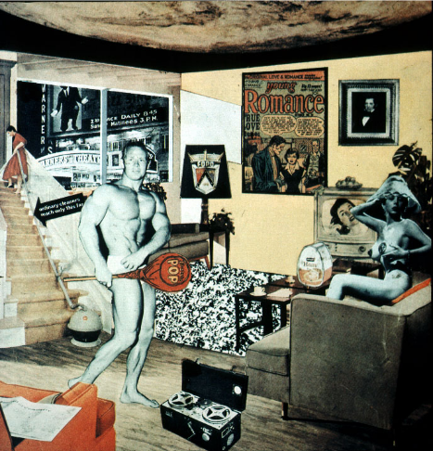
week 4: domestic labour and the rise of female consumers
+ Major Assignment: "Just What is it That Makes Today’s Homes So Different, So Appealing?”
+ Part 1: Research (30%, due October 31)
+ Part 2: Integration (40%, due November 28)
+ Richard Hamilton (1956)

Slide 26
week 4: domestic labour and the rise of female consumers
+ Major Assignment: "Just What is it That Makes Today’s Homes So Different, So Appealing?”
+ Overview:
+ Commit to a specific artifact, live with it, document your interactions/environment/context of use
+ Can be almost anything (shampoo, coffee cup, typeface, etc.) - be specific!
+ Collection of information, texts, photographs that help you to better understand the life and story
of your artifact
+ Determine how it influences, and is influenced by the culture/world in which it operates
+ Will be the subject of your entire semester of research--choose carefully!
+ Part 1: Research (30%, due October 31)
+ Anthropological field study
+ Section 1:
+ Explain your choice; personal resonance/significance
+ Describe its physical characteristics; 10 captioned photos, brief text
+ Detailed description of its contextual environments; 5 captioned in-situ photos, brief text
+ Capture within its natural environment
+ Section 2:
+ 10 captioned images of different but comparable products; same codes/cultural signals and
connotations (cannot be different brands of same artifact type)
+ Choose 4 photos to elaborate on how each expands your understanding of the original artifact
+ Section 3:
+ Summary/Conclusions
+ Format:
+ PDF presentation
+ 25 captioned photos; approximately 750 words (not including captions)

Slide 27
week 4: domestic labour and the rise of female consumers
+ Heads-Up:
+ Tutorial: Library Orientation with John Latour
+ Meet in LB-322
+ Presentation documentation
+ Preparation for Next Class:
+ Read ONE of the following:
+ Adaskina, Natalia. “Constructivist Fabrics and Dress Design.”
+ Heller, Steven. “Polemics and Politics, American Style.”
+ PLUS:
+ Abelson, Danny. “Canada Finds an Identity, Finally.”
+ Klein, Naomi. “New Branded World.”
+ Briefly peruse the following websites:
+ “Evolution of Logos.” Best Ad
+ Hastreiter, Kim et al. “Rebranding America.” Paper
+ Video: The Cola Conquest. Dir. Irene Angelico.
+ Required viewing before next session (first part of the trilogy ~50:00)
+ Second Article Summary Due October 24
+ Based on readings/materials/topics from weeks 4-6

