Slide 1
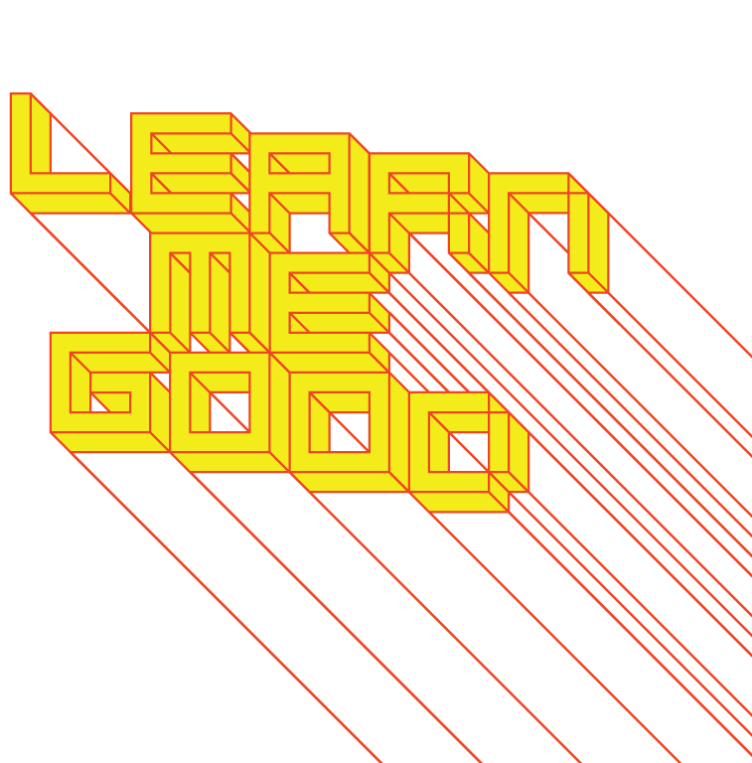
WEEK 8

Slide 2
week 8: kitsch + the politics of camp
+ Class Schedule:
+ Major Assignment Part 1: Due Today!
+ Please upload a copy of your project to Moodle
+ Presentation and Discussion:
+ Kitsch, camp
+ "To be natural is such a very difficult pose to keep up.” – Oscar Wilde
+ Marketing exoticism, leisure capital, tourism, cultural appropriation
+ Tutorial
+ Optional Activity:
+ Edward Burtynsky, Manufactured Landscapes
+ Heads-Up:
+ Third (and last!) Article Summary is due in week 10 (Nov. 14)
+ Based on readings from weeks 7-9

Slide 3
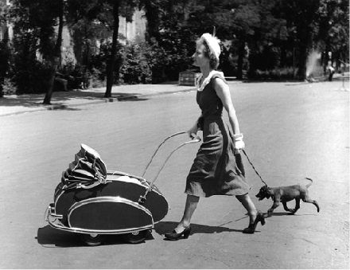
week 8: kitsch + the politics of camp
+ Looking Back and Moving Forward
+ Bernard London suggested planned obsolescence as a means to overcome the economic down-turn
during the Depression era
+ Pre-determined lifespan for goods
+ Impose tax on those who use products beyond their "expiry" date; destroy and replace
+ Crept into industrial design, as manufacturers built failure into artifacts
+ Quicker turnover of products, rather than being built for longevity
+ Psychological obsolescence
+ Insidious pressure to conform to
changing styles and trends
+ Peer pressure plays upon societal
insecurities
+ "Keeping up with the Joneses"
+ Post-WWII period is a period of accelerated
growth in household goods
+ Conspicuous consumption is the norm
+ Viewed as helping to restore the economy
+ Patriotic duty
+ Rise of leisure class and travel
+ Utopian promise of machine age
+ Freedom from "drudgery" and toil

Slide 4
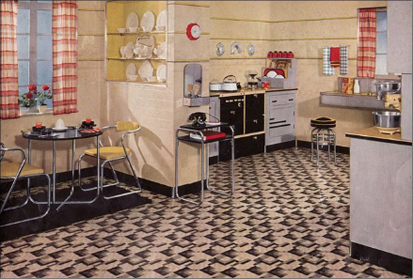
week 8: kitsch + the politics of camp
+ Alienation and the Industrial System of Manufacturing
+ Karl Marx described this state as "false consciousness"
+ Misguided capitalist mindset
+ Difference between desires/wants and the real world
+ Disguises the true relations between the proletariat and the ruling class
+ Workers become unwitting contributors to their own disempowerment
+ Cycle of production/consumption holds the poor and middle-class hostage to the system
+ Entangled nature of this system requires all parts to be functioning optimally (ultimate
demise leading to the Great Depression)
+ False sense that labour leads to success for all
+ 1930s: Perceived threat to culture
through mass produced forms
+ Degradation of quality, in the name
of cheapness and efficiency
+ Belief that poor goods diminish
public welfare

Slide 5
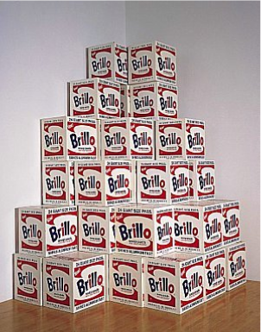
week 8: kitsch + the politics of camp
+ Avant-Garde and Kitsch:
+ Theodor Adorno (Frankfurt School)
+ The rise of a "culture industry": art at the service of the market, and not a higher spiritual goal
+ Pure aesthetic folly designed for capital gain
+ Non-challenging and regressive (i.e. not "Art")
+ Gives the public something to observe--a distraction from the social realities and oppression of
capitalism
+ Citizens become "productive" members of society
through acts of consumption
+ Art is supposed to be subjective and challenge the status
quo and power structures, not be subservient to the
demands of the market
+ Hermann Broch (Early Modernist)
+ Kitsch is "the evil within the value-system of art"
+ Depends solely on bastardization of creativity through
imitation, parody, and simplified formulas
+ Not the same as bad art: kitsch seeks to achieve
"beauty" rather than "truth"
+ Clement Greenberg (Modern Art Critic)
+ Decline of taste is a direct result of consumer society
+ The avant-garde arose to defend aesthetic standards
+ Greenberg equated genius with originality
+ Andy Warhol, Brillo Soap Pads Boxes (1964)

Slide 6
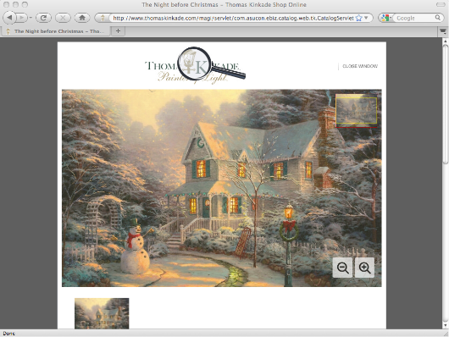
week 8: kitsch + the politics of camp
+ Avant-Garde and Kitsch:
+ Follows from Morris: cheap, mass-produced objects
+ Tasteless, aesthetically bankrupt
+ Borrow from "high" art, but without the conceptual framework or craftsmanship
+ Derivative, and often overtly sentimental/melodramatic
+ Panders to popular demand
+ Purely for commercial purposes, and not self-expression of the artist (shallow)
+ Thomas Kinkade, The Night
Before Christmas

Slide 7
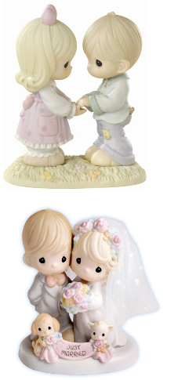
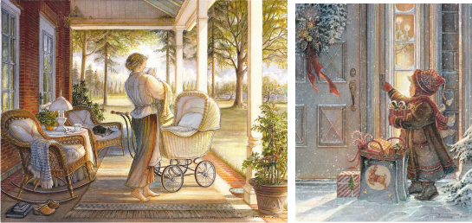
week 8: kitsch + the politics of camp
+ Avant-Garde and Kitsch:
+ Precious Moments + Tricia Romance

Slide 8
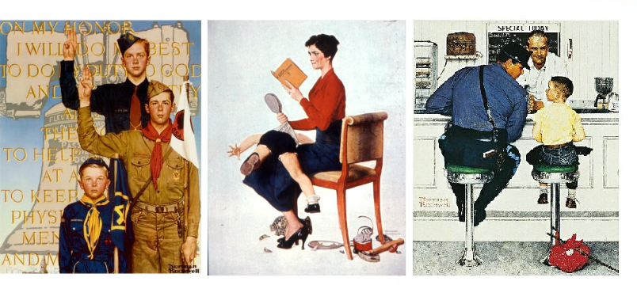
week 8: kitsch + the politics of camp
+ Avant-Garde and Kitsch:
+ Norman Rockwell

Slide 9
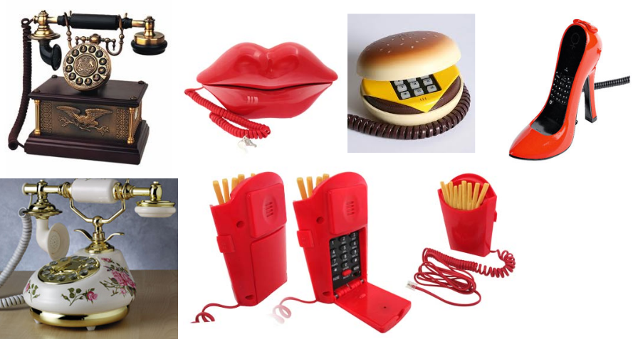
week 8: kitsch + the politics of camp
+ Avant-Garde and Kitsch:

Slide 10
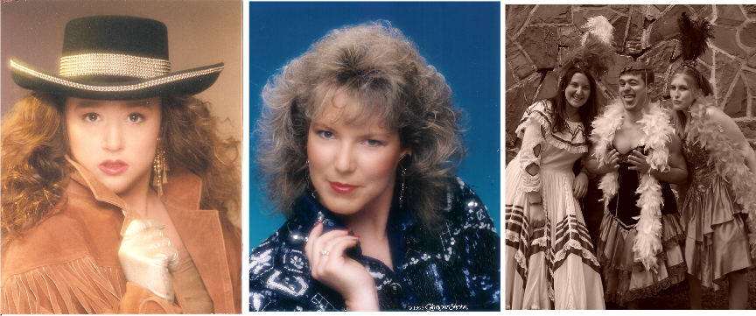
week 8: kitsch + the politics of camp
+ Avant-Garde and Kitsch:

Slide 11
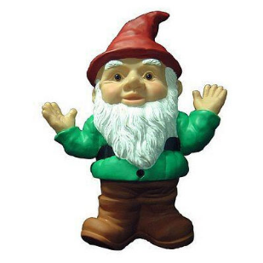
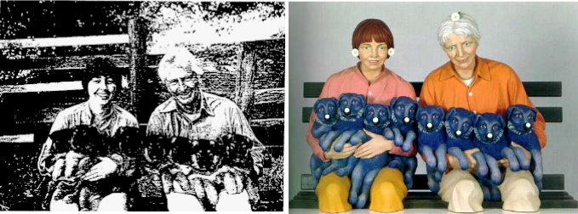
week 8: kitsch + the politics of camp
+ "High" and "Low" Culture
+ Cultivating new markets
+ Prestige and value-added for limited supplies
+ Kitsch is the new baseline
+ Increasing segmentation to address new
consumer-communities
+ Emergence of broadcast media leads to "popular" culture
+ "Dumbing down" of what was the domain of the elite
+ Co-optation of kitsch aesthetics
+ Art Rogers, Puppies (1980) + Jeff Koons, String of Puppies, 1998

Slide 12
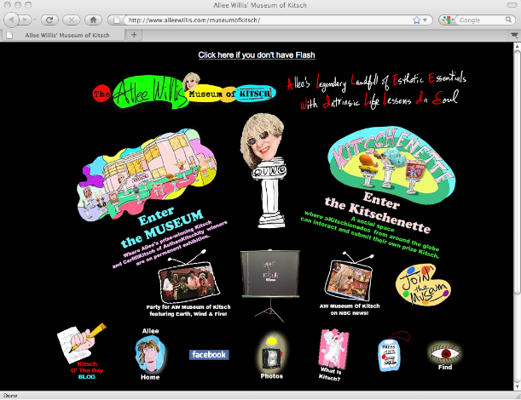
week 8: kitsch + the politics of camp
+ What is Kitsch?
+ The Alee Willis Museum of Kitsch

Slide 13
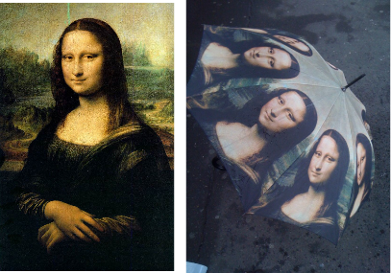
week 8: kitsch + the politics of camp
+ Why Study Kitsch?
+ Democratic art aimed at a broad audience segment
+ Greater access to a popularized form of aesthetics
+ Leonardo Da Vinci's Mona Lisa is not kitsch; umbrellas and other reproductions are
+ Paradoxically, reproduction heightens the "auratic" value of the original
+ John Berger, Ways of Seeing
+ Products designed to fit into the post-war lifestyle
+ Stimulate the redevelopment effort through active consumption
+ Rise of tourism and a leisure class
+ Demonstrate worldliness through souvenirs and ephemera
+ Homes become the new locations to demonstrate wealth, success, and taste
+ Escalating cycles of change to keep consumers purchasing

Slide 14
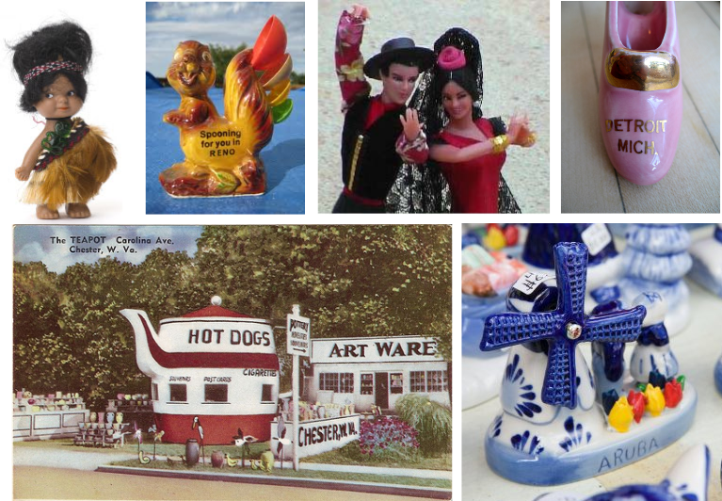
week 8: kitsch + the politics of camp
+ Why Study Kitsch?

Slide 15
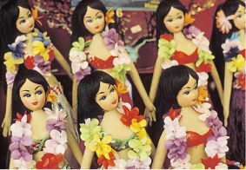
week 8: kitsch + the politics of camp
+ Selling Culture
+ Kitsch provides comfort and familiarity in the face of the unknown
+ It denies difficult or unflattering truths (superficial)
+ It is unchallenging and uncritical
+ The evolution of kitsch cemented the lower/working class position in culture
+ Fundamentally tied to the system of mass production and capitalism
+ Case Study: Hawaii
+ The youngest state in the U.S. (1959 statehood/1893 overthrow)
+ Exoticism of Polynesian and Asian influences
+ Redefined as a tourist mecca--trading on historical and
cultural influences
+ Modernization accompanied statehood
+ The more appealing aspects of the Indigenous culture
highlighted, with little context
+ Present a simulation of "authentic" Hawaiian life
+ Sanitized for American visitors (superficial mélange of aesthetics and role playing)
+ Only 0.15% of the population are native Hawaiian speakers
+ Hawaii Creole English: "pidgin"
+ Derived from English with other words from Hawaiian, Chinese, Japanese, etc.
+ A modern phenomenon presented as a rich, ancient tradition
+ Very few traditions persist--mainly reenactments
+ Lu'aus, grass skirts, coconut bras are all manufactured culture for the tourist economy
+ "Mythic" nature of the hula dance is largely constructed
+ Significance of ancient hula lost; only vestiges remain

Slide 16
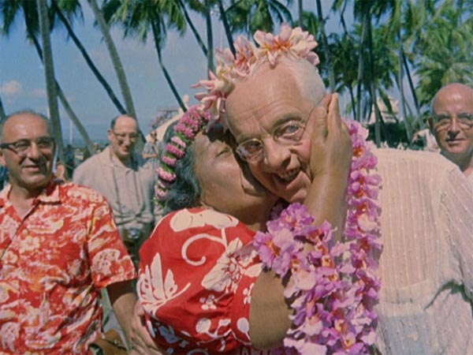
week 8: kitsch + the politics of camp
+ Jacopetti, Cavara, Prosperi, Mondo Cane (1962)—Hawaii sequence begins ~1:22:00
+ Shockumentary from the era
+ Present the "otherness" of Hawaiian people

Slide 17
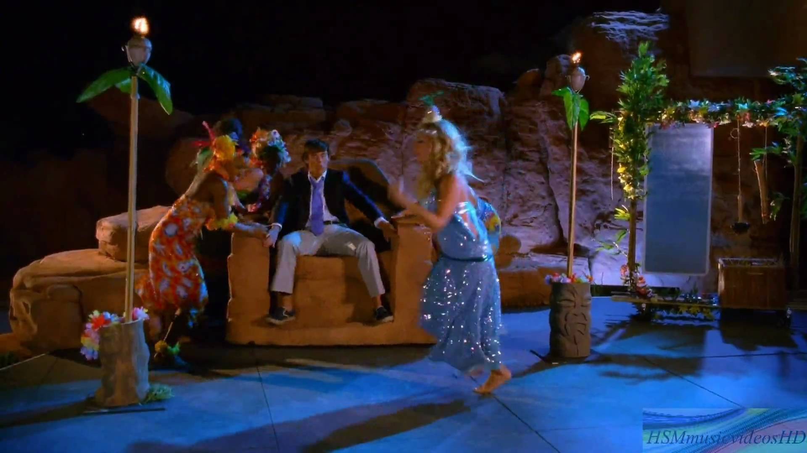
week 8: kitsch + the politics of camp
+ Kenny Ortega, High School Musical 2 (2007)

Slide 18
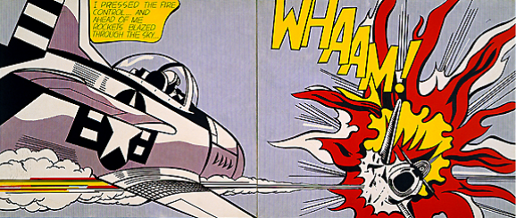
week 8: kitsch + the politics of camp
+ Susan Sontag, Notes on "Camp" (1964)
+ "Many things in the world have not been named; and many things, even if they have been named,
have never been described. One of these is the sensibility--unmistakably modern, a variant of
sophistication but hardly identical with it--that goes by the cult name of 'Camp.'"
+ Sontag argued against kitsch as mere folly
+ Reclaim the pleasure found in popular arts
+ "The camp 'sensibility' offered a mode of appreciating kitsch (as well as 'serious' art) because of its
excessiveness, its role-playing, its overt decoration. Individuals with camp sensibilities sophisticate
the understanding of kitsch, for camp judgments imply a specific way of perceiving--a trained eye or
ear that stands parallel to Greenberg's elite coterie of artists and viewers." --Whitney Rugg
+ Artists began borrowing imagery from popular culture and commercial life
+ Diminishing hierarchical
division between
art forms
+ Roy Lichtenstein, Whaam!
(1962)

Slide 19
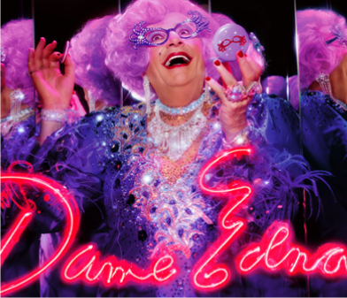
week 8: kitsch + the politics of camp
+ Susan Sontag, Notes on "Camp" (1964)
+ Camp is appealing because it expresses "bad" taste or presents an ironic value proposition
+ Key elements (according to Sontag):
+ Artifice, frivolity, naïve middle-class pretentiousness, and "shocking" excess
+ Exaggerated, affected, theatrical--but earnest
+ The power of camp is derived from the cringe-worthy lack of self-awareness
+ True camp is not cultivated, but recognized by the perceiver
+ Sontag: "To talk about Camp is therefore to betray it. [...] To name a sensibility, to draw its
contours and to recount its history, requires a deep sympathy modified by revulsion."
+ Converts the serious into the frivolous
+ Oscar Wilde: "One should either be a work of art,
or wear a work of art." --Phrases & Philosophies
for the Use of the Young

Slide 20
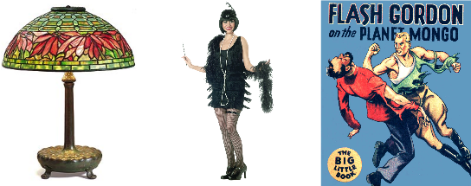
week 8: kitsch + the politics of camp
+ Susan Sontag, Notes on "Camp" (1964)
+ Camp simultaneously subverts and valorizes
+ Drag culture is a clear example: it appropriates hyper-masculine or feminine characteristics
+ Celebrates, yet critiques the gender norms in contemporary culture
+ Camp is a popular form of resistance
+ Not intended for the educated and elite (Greenberg, et al)
+ Response to disempowerment in everyday life
+ "Low" culture reclamation of the pleasures of banality--does not conform to
dictated/institutional rules or standards
+ The excessive quality of camp references the proliferation of media and the consumer impetus
+ A form of critique that emphasizes style over politics
+ Examples of camp are often drawn from outdated stylistic trends
+ Things that have fallen out of favour are recouped and revisited through a contemporary lens
+ Sontag: Tiffany lamps, 1920s clothing, pulp novels, etc.

Slide 21
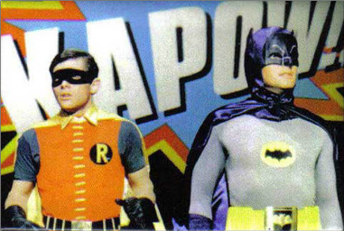
week 8: kitsch + the politics of camp
+ Camp
+ Camp is both a critique and a joke
+ It takes a societal norm (or object, style, medium), analyzes it, then subverts it through humorous
means
+ The joke is always presented in a serious, dead-pan manner
+ It's so bad that it's good
+ Largely dependent upon personal taste, but some examples are nearly-universal
+ Camp is a mode where kitsch is activated--it puts it into practice through one's position to the source
artifact/media
+ Contemporary camp has lost some its subversive power
+ Reduced to the message that popular culture can still be appreciated by a sophisticated individual
+ "Slumming" becomes a new form of aesthetic snobbery

Slide 22
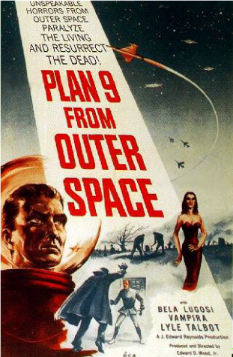
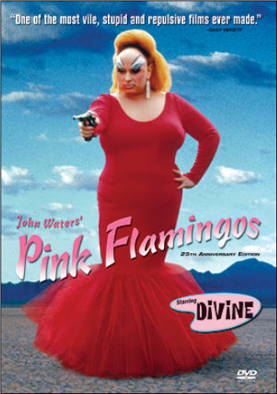
week 8: kitsch + the politics of camp
+ Ed Wood, Plan 9 From Outer Space (1958) + John Waters, Pink Flamingoes (1972)
+ Pink Flamingoes is camp by design--cultivated sensibility of the "trashy" and taboo by Waters

Slide 23
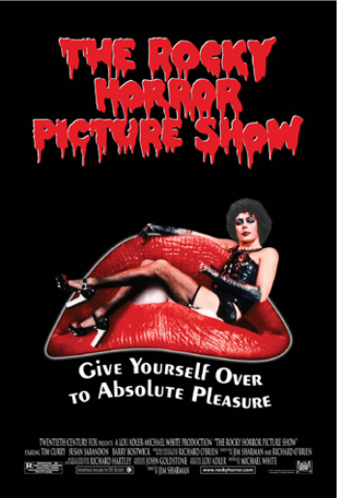
week 8: kitsch + the politics of camp
+ Jim Sharman, Rocky Horror Picture Show (1975) + Paul Verhoeven, Showgirls (1995)

Slide 24
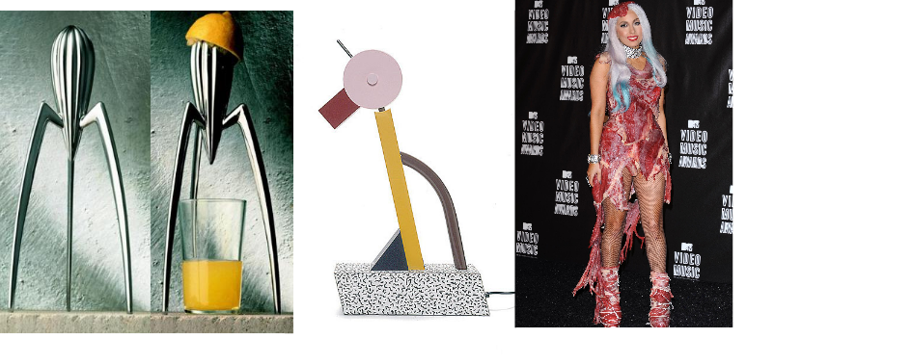
week 8: kitsch + the politics of camp
+ Artifice
+ "Camp sees everything in quotation marks. It's not a lamp, but a 'lamp'; not a woman, but a
'woman.' To perceive Camp in objects and persons is to understand Being-as-Playing-a-Role. It is
the farthest extension, in sensibility, of the metaphor of life as theater." --Susan Sontag
+ Function (or "content" according to Sontag) is subsumed by form

Slide 25
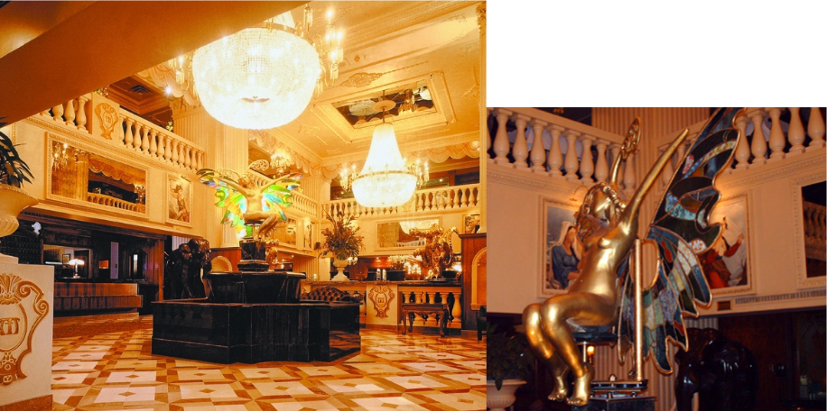
week 8: kitsch + the politics of camp
+ Hotel de la Montagne (R.I.P.) ~1:00
+ A preface to next week's lecture on postmodernism and plurality

Slide 26
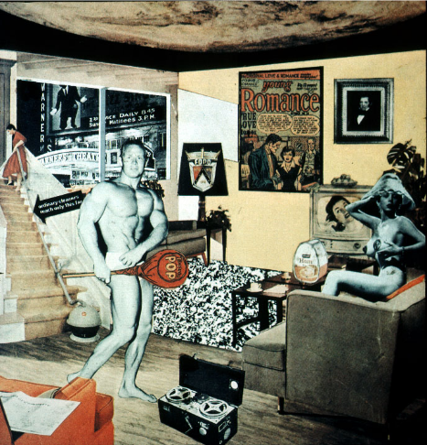
week 8: kitsch + the politics of camp
+ Major Assignment: "Just What is it That Makes Today’s Homes So Different, So Appealing?”
+ Part 2: Integration (40%, Due November 28)
+ Richard Hamilton (1956)

Slide 27
week 8: kitsch + the politics of camp
+ Major Assignment: "Just What is it That Makes Today’s Homes So Different, So Appealing?”
+ Overview:
+ Commit to a specific artifact, live with it, document your interactions/environment/context of use
+ Can be almost anything (shampoo, coffee cup, typeface, etc.)--be specific!
+ Collection of information, texts, photographs that help you to better understand the life and story
of your artifact
+ Determine how it influences, and is influenced by the culture/world in which it operates
+ Will become the subject of your entire semester's research--choose carefully!
+ Part 2: Integration (40%, due November 28)
+ Connect object to broader culture and theoretical/historical/social framework
+ Section 1:
+ 6 sources of information about object (1+ Library book, 1+ scholarly article, 1+ popular media)
+ Discuss how artifact relates predominant cultural values/ideals (be specific about the time,
location, community, user, etc.)
+ Provide proper citations; credit all borrowed thoughts and references
+ Section 2:
+ Choose one historical artifact (pre-1968) to compare or contrast with your artifact
+ Describe how it reflected its time/culture and how it relates to your contemporary example
+ Section 3:
+ Conclusion
+ How does this study help you to better understand contemporary culture, and your role as a
designer?
+ Format:
+ 2000-word paper with appropriate citations, title page, etc.
+ Include relevant illustrations/photos/captions

Slide 28
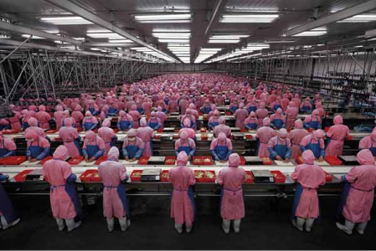
week 8: kitsch + the politics of camp
+ Heads-Up:
+ Tutorial
+ Optional Activity:
+ Edward Burtynsky, My Wish: Manufactured Landscapes and Green Education (TED)
+ Full film available through Concordia Library website
+ Preparation for Next Class:
+ Read: Raizman, David. “Politics, Pluralism, and Postmodernism.” History of Modern Design.
+ Third Article Summary is due in week 10 / Nov. 14 (Based on readings from weeks 7-9)

