Slide 1
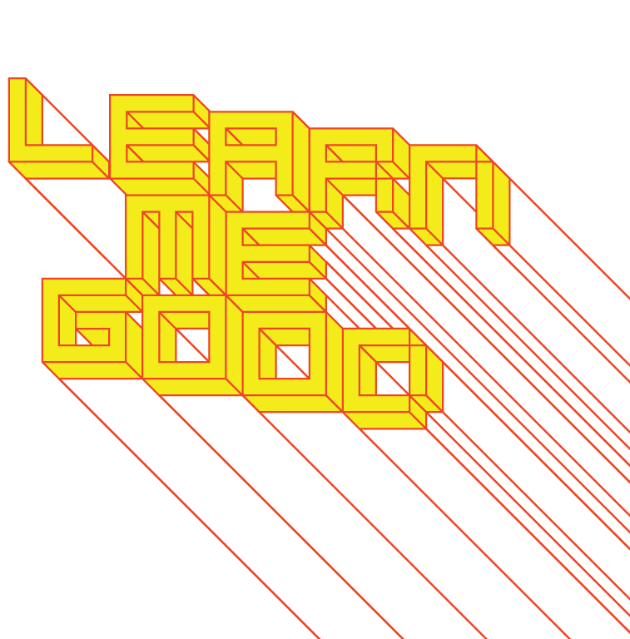
WEEK 10

Slide 2
week 10: selling disenfranchisement
+ Class Schedule:
+ Presentation and Discussion:
+ The rise of media culture, multi-modal broadcasting
+ Coolhunting, anti-advertising, the influence of marketers
+ Reinforcement of gender and cultural stereotypes
+ Tutorial
+ Video Screenings:
+ "The Story of Stuff." Narr. Annie Leonard (Online)
+ "Futuro: A New Stance for Tomorrow." Dir. Mika Taanila
+ Major Assignment Part 2: Due November 28
+ Please use tutorial sessions and office hours to address questions and request
feedback/comments

Slide 3
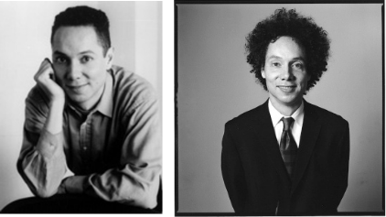
week 10: selling disenfranchisement
+ Malcolm Gladwell, Blink
+ Blink: the value judgments, assumptions, and qualitative assessments we make in the blink of an eye
+ Gladwell does not believe this is purely emotional or the product of intuition - it is rational:
+ "It's thinking--its just thinking that moves a little faster and operates a little more mysteriously than
the kind of deliberate, conscious decision-making that we usually associate with "thinking." ...
What is going on inside our heads when we engage in rapid cognition? When are snap judgments
good and when are they not? What kinds of things can we do to make our powers of rapid
cognition better?" --M. Gladwell
+ Hair anecdote: "... what struck me was how even more subtle and absurd the stereotyping was in my
case: this wasn't about something really obvious like skin color, or age, or height, or weight. It was
just about hair. Something about the first impression created by my hair derailed every other
consideration in the hunt for the rapist, and the impression formed in those first two seconds exerted
a powerful hold over the officers' thinking over the next twenty minutes. That episode on the street got me thinking about the weird power of first impressions." --M. Gladwell

Slide 4
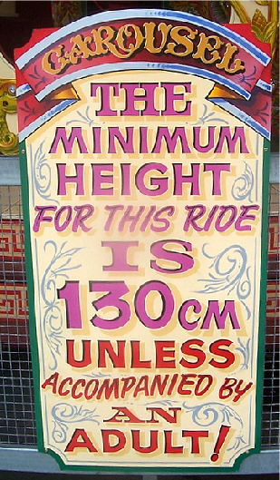
week 10: selling disenfranchisement
+ Malcolm Gladwell, Blink
+ When rapid cognition and “thin-slicing” goes awry
+ Racial profiling, security screenings, etc.
+ CEOs and height: "There is no correlation between height and
intelligence, or height and judgment, or height and the ability to
motivate and lead people. But for some reason corporations
overwhelmingly choose tall people for leadership roles."
+ Heightism: Fortune 500 survey (2005)
+ Average height of CEOs: 6 feet (2-3 inches taller than average
men; 90% above average)
+ Shorter individuals paid less than taller; similar discrepancies
to gender and racial divides
+ Perceived inferiority, cognitive ability, and intelligence
+ 1.8% wage increase for every inch above the norm
+ Blink: "... the content and origin of those instantaneous impressions
and conclusions that bubble up whenever we meet a new person,
or confront a complex situation, or have to make a decision under
conditions of stress." --M. Gladwell
+ These psychological studies can be applied to marketing and
targeting specific segments

Slide 5
week 10: selling disenfranchisement
+ The Merchants of Cool: Hunting for Cool (8:30); Under-the-Radar Marketing (16:00)
+ Marketing to the teen demographic
+ Douglas Rushkoff: “The pardox of “cool hunting” is that it kills what it finds.”
+ What are the implications of coolhunting for the development of new ideas, new
music, new art forms, etc.?
+ Robert McChesney: “In much the same way that the British Empire tried to take over
Africa and profit from its wealth, corporations look at [teens] like this massive empire
they are colonizing, and their weapons are films, music, books, CDs, Internet access,
clothing, amusement parks, sports teams.”
+ Breakout Discussion:
+ Are coolhunters and those who use the information they supply similar to colonial
powers?
+ Do they exploit teens or are they providing desired benefits and services?

Slide 6
week 10: selling disenfranchisement
+ The Merchants of Cool: Hunting for Cool (8:30); Under-the-Radar Marketing (16:00)
+ "Under-the-Radar" Marketing:
+ Hiring teens to log-on to chat rooms to talk up bands
+ Recruiting college freshmen to throw campus parties where they distribute marketing
materials
+ Ironically, marketers have justified "stealth" marketing as necessary because teens
have become more media savvy
+ Breakout Discussion:
+ Do you think that "stealth" techniques are ethical?
+ If a marketer offered you money to log-on to chat rooms or throw a party, would
you?
+ When you are tuned in to a concert (like the hip hop concert featured in the
program), or reading a message in a chat room, how important is it to know
whether or not it is a commercial?
+ Can you identify the "storytellers" behind the media you consume most often?

Slide 7
week 10: selling disenfranchisement
+ Marketing and Cyberculture
+ Increased interpenetration of technology in all aspects of life
+ Carry more information with us (miniaturization)
+ Ocular culture: recording our world for posterity
+ "Old-fashioned" skills and technologies become obsolete
+ "The ability to write by hand is now a less significant skill than typing speed. And the language
of emails - as with mobile phone text messages - is markedly different from that of handwritten
interaction, being more conversational, abbreviated, grammatically clumsy and peppered with
unimportant spelling errors." --G. Davis
+ Changes in communication necessitate new aesthetic approaches and mediums
+ Proliferation and dispersal result in fundamental changes in culture and interaction
+ Example: shifts in digital music sales - bypass existing systems
+ Easy replication and fragmentation of the market (more and more specialized genres, self-
publishing, etc.) leads to crisis in the music industry
+ Technology changes the very way we perceive/interpret/respond to media
+ Film: "... the popularization and pervasiveness of electronic technology has profoundly altered our
spatial and temporal sense of the world ... the hyperreal space of electronic simulation - whether it be
the space of computer-generated special effects, video games, or virtual reality - is characterized by a new depthlessness: one which is at the same time expansive and inclusive." --M. Pierson

Slide 8
week 10: selling disenfranchisement
+ Marketing and Cyberculture
+ Hybrid formats
+ Movies begin to look like games (due to CGI)
+ Games become the subject of films
+ Interactivity blurs the boundaries of author and spectator
+ "Every effects-laden science-fiction film is a sign that cinematographic
space is in the process of being reformulated according to the new
electronic coordinates and experiential values of a
postmodern, video-game culture." --M. Pierson
+ Streaming content providers: disrupts established notions of TV's
form and purpose
+ Changes the shape of the television industry
+ Higher definition, more bandwidth, interactive/streaming services
+ "... has thrown into crisis ... long-established industry practices,
business relationships and textual forms."
+ "The current uncertainty has also put into question traditional
industry and popular accounts of the medium's role as signifier
of national identity (and public service broadcasting's political
rationale in the UK and elsewhere), its ontology of liveliness and
photographic realism and its place as a consumer product within the gendered household."
+ Massively-Mass Media
+ The Internet has amped-up the media proliferation, and has called into question many traditional
forms of dissemination, marketing, and spectatorship
+ Further dispersal of "mainstream" into niche culture

Slide 9
week 10: selling disenfranchisement
+ The Global Village
+ Marshall McLuhan, Understanding Media (1964)
+ "The medium is the message."
+ Shannon-Weaver Model of Communication (1948)
+ Not just a vehicle of communication, but possessing inherent qualities that shape understanding
+ "... simply defining 'message' as content or information to be transmitted misses what McLuhan
believed to be one of the most important features of media: their power to change the course and
functioning of human relations and activities." --G. Davis
+ "Medium" is an extension of ourselves (bodies, minds, beings)
+ "Message" is "any change in scale, pace, or pattern that a medium causes in societies or cultures."
--M. McLuhan
+ Personal and social consequences of a medium are a result of scale: escalating by extension of
ourselves and/or through technology
+ The concept of global extension has become a key factor in contemporary media
+ Producers of media and products have crossed geographic boundaries ("Big Brother Kazakhstan")
+ Globalization/Americanization: form of cultural or media imperialism
+ Traditional, local cultures eroded in this process: traditional imperialist power relation
+ American Idol was broadcast to over 100 nations outside of the United States
+ Disney's The American Idol Experience

Slide 10
week 10: selling disenfranchisement
+ Simulation
+ Jean Baudrillard
+ In contrast to McLuhan's "Global Village": he did not view technology as a unifying extension
+ Proliferation of mass media (advertising, television, cinema) that focuses on creation of simulated
worlds, that bear no resemblance to lived reality
+ So widespread and all-pervasive that distance between real world and simulations implodes
+ "... simulation ... undermines any contrast to the real, absorbing the real world within itself.
Instead of a "real" economy of commodities that is somehow bypassed by an "unreal" myriad of advertising images, Baudrillard now discerns only a hyperreality, a world of self-referential
signs." --M. Poster
+ Has become a culturally-dominant experience: AI, deepfakes, reality TV, Celebration, etc.
+ Film and Simulation
+ Sequels and remakes (Planet of the Apes, Ocean's Eleven)
+ Fictionalization of real, historical events
+ Presented as factual accounts
+ "... cinema becomes more cinema than cinema, in a kind
of vertigo in which ... it does no more than
resemble itself and escape in its own logic, in the
very perfection of its own model." --J. Baudrillard
+ Can influence our perceptions of reality (Titanic)

Slide 11
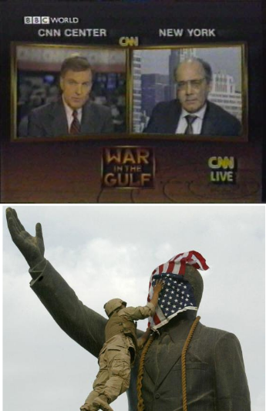
week 10: selling disenfranchisement
+ Television and Simulation
+ Actors often confused with the parts they play when
encountered in the "real" world
+ Characters perform roles for which they are not trained,
nor experts (i.e. ER, Law & Order, CSI, etc.)
+ Actors from ER hired to give testimonials for pharmaceutical
company: viewers more likely to trust the fake doctors' advice
+ Baudrillard goes so far as to claim that the Gulf War in 1991 was
completely staged
+ Television news shaped viewers' opinions: CNN and cable
graphics emerged as a new form of narrative propaganda
+ The televised version was more "real" than the actual conflict
+ Viewers used to the format of fictional media: a shared
aesthetic language
+ Invasion of Iraq was even more highly-simulated
+ "Weapons of Mass Destruction," press stage,
toppling of Hussein statue, etc.
+ “Fake news”
+ The problem with both McLuhan and Baudrillard
+ Assume that citizens are powerless to critique media
+ Media overwhelms individuals
+ Ignores differences in modes of dissemination
+ Internet is not the same as television
+ Ignores countercultural forms and resistance

Slide 12
week 10: selling disenfranchisement
+ The Internet as a Medium
+ Early fear and criticism of the format
+ Eye strain, dangerously "immersive," antisocial
+ "... the dissolution or fragmentation of the subject and the instantaneous, transient nature of all
communication disconnect or abstract the individual from physical action and a sense of social
and personal responsibility to others." --M. Willson
+ Arguments connecting new forms of mass media are not new: 1950s cinema causes juvenile
delinquency
+ Focus on policing and monitoring Internet content: not the same level of control as TV and other
formats (classification ratings, reviewers, etc.)
+ Fear of open access to pornography and its effects on children, solicitation, etc.
+ Other concerns
+ Politically or ideologically subversive
+ Different standards, tolerance, and laws between countries
+ Globalization means lack of centralized monitoring (for better or for worse)

Slide 13
week 10: selling disenfranchisement
+ The Internet as a Medium
+ Utopianism
+ Gives voice to the disempowered
+ Malleable, "neutral" spaces for people to connect/organize around like interests or beliefs
+ Overcome physical or social impediments
+ Physical appearance is less vaunted than communication skills and ideas
+ Allows for virtual performance/role-playing (freedom less acceptable in the "real" world)
+ Market Forces
+ Commercialization of Internet in 1993 opened the floodgate for consumerism (privatized)
+ Messages inextricably embedded in all aspects of use - social, business, entertainment
+ "Marketspace" becomes "Consumerspace"
+ We knowingly participate in being marketed to
+ "In an age when people have more capacity--through technologically aided communication--to be
interconnected across space and time than at any other point in history, the postmodern individual
in contemporary Western society is paradoxically feeling increasingly isolated and is searching for
new ways to understand and experience meaningful togetherness." --M. Willson
+ Marketers are aware of this insecurity, and use this to their advantage
+ It becomes a dominant myth to sell products - promise of "interconnectedness”
+ Packard-Bell, “Wouldn’t you rather be at home?” (1997)

Slide 14
week 10: selling disenfranchisement
+ Subversion of Marketing and Branding
+ Reverend Billy. “What is the Sho-po-ca-lypse?”
What Would Jesus Buy?

Slide 15
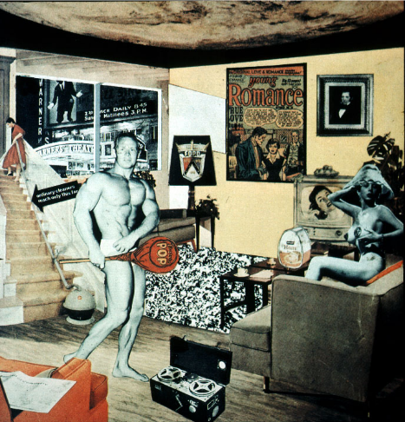
week 10: selling disenfranchisement
+ Major Assignment: "Just What is it That Makes Today’s Homes So Different, So Appealing?”
+ Part 2: Integration (40%, Due November 28)
+ Richard Hamilton (1956)

Slide 16
week 10: selling disenfranchisement
+ Major Assignment: "Just What is it That Makes Today’s Homes So Different, So Appealing?”
+ Overview:
+ Commit to a specific artifact, live with it, document your interactions/environment/context of use
+ Can be almost anything (shampoo, coffee cup, typeface, etc.)--be specific!
+ Collection of information, texts, photographs that help you to better understand the life and story
of your artifact
+ Determine how it influences, and is influenced by the culture/world in which it operates
+ Will become the subject of your entire semester's research--choose carefully!
+ Part 2: Integration (40%, due November 28)
+ Connect object to broader culture and theoretical/historical/social framework
+ Section 1:
+ 6 sources of information about object (1+ Library book, 1+ scholarly article, 1+ popular media)
+ Discuss how artifact relates predominant cultural values/ideals (be specific about the time,
location, community, user, etc.)
+ Provide proper citations; credit all borrowed thoughts and references
+ Section 2:
+ Choose one historical artifact (pre-1960) to compare or contrast with your artifact
+ Describe how it reflected its time/culture and how it relates to your contemporary example
+ Section 3:
+ Conclusion
+ How does this study help you to better understand contemporary culture, and your role as a
designer?
+ Format:
+ 2000-word paper with appropriate citations, title page, etc.
+ Include relevant illustrations/photos/captions

Slide 17
week 10: selling disenfranchisement
+ Heads-Up:
+ Tutorial
+ Video Screenings:
+ The Story of Stuff. Narr. Annie Leonard (Online)
+ Futuro: A New Stance for Tomorrow. Dir. Mika Taanila
+ Preparation for Next Week:
+ Csikszentmihalyi, Mihaly. “Why We Need Things.” History From Things
+ Garland, Ken. "First Things First."
+ Barnbrook, Jonathan et al. “First Things First 2000.”
+ Website: “About," “Design.” The High Line
+ Website: Ecofont. SPRANQ Creative Communications
+ Major Assignment Part 2: Due November 28
+ Please use tutorial sessions to address questions and request feedback/comments

