Slide 1
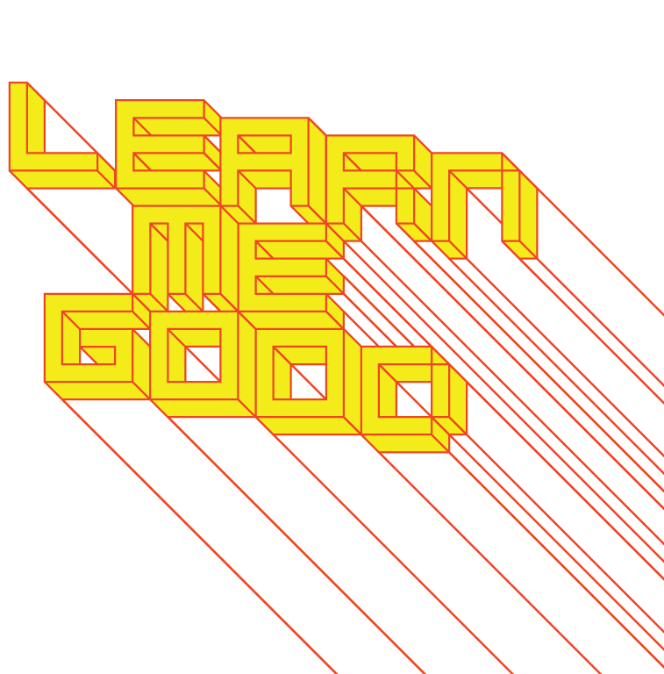
WEEK 1

Slide 2
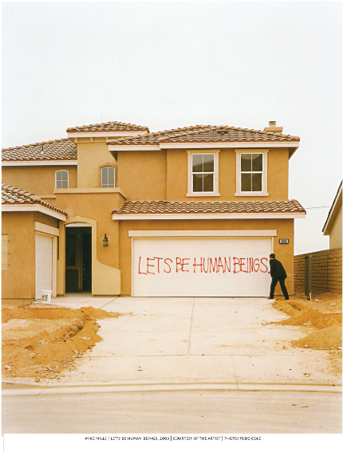
week 1: rhetoric, ethos + responsibility
+ Mike Mills, Let's Be Human Beings

Slide 3
week 1: rhetoric, ethos + responsibility
+ To See, To Understand
+ “I'm an eye. A mechanical eye. I, the machine, show you a world the way only I can
see it. I free myself for today and forever from human immobility. I'm in constant
movement. I approach and pull away from objects. I creep under them. I move
alongside a running horse's mouth. I fall and rise with the falling and rising bodies.
This is I, the machine, maneuvering in the chaotic movements, recording one
movement after another in the most complex combinations.
Freed from the boundaries of time and space, I co-ordinate any and all points of the
universe, wherever I want them to be. My way leads towards the creation of a fresh
perception of the world. Thus I explain in a new way the world unknown to you.”
- Dziga Vertov
+ Man With a Movie Camera (1929)

Slide 4
week 1: rhetoric, ethos + responsibility
WHY ARE YOU HERE?
+ "A space can only be made into a place by its occupants. The best that the designer
can do is put the tools into their hands."
- Steve Harrison and Paul Dourish, "Re-place-ing space"
+ "We need to become hunter-gatherers of ideas and tools."
- John Thackara, In the Bubble: Designing in a Complex World
+ Seth Godin: "This is Broken" (~20:00)
+ MIT D-Lab: Development through Discovery, Design and Dissemination

Slide 5
week 1: rhetoric, ethos + responsibility
CAN WE FIX IT? YES WE CAN!
+ To be "a designer is having a very special way of viewing the world, seeing
possibilities - not just (having) certain skills. (It is:) ... how you organize your day,
design your kitchen, and prepare a meal. Questioning the way things are being done.
A way of living, organizing and seeing - not something you ... take off like a coat. ...
Every profession requires certain skills and a real professional questions, improves
and refines his (or her) style of working over time ... This 'special way of viewing the
world' is what I think makes the difference - and a designer."
- Michael Holt, "Good Designer = Good Design Teacher?”
YOU HAVE A RESPONSIBILITY!

Slide 6
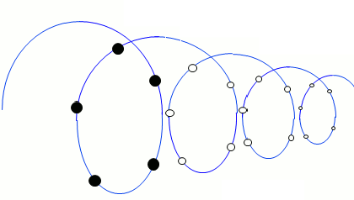
week 1: rhetoric, ethos + responsibility
YOU ARE AN ACTOR
+ "When objects are lost, subjects are found."
- Sherry Turkle
+ "The shadow of the object fell upon the ego."
- Sigmund Freud
+ "Hear and forget. See and remember. Do and understand."
- Confucius
+ Course Modules:
+ Process (Responsibility): Agents of change/design for debate
+ Experience (Empathy): Cognitive meaning + arousal = emotion
+ Systems (Complexity): Heterarchical and self-evolving systems
+ Enactment (Performance): Act lightly, sense the feedback, act again

Slide 7
week 1: rhetoric, ethos + responsibility
+ The "Rules": Course Overview + General Objectives
+ Design as a subset of material culture studies:
+ Intersects with several disciplinary areas:
+ Cognitive science, anthropology, sociology, media studies, and semiotics (among others)
+ Your design education in DART 262 (and Concordia, in general) will address:
+ Cultural studies of design - helping you to discover what constitutes successful design, what
inspires you, and how design activates and reflects the culture of its time and place
+ Design from a contextual perspective - recognizing that an artifact’s identity, value, and
usefulness is directly affected by its setting, and by the historical/cultural/geographical world
+ Acute sensitivity to the surroundings in which your design will exist - understanding the
relationship between creation, dissemination, interaction, and reception
+ How? The Laboratories for Learning:
+ Classroom: readings, lectures, and contact time with instructor
+ Placement of artifacts within a broader context
+ "Though experiments" and play sessions
+ Lived Reality: observation, documentation, experimentation
+ Study of how objects interface with daily life

Slide 8
week 1: rhetoric, ethos + responsibility
+ Rules, Rules, Rules!
+ Site: www.learnmegood.ca
+ Weekly Presentations: www.learnmegood.ca/262/x/presentation.swf
+ Contact: christopher.moore@concordia.ca
+ Office hours: best to email for an appointment (in person or via Zoom)
+ Teaching Assistant
+ Contact: ta@learnmegood.ca
+ Roles:
+ First contact for questions regarding course content, assignment specifications
+ Conduct and moderate tutorial sessions; host supplementary activities
+ Maintain classroom decorum
+ Texts:
+ There are no required texts for this course
+ All readings will be available online through the Concordia Library site or
Learn Me Good portal

Slide 9
week 1: rhetoric, ethos + responsibility
+ (EVEN MORE) Rules, Rules, Rules!
+ Evaluation:
+ 10% Readings / Participation / Attendance
+ 30% Moodle Responses (10, each worth 3%; submit to Moodle)
+ 5% Show and Tell (A Lie)
+ 5% Exhibition Review
+ 50% Major Assignment (three parts)
+ 20% Part 1 (Paper, Individual)
+ 20% Part 2 (Paper and Presentation, Teams)
+ 10% Part 3 (3 Posters, Teams)
+ Overview of Weekly Expectations:
+ Readings / websites / video screenings (most readings available as PDFs on reserve through Library website)
+ Moodle Responses:
+ Post to Moodle forums (weekly)
+ Based on tutorial Activities
+ Overview of Major Assignment:
+ Three parts: research and applied project
+ "Real world" study, plus academic research and creative output

Slide 10
week 1: rhetoric, ethos + responsibility
+ Who is this man?

Slide 11
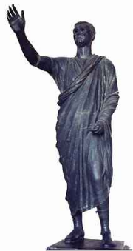
week 1: rhetoric, ethos + responsibility
+ Ethos
+ Gord's Gold/CBC Sunday (~7:00)
+ Moral core = the disposition, character, or fundamental values peculiar to a specific
person, people, culture, or movement
+ Could be considered in relation to brand identity
+ In rhetoric = Aristotle: a component of all arguments; "moral competence," expertise
and knowledge
+ When determining whether a given argument is valid or not, one must question the
ethos the speaker has established
+ Violations of ethos:
+ The speaker has a direct interest in the outcome
+ The speaker has a vested interest or ulterior motive
+ The speaker has no expertise
+ To establish rhetorical ethos = prove that the speaker is dispassionate,
knowledgeable, and interested in the public good

Slide 12
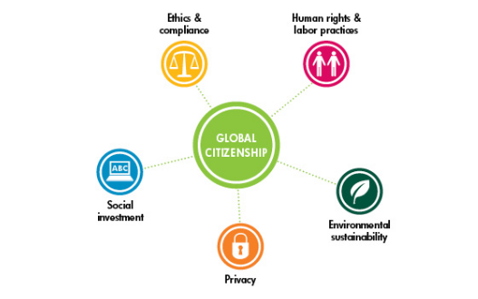
week 1: rhetoric, ethos + responsibility
+ Design Ethos Conference 2010
+ "Even as debate surrounding the fundamental issues of form, content and audience has raised
the graphic design field to a new level of maturity, visual communicators are confronted with
evidence that their work is negatively impacting both socioeconomic balance around the globe
and Earth's vital natural systems.
At the center of this debate is the need for a new ethos that can effectively address matters of
global equity, true sustainability, and the downsides to consumerism on an increasingly
populated planet. The inattention to social, cultural, and environmental repercussions of an
outdated mode of business operation cannot continue. Pragmatic notions of global citizenship
are necessary."

Slide 13
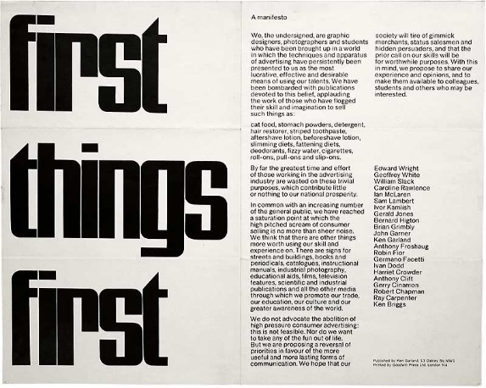
week 1: rhetoric, ethos + responsibility
+ First Things First (Revisited)
+ Ken Garland (1964)
+ First Things First 2000 (1999)
+ First Things First 2014 (2014)

Slide 14
week 1: rhetoric, ethos + responsibility
+ First Things First
+ "We, the undersigned, are graphic designers, photographers and students who have been brought
up in a world in which the techniques and apparatus of advertising have persistently been
presented to us as the most lucrative, effective and desirable means of using our talents ... [Our
time has been] wasted on these trivial purposes, which contribute little or nothing to our national
prosperity."
- Ken Garland
+ Original manifesto reinstated in 1999, signed by 33 leading design professionals (22 original)
+ A rejection of the hyper-capitalist drive behind design practice (at the mercy of industry/the market)
+ Return design to its place as a means to resolving larger social/cultural issues
+ Not merely an aesthetic practice based on changing styles or trends
+ Investigate the influence and ubiquity of designed artifacts in everyday experience
+ Make meaningful changes in the world
+ A pledge to educate new generation of designers to become leaders in this practice
+ "We think that there are other things more worth using our skill and experience on ... We hope that
our society will tire of gimmick merchants, status salesmen and hidden persuaders, and that the
prior call on our skills will be for worthwhile purposes."
- Ken Garland

Slide 15
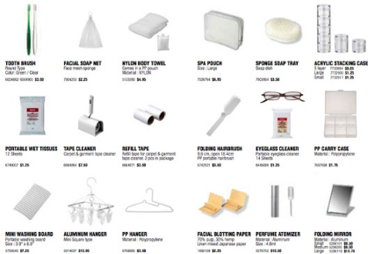
week 1: rhetoric, ethos + responsibility
+ MUJI: Naoto Fukasawa
+ Design Ethos:
+ Mujirushi Ryōhin = No Brand Quality Goods
+ Democratization of Design
+ High quality products at "lower than usual" retail prices
+ Original Muji marketing slogan: "lower priced for a reason"
+ "Kanketsu": the concept of simplicity; aiming to "bring a quiet sense of calm into strenuous
everyday lives."
+ Simple products that are basic and necessary
+ Sustainable attributes:
+ "Restrict the use of substances that may
have a significant impact on people
or the environment"
+ "Reduce waste by standardising modules,
facilitating disassembly and by reducing packaging"
+ Process:
+ Design process resists technology and prototypes
are produced with paper rather than
computers, so as not to encourage unnecessary detail
+ Manufacturing process is determined on the
basis of the consumer's use of the product
+ Finishes, lines, forms are minimized for manufacturing ease

Slide 16
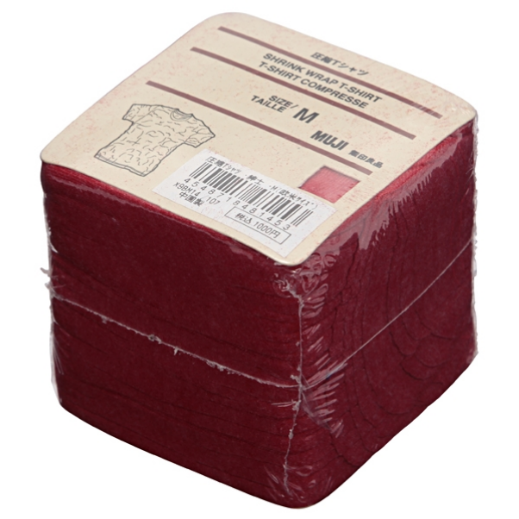
week 1: rhetoric, ethos + responsibility
+ MUJI: Naoto Fukasawa
+ Fukasawa discusses his approach
to interaction design
+ "Design dissolving into
behaviour"

Slide 17
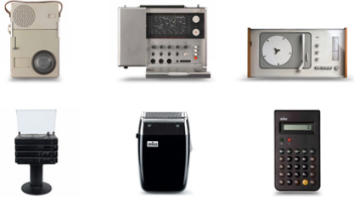
week 1: rhetoric, ethos + responsibility
+ Less and More: The Design Ethos of Dieter Rams
+ Joined Braun in 1955; became design head in 1961
+ Career spans more than 40 years; over 500 products
+ Fundamentally changed the field of industrial design: emerged at the dawn of mechanization and
mass production
+ "From our position as the consumers and manufacturers of the 21st century, we can look back on
this history - with its legacy of greatly accelerated lifestyle and industry - and see clearly both the
problems and the great potential inherent in design."
+ Generalist:
+ Involved with each step of the development process, from initial product planning to design,
manufacture and advertising
+ Functionalist approach to design
+ "Less but better"
+ Interview with Rams
+ The legacy of Rams

Slide 18
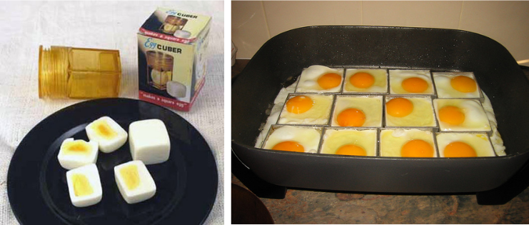
week 1: rhetoric, ethos + responsibility
SO...
WHY ARE YOU HERE?
What is your design ethos?
+ Assignment 1 Introduction
+ 25 Words + Emblematic Artifact
+ Post to Week 1 Moodle forum

Slide 19
week 1: rhetoric, ethos + responsibility
+ Tutorial: Design Ethos
+ Karim Rashid: “Design is about the betterment of our lives poetically, aesthetically, experientially,
sensorially, and emotionally”

Slide 20
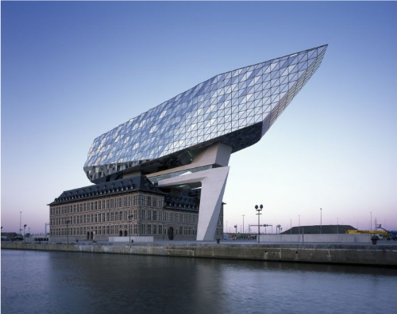
week 1: rhetoric, ethos + responsibility
+ Tutorial: Design Ethos
+ Zaha Hadid: “Architecture is really about well-being. I think that people want to feel good in a space
... On the one hand it's about shelter, but it's also about pleasure”

Slide 21
week 1: rhetoric, ethos + responsibility
+ Tutorial: Design Ethos
+ Jonathan Ive: “There is beauty when something works and it works intuitively”

Slide 22
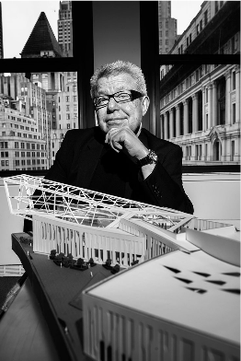
week 1: rhetoric, ethos + responsibility
+ Tutorial: Design Ethos
+ Daniel Libeskind: “Our lives are complex; our emotions are complex; our intellectual desires are
complex. I believe that architecture … needs to mirror that complexity in every single space that we
have, in every intimacy that we possess”

Slide 23
week 1: rhetoric, ethos + responsibility
+ Tutorial: Fill in the Blanks! (10 minutes)
+ It would be my dream to work for (name of design company), but I could never work for (name of
design company)
+ If I could marry a product, it would be a (name of product), but I would break up with (name of
product)
+ (Kind of design) makes me smile, (kind of design) bores me, (kind of design) makes me cry, (kind of
design) makes me furious
+ Post this exercise to the Moodle forum

Slide 24
week 1: rhetoric, ethos + responsibility
+ Tutorial: Design Ethos Statement
+ Elaborate a 25-word statement of your design ethos.
+ Post an image of an emblematic object that you believe represents (or at least resembles) your
design ethos and briefly explain why (2 to 3 sentences). Also, you have the option of posting an
image that is the complete opposite of your ethos, explaining your choice.

Slide 25
week 1: rhetoric, ethos + responsibility
+ Ready, Set, Go!
+ For Next Week:
+ Read: Antonelli, Paula. "Design 1:1" (PDF/Library Reserves)
+ Read: Antonelli, Paula. "@ at MOMA" (Link)
+ Visit website: Designs On (IDEO-Link)
+ Respond to Moodle Prompt:
+ Sign on to Moodle for DART 262
+ Post your 25-word statement of design ethos
+ Include a low-resolution photo of your emblematic artifact and describe how it illustrates your
critical design perspective (approximately 100 words - MAX!)

