Slide 1
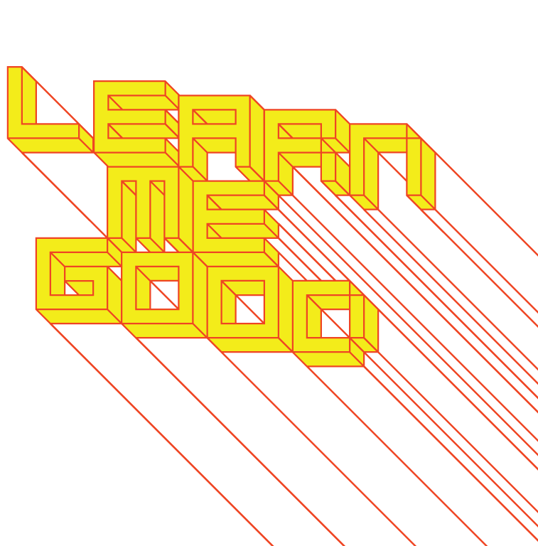
WEEK 10

Slide 2
week 10: project development
+ Project Development:
+ Continue research and preparation of your paper and presentation
+ This is the time to ask questions and seek clarification
+ Ensure that all areas of the assignment guidelines have been addressed
+ Assign roles to each team member (everyone must contribute to the oral presentation!)
+ Part 3 Introduction:
+ Poster series
+ You may wish to use the class time to brainstorm approaches to part 3
+ Some of the graphics may be integrated into your oral presentation
+ Design Program Town Hall
+ Friday, March 29, 1:00pm
+ Use Zoom link on Moodle
+ An opportunity to ask questions and provide feedback on the program

Slide 3
week 10: project development
+ Assignment: Je me souviens (Part 2 due April 2; Groups of 3; 20%)
+ Montreal as a UNESCO City of Design
+ What makes a "design city"?
+ Select an example of what you feel to be well-designed
+ Architecture, public parks, systems, street furniture, infrastructure, etc.
+ MUST be Montreal-specific
+ "Even the city itself acknowledges that ‘design in Montreal is not simply for show but a source of
daily wellbeing.’ Not only has Montreal demonstrated that design can be a powerful tool in
promoting inclusion and plurality of values, but the city has also called upon its citizens to play a
critical and active part in mobilizing design to inspire more innovative living environments that
enhance daily life and existence.” --Koichiro Matsuura (UNESCO Director-General)
+ Not just a celebration of Montreal's attributes
+ The second part of this assignment addresses the less effective elements of the city
+ Think about inhabitation: how do these artifacts/experiences shape the daily life of citizens (for
better or for worse)?
+ Use the issues, frameworks, guiding principles explored in class
+ What contextual, semantic, and physical concerns need to be addressed/investigated?
+ Examine the patterns of use, appropriateness of material choices, and general mood/atmosphere
+ What prevents it from being workable/livable/enjoyable?
+ Why doesn't it provide a more positive contribution to the everyday experience?

Slide 4
week 10: project development
+ Assignment: Je me souviens (Part 2 due April 2; Groups of 3; 20%)
+ Suggested Framework (Similar criteria to Part 1)
+ Section I: Observation (500 words):
+ Ia: Briefly explain your choice; identify date/name of designer (if known); succinctly state its major
positive attributes (100 words)
+ Ib: Provide a brief history of your artifact/space, including key dates/transitions (100 words)
+ Ic: Provide a description of its visual and physical characteristics; include a map denoting its location
in the city (150 words, plus 10 photos/captions)
+ Id: Include a detailed description of its contextual environment (150 words); consider
+ Surfaces: hard/soft; changing/static
+ Size or volume: interior/exterior; confined/walled/open; reverb/echo/flat
+ Variety: balance of natural/human/manufactured phenomena; contrasts/similarities
+ Qualities: loud/quiet; harsh/sharp/soft/gentle
+ Layers: multiple simultaneous/discrete; easily-distinguished/seamless blend
+ Make sure that your photographs reveal different facets of the artifact
+ Verify that you are able to photograph in-situ (i.e. not private property)

Slide 5
week 10: project development
+ Section II: Occupation (500 words)
+ IIa: How does the general public interact with your artifact? Who, how, when, and under what
circumstances? Does this change during the day or seasons? Is it available to all, or restricted to a
specific demographic? (250 words)
+ IIb: Consider the functionality of your artifact (perceived/purported practical functions). Is there a
discrepancy between this and the experience of the user? Can this be quantified? (250 words)
+ Section III: Analysis (500 words)
+ IIIa: Apply principles studied in DART 261/262 to justify your assessment
+ As a starting point, consider Dieter Rams' Ten Principles for Good Design
+ Consider durability of your artifact: both physical and emotional
+ Is your artifact healthy: physically, environmentally, socially?
+ Does it help the public in positive ways (not mere ornamentation)?
+ Is it responsive to human scale? Does it evoke a positive sentiment?
+ You must integrate a minimum of 3 sources from the course or elsewhere

Slide 6
week 10: project development
+ Section IV: Proposal (400 words)
+ Propose a solution to rectify the problems identified in the analysis
+ Provide sketches, diagrams, and a 400-word written description of the changes
+ This will lead up to Part 3 of the assignment, which will entail a 3-poster set
+ You may wish to divide up the sections among your team members to make the most optimal use of
your time/energies
+ Section V: Conclusion (100 words)
+ Succinctly describe your reasoning for the positive assessment
+ How does it activate and reflect the culture of its time and place?
+ If your artifact is historical, how does it function today?
+ Oral Presentation (Week 12)
+ Each team will present their research and proposals in 10-15-minute sessions
+ 5-minute (MAX!) video presentation, followed by Q&A session
+ It is recommended that you use a video sharing site (YouTube, Vimeo, etc.) and provide a link
+ All files MUST be uploaded to Moodle prior to the class session to expedite the process
+ Order will be determined randomly
+ You MUST attend all sessions

Slide 7
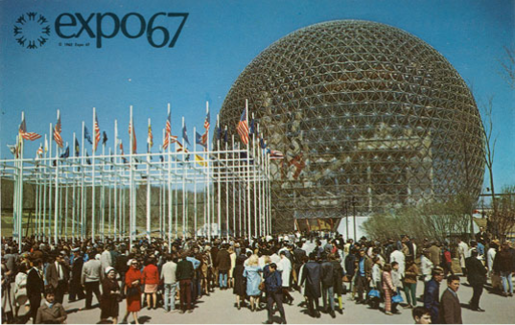
week 10: project development
+ Deliverables:
+ Approximate length: 2000 words, plus captions (PDF FORMAT ONLY)
+ 15 minutes per team
+ 10-15-minute oral presentations, followed by 5-minute discussion
+ Week 11 (randomly selected)
+ Be prepared to share your presentation
+ Photographs and captions should be integrated into the body of the text
+ Upload one copy to the class Moodle

Slide 8
week 10: project development
+ Assignment: Je me souviens (Part 3 due April 9; Groups of 3; 10%)
+ Translate the written essay into a set of THREE posters
+ Present the argument and solution in a succinct, visual language
+ Triptych: they must work together as a cohesive set (not three separate interpretations)
+ There is no specific format or set of information that MUST be included
+ They must be clear and understandable to an audience that may not know your
selected artifact
+ Suggested approach:
HISTORY PROBLEM SOLUTION
+ Deliverables
+ One submission per team
+ Three 18"x24" poster layouts (PDF FORMAT ONLY!)
+ If your team has four members, I expect one ADDITIONAL poster, that may expand on any of
the three thematic categories
+ Upload the files to the class Moodle

