Slide 1
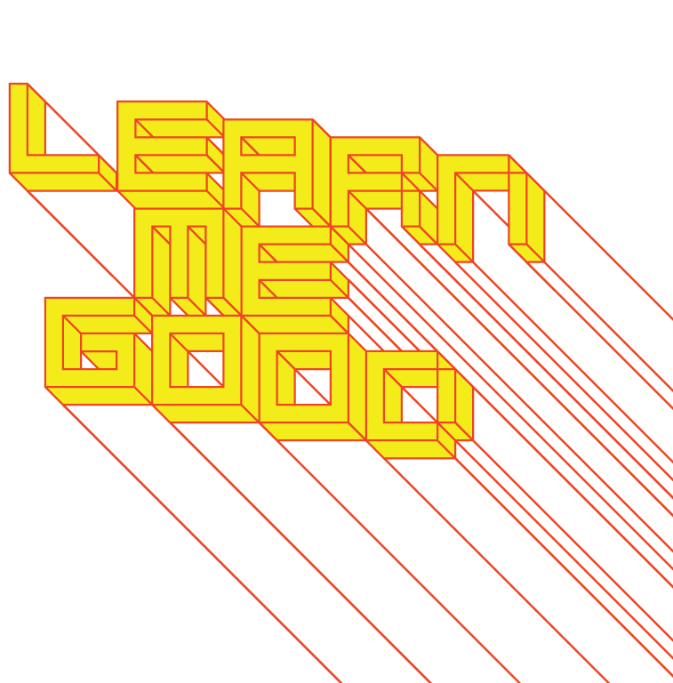
WEEK 4

Slide 2
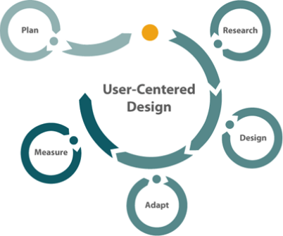
week 4: social design and user-centered processes
+ Class schedule:
+ Thought Experiments
+ Group presentations: choose a representative

Slide 3
week 4: social design and user-centered processes
+ Thought Experiments
+ Scenarios
+ Louise is a 78-year-old ceramicist who has experienced significant muscle loss as the result of a
stroke. She also finds it difficult focusing for long periods of time, describing herself as “foggy” and
lacking the same perceptual awareness she once possessed. Both the physical and neurological
effects have made it virtually impossible for her to continue her creative practice. Louise’s
rehabilitation therapist has recommended that she use video games to help restore her mental
faculties and develop a greater sense of body awareness lost following the stroke.
What type of game (or other therapeutic aid) might you design to appeal to this aging
demographic? Consider themes, physical movements, and motivations that will help Louise return
to her ceramics practice.
+ D_S/GN is a print magazine that garnered critical acclaim throughout the 1990s/early 2000s, but has
since lost a great deal of relevance within the professional community. The publication is looking to
update their image, save money, and develop a stronger web presence. Currently, their website
only features subscription information and general details about the printed publication. The editors
desperately want to make use of the flexible tools afforded by new technologies to expand their
content offerings.
+ For both scenarios, research existing examples
+ List the specific needs and desires in each case
+ Use your creativity to exceed expectations and assumptions (be as wild and speculative as
you wish)

Slide 4
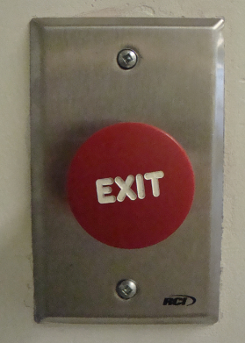
week 4: social design and user-centered processes
+ Human Factors
+ Multidisciplinary area of research (design, statistics, engineering, psychology, etc.)
+ Applies science-based research to ergonomics, biometrics, etc.
+ Studies human capabilities and their use in the development process
+ Involves behavioural analysis and how bodies integrate with systems
+ Usability, human-machine interaction, experience design
+ Invites participants into the process at all levels of the design/iterative process
+ Constraints: limitations on the system (materials, scale,
technology, etc.)
+ Example: it is not possible to move a cursor beyond the screen
+ Affordances: potential; the boundaries of what is possible, given
specific conditions
+ The quality of an artifact or environment to allow an individual
to perform a task
+ Originally proposed by Donald Norman as ANY possible actions
+ Refined to suggest PERCEIVED affordances
+ The characteristics of an artifact that communicate how
they should be used
+ How easily can the user locate/understand the system
and its use?
+ Suggests agency on the part of the user, as opposed to
a unidirectional flow of information
+ Takes into account cultural differences

Slide 5
week 4: social design and user-centered processes
+ Donald Norman, The Design of Everyday Things
+ In the world of design, what matters is:
1. If the desired controls can be perceived
1.a. In an easy to use design, if they can both readily be perceived and interpreted
2. If the desired actions can be discovered
2.a. Whether standard conventions are obeyed
In a game, the designer may deliberately violate the A principles (1A and 2A). Sometimes, even in
effective, mass-consumer designs, it is useful to violate these principles. Thus, sometimes there are
"back doors" for those who maintain the system, and it is not desirable that the average user
know of their existence. But if the user is to be effective at, these principles should be followed.
+ Other Positive Examples of Violating Affordances?
+ 4 Design Principles
+ Follow conventional usage, both in the choice of images and the allowable interactions
+ Use words to describe the desired action (e.g., "click here" or use
labels in front of perceived objects)
+ Use metaphor
+ Follow a coherent conceptual model so that once part
of the interface is learned, the same principles
apply to other parts

Slide 6
week 4: social design and user-centered processes
+ Bill Moggridge, Designing Interactions
+ Service Design:
+ Live | Work
+ Fran Samalionis (IDEO)

Slide 7
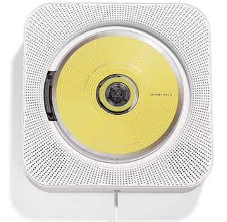
week 4: social design and user-centered processes
+ Robert Fabricant, Design With Intent
+ Design for behavioural change
+ Create artifacts that result in direct social engagement
+ Question traditional approaches to user-centered design
+ Too focused on observed and implied user needs
+ Designer becomes one step removed from the research process
+ Naoto Fukasawa: Design should "dissolve into behavior."
+ Simplicity means that users are unaware of the designer's existence (anti-ethos)
+ Sustainability and social change have led to designers questioning their neutral position
+ 3 Successors to Traditional UCD Approaches:
+ Persuasion Design
+ Catalyst Design
+ Performance Design

Slide 8
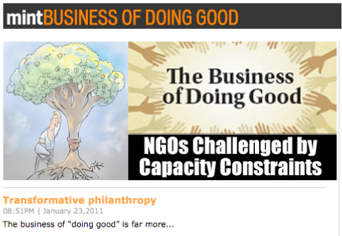
week 4: social design and user-centered processes
+ Robert Fabricant, Design With Intent
+ Persuasion Design
+ UCD assumes that the designer is merely at the service of observed phenomena/user groups
+ Denies that a designer's values may be different than the user
+ Embeds forms of influence and "choice architectures" into products and services
+ Create positive behaviour change
+ "... studies have shown that the average person will reduce their energy consumption by eight
percent if a smiley face is included on their electrical bill to reinforce the behavior."
+ Start with desired results and work backwards
+ Mint: The Business of Doing Good
+ India's 2nd most read business daily
+ Venture in collaboration with
The Wall Street Journal

Slide 9
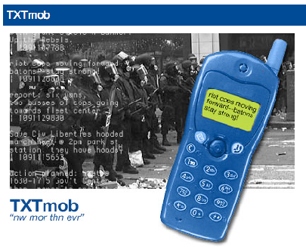
week 4: social design and user-centered processes
+ Robert Fabricant, Design With Intent
+ Catalyst Design
+ "Assuming the role of the designer is not neutral, how do you engage a community, change
behavior, and open up new possibilities without imposing your individual point of view?"
+ Social media has opened up new potentials for participatory design
+ Changes the relationship between designer and user
+ Use tools of design to facilitate, rather than dictate
+ Help communities engage to change their own behaviour
+ Apply alternative techniques for assembling teams (as opposed to anonymous users found
through consulting firms)
+ Mobile technologies can help organize communities
+ TXTmob (2004), Institute for Applied Autonomy/Tad Hirsch
+ Distributed text messaging for organizing
protesters
+ Used at DNC and RNC during 2004 US
presidential election
+ Source code used in development of Twitter (X)

Slide 10
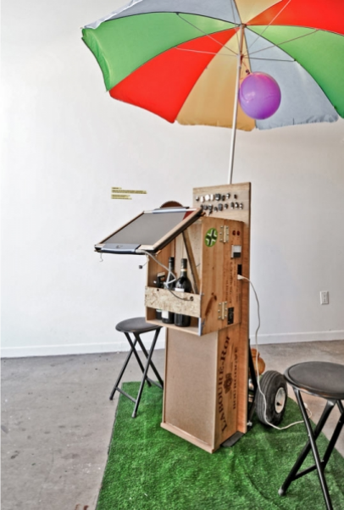
week 4: social design and user-centered processes
+ Robert Fabricant, Design With Intent
+ Performance Design
+ Empathy is crucial to behavioural change
+ "Empathy helps us better understand
consequences in two ways: We anticipate the
effects of our actions on others, and we experience
the emotions of others who have made similar
choices."
+ Virtual worlds and game environments (Second Life,
World of Warcraft) allow us to perform and test
alternate models of lived reality
+ Create scenarios and personae to role-play
different characters
+ Develop empathy and an understanding for the
positions of other stakeholders
+ Power Cart (2008), Mouna Andraos
+ Solar power and crank generator used to harness
"clean" energy to charge devices
+ Produced through Eyebeam, NYC
+ Water Wars (2010), Tad Hirsch
+ Game about water scarcity and enviro policy
+ Civic Games: "a class of socially-engaged games
whose intent is to involve citizens in public affairs
and democratic processes"

Slide 11
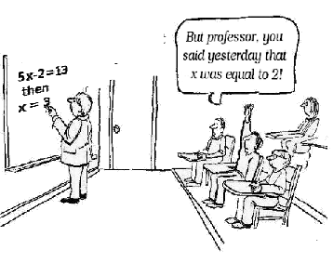
week 4: social design and user-centered processes
+ Reconciling Relationships
+ 3 Spheres of Artifact Mediation
+ Functionality: usefulness; materiality and making
+ Meaningfulness: cultural messages in society; often of more significant value than the usefulness
+ Economy: production, distribution, exchange; labour and market
+ "The task of a 'traditional' designer is (within the confines
of this model) to solve the problem arising from a design
brief: how the needed functionality can be produced
smartly by using the available materials and production
technologies. At the same time he or she has to shape
this functionality into a form which references the world
of meanings in culture and society in such a way that the
buyer and user will gain some added value from that,
for example aesthetic pleasure. And all the time this
must happen within the limits given by potential
production volumes and costs of
production, distribution and marketing.”
- Kari Kuutti

Slide 12
week 4: social design and user-centered processes
+ Reconciling Relationships
+ Design Education
+ Has typically been characterized by individualism and developing a distinct "style"
+ The assumption is that a single design brief will produce distinct results from each student
+ The baseline assumption for design is to suppress one's ego
+ At the service of the best, most efficient system for a given demographic
+ Use of participatory design strategies to move away from a singular authorship
+ Emergence of Mobile Devices
+ One of the most critical turning points
+ Evolution of new modalities for interaction required new software/graphical interfaces
+ Current Human-Centered Design Approaches
+ Design is more and more using human-centered approaches to the development process
+ Develop collaborative teams to make best use of resources and specializations
1 + 1 + 1 + 1 + 1 ...

Slide 13
week 4: social design and user-centered processes
+ Assignment: Je me souviens (Part 1 due February 20; 20%)
+ Montreal as a UNESCO City of Design
+ What makes a "design city"?
+ Select an example of what you feel to be well-designed
+ Architecture, public parks, systems, street furniture, infrastructure, etc.
+ MUST be Montreal-specific
+ "Even the city itself acknowledges that ‘design in Montreal is not simply for show but a source of
daily wellbeing.’ Not only has Montreal demonstrated that design can be a powerful tool in
promoting inclusion and plurality of values, but the city has also called upon its citizens to play a
critical and active part in mobilizing design to inspire more innovative living environments that
enhance daily life and existence.” - Koichiro Matsuura (UNESCO Director-General)
+ Not just a celebration of Montreal's attributes
+ The second part of the assignment will address the less effective elements of the city
+ Think about inhabitation: how do these artifacts/experiences shape the daily life of citizens (for
better or for worse)?
+ Use the issues, frameworks, guiding principles explored in class
+ What contextual, semantic, and physical concerns need to be addressed/investigated?
+ Examine the patterns of use, appropriateness of material choices, and general mood/atmosphere
+ Is it workable/livable/enjoyable?
+ Does it make a positive contribution to the everyday experience?

Slide 14
week 4: social design and user-centered processes
+ Assignment: Je me souviens (Part 1 due February 20; 20%)
+ Suggested Framework
+ Section I: Observation (500 words):
+ Ia: Briefly explain your choice; identify date/name of designer (if known); succinctly state its major
positive attributes (100 words)
+ Ib: Provide a brief history of your artifact/space, including key dates/transitions (100 words)
+ Ic: Provide a description of its visual and physical characteristics; include a map denoting its location
in the city (150 words, plus 10 photos/captions)
+ Id: Include a detailed description of its contextual environment (150 words); consider
+ Surfaces: hard/soft; changing/static
+ Size or volume: interior/exterior; confined/walled/open; reverb/echo/flat
+ Variety: balance of natural/human/manufactured phenomena; contrasts/similarities
+ Qualities: loud/quiet; harsh/sharp/soft/gentle
+ Layers: multiple simultaneous/discrete; easily-distinguished/seamless blend
+ Make sure that your photographs reveal different facets of the artifact
+ Verify that you are able to photograph in-situ (i.e. not private property)

Slide 15
week 4: social design and user-centered processes
+ Assignment: Je me souviens (Part 1 due February 20; 20%)
+ Section II: Occupation (500 words)
+ IIa: How does the general public interact with your artifact? Who, how, when, and under what
circumstances? Does this change during the day or seasons? Is it available to all, or restricted to a
specific demographic? (250 words)
+ IIb: Consider the functionality of your artifact (perceived/purported practical functions). Is there a
discrepancy between this and the experience of the user? Can this be quantified? (250 words)
+ Section III: Analysis (500 words)
+ IIIa: Apply principles studied in DART 261/262 to justify your assessment
+ As a starting point, consider Dieter Rams' Ten Principles for Good Design
+ Consider durability of your artifact: both physical and emotional
+ Is your artifact healthy: physically, environmentally, socially?
+ Does it help the public in positive ways (not mere ornamentation)?
+ Is it responsive to human scale? Does it evoke a positive sentiment?
+ You must integrate a minimum of 3 sources from the course or elsewhere
+ Section IV: Conclusion (100 words)
+ Succinctly describe your reasoning for the positive assessment
+ How does it activate and reflect the culture of its time and place?
+ If your artifact is historical, how does it function today?

Slide 16
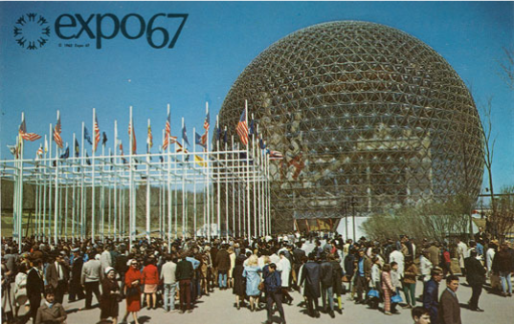
week 4: social design and user-centered processes
+ Assignment: Je me souviens (Part 1 due February 20; 20%)
+ Deliverables:
+ Complete ALL 4 SECTIONS for the due date
+ Approximate length: 1600 words, plus captions (PDF FORMAT ONLY)
+ Photographs and captions should be integrated into the body of the text
+ Upload to Moodle

Slide 17
week 4: social design and user-centered processes
+ Ready, Set, Go!
+ For Next Week:
+ Read: Chapman, Jonathan. "Authors of Experience." Emotionally Durable Design.
(Library reserve link)
+ Read: Krippendorff, Klaus. "Trajectory of Artificiality;" "Products;" Design; "Functionalism."
The Semantic Turn. (Library reserve link)
+ Respond to Thought Experiment (Moodle):
+ Please post the prompt and identify the scenario explored in today's class. Elaborate on the
play session and upload your response to the week 4 Moodle forum.
+ Je me souviens--Part 1
+ Two weeks left!

