Slide 1
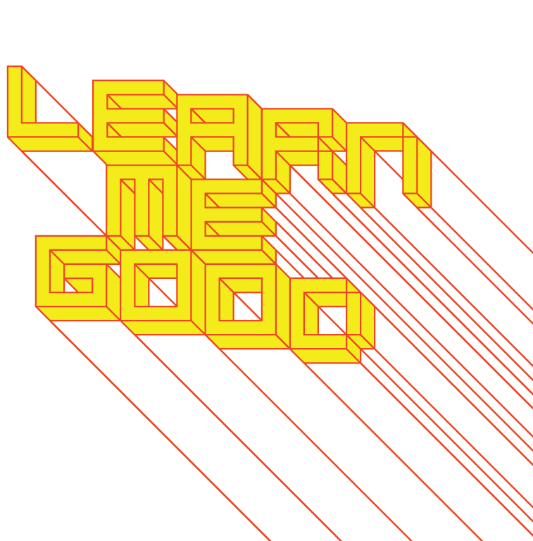
WEEK 6

Slide 2
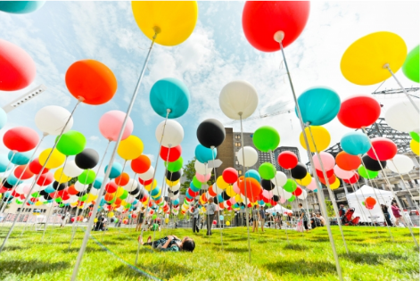
week 6: design experiences II: the "common" object
+ Class schedule:
+ Je me souviens--Part 1
+ DUE TODAY!
+ Presentation: Design and the Everyday (~90:00)
+ Thought Experiments (~30:00)
+ Teams: each member must pitch their example of ineffective Montreal design
+ Tutorial: select most positive direction and begin formulating the arguments
+ Next Week: Reading Break
+ No classes – begin development on part 2
of the Je me souviens assignment
+ Daily tous les jours, Musée des possibles

Slide 3
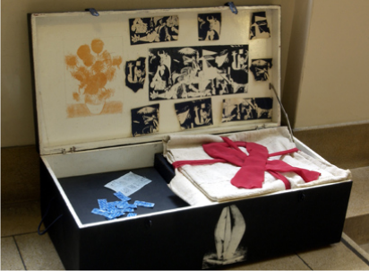
week 6: design experiences II: the "common" object
+ Sherry Turkle, Evocative Objects
+ “If being attentive to the details of people's lives might be considered a vocation, mine was born in
the smell and feel of the memory closet and its objects. That is where I found the musty books,
photographs, corsages, and gloves that made me feel connected. That is where I determined that I
would solve mysteries and that I would use objects as my clues.”
+ Bricolage
+ To fiddle, tinker: to make creative and resourceful use of whatever materials are at hand
(regardless of their original purpose)
+ “We find it familiar to consider objects as useful or aesthetic, as necessities or vain indulgences.
We are on less familiar ground when we consider objects as companions to our emotional lives
or as provocations to thought. The notion of
evocative objects brings together these two less
familiar ideas, underscoring the inseparability
of thought and feeling in our relationship to things.
We think with the objects we love; we love the
objects we think with.”
+ Objects serve as markers of relationships and
emotional connections

Slide 4
week 6: design experiences II: the "common" object
+ Sherry Turkle, Evocative Objects
+ Intellect and Emotion
+ “Life, of course, is not lived in discrete stages, nor are the relationships with objects that
accompany its journey. Objects have life roles that are multiple and fluid.”
+ Lack of study in material culture: “[There was a] sense that one was studying materialism,
disparaged as excess, or collecting, disparaged as hobbyism, or fetishism, disparaged as
perversion.”
+ Did not ascribe to the high moralistic intentions of fine art
+ Art & Copy (Dir. Doug Pray/PBS, 2009; begins ~1:00:00)
+ Hal Riney segment
+ In many ways, advertisers have a clearer understanding of the emotional lives of objects than
psychologists and theorists

Slide 5
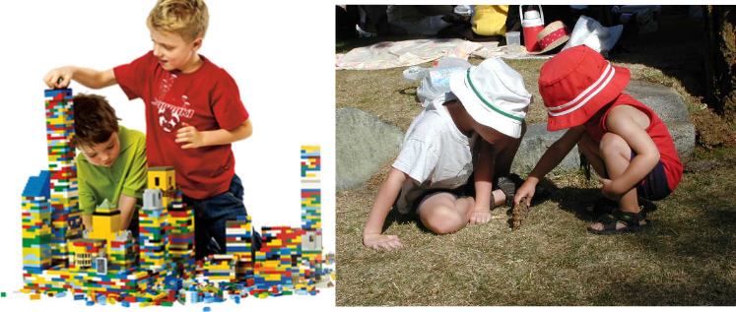
week 6: design experiences II: the "common" object
+ Sherry Turkle, Evocative Objects
+ Learning Through Play
+ Children have a “close-to-the-object” approach to learning and development
+ Confirms our experience of the world
+ Walt Whitman: "A child went forth everyday/ and the first object he look'd upon, that object he
became."
+ Play becomes a gateway transition to formal thinking and intellectual development
+ Should not be seen as inferior, but a fundamental part of “knowing”
+ “Scientific laboratories were shown to be places where discoveries are made in a concrete,
ad hoc fashion, and only later recast into canonically accepted formalisms; Nobel laureates
testified that they related to their scientific materials in a tactile and playful manner.”

Slide 6
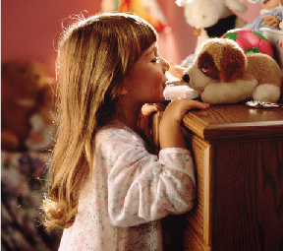
week 6: design experiences II: the "common" object
+ Sherry Turkle, Evocative Objects
+ Objects and the Self
+ Some objects are experienced as part of the self; we feel at one with our objects
+ “The diabetic feels at one with his glucometer, as increasingly we feel at one with the glowing
screens of our laptops, [and our smartphones].”
+ Most objects gain their long-standing intimacy based on how they came into the owner’s life
+ Others are inherently evocative: “uncanny”
+ Sigmund Freud: we experience as uncanny those things that are "known of old yet unfamiliar."
+ Not frightening, but not quite right; distorted: “a museum mummy becomes an author's
uncanny ‘double.’”
+ Some remind us of the childhood line between self and other: “a young child believes her stuffed
bunny rabbit can read her mind”
+ Some relate to transitional moments and thresholds: full of possibility and uncertainty (a mix of
fear and excitement)

Slide 7
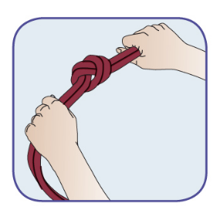
week 6: design experiences II: the "common" object
+ Sherry Turkle, Evocative Objects
+ Thinking and Experiencing
+ Evocative objects ground concepts and theory in the everyday experience
+ There are strong correlations between things and thinking, making and conceptualizing,
doing and reflecting
+ “We tie a knot and find ourselves in partnership with string in our exploration of space.”
+ Objects are able to catalyze self-creation
+ “…a new car becomes a new skin, of how a change of jewelry
can become its own voyage to a new world.”
+ Objects bring together thought and feeling
+ “…objects of science are objects of passion.”
+ Memory and Loss
+ “For Freud, when we lose a beloved person or object, we begin
a process that, if successful, ends in our finding them again,
within us. It is, in fact, how we grow and develop as people.
When objects are lost, subjects are found.”
+ What does Freud mean by this idea?

Slide 8
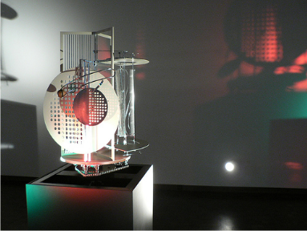
week 6: design experiences II: the "common" object
+ Mihaly Csikszentmihalyi, “Design and Order in Everyday Life”
+ Order and Chaos
+ “[Painter/designer] György Kepes thought that people of the twentieth century live in chaotic
environments, are involved in chaotic relationships, and carry chaos at the core of their
consciousness.”
+ Art’s role is to reduce chaos and impose a sense of order on the environment, thoughts,
and feelings
+ László Moholy-Nagy
+ The goal of art is to form a "unified manifestation ... a balance of the social, intellectual, and
emotional experience; a synthesis of attitudes and opinions, fears and hopes."
+ Art helps to reconcile our biological instincts with the artificial rules we have constructed to
organize social life
+ How does this occur in practical ways?
+ Moholy-Nagy, "Light Space Modulator"

Slide 9
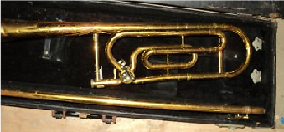
week 6: design experiences II: the "common" object
+ Mihaly Csikszentmihalyi, “Design and Order in Everyday Life”
+ Field Studies
+ Visit “normal” subjects’ homes to see how they responded to art objects and design qualities in
their environment
+ What kind of “art” objects did they have in their homes?
+ How often did they notice such objects?
+ What went on in their minds when they did respond?
+ Few people had anything meaningful to say about the subject
+ Art played an insignificant role in their lives—marginal to their sense of self or well-being
+ Their objects of strong attachment were largely devoid of aesthetic value
+ Charged with meaning, personal significance, and integral to the owners’ lives
+ “…a woman pulled out an old Bible that she cherished as a symbol of family continuity; a man
showed us a desk he had built, a piece of furniture which embodied his ideals of simplicity and
economy; one boy showed us his stereo with which he could make "weird sounds" when he was
depressed; while an old woman showed us the razor which her husband, who had been dead for
eighteen years, had shaved with and which she still kept in the medicine cabinet. Finally, a
successful lawyer took us to the basement where he unpacked a trombone he used to play in
college. He explained that whenever he felt
overwhelmed by his many responsibilities, he took
refuge in the basement to blow on the old trombone.”

Slide 10
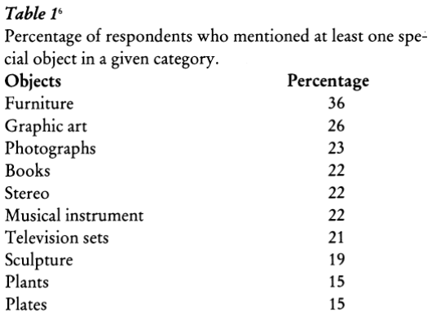
week 6: design experiences II: the "common" object
+ Mihaly Csikszentmihalyi, “Design and Order in Everyday Life”
+ What would you choose?

Slide 11
week 6: design experiences II: the "common" object
+ Mihaly Csikszentmihalyi, “Design and Order in Everyday Life”
+ “Symbolic Ecology”
+ A network of objects that create a unified sense of self
+ 136 of the 1694 objects referred to graphic arts—most were homemade (children, relatives,
friends)
+ Value embodied in the close personal ties, not the formal aesthetic qualities
+ Only 16% of the reasons given for why the owners cherished these works related to how they
looked
+ Appreciation means that the owner becomes part of the act of creation—less about the artist’s
creative effort

Slide 12
week 6: design experiences II: the "common" object
+ Mihaly Csikszentmihalyi, “Design and Order in Everyday Life”
+ Motivations
+ The youngest subjects responded to the activity potential of objects
(musical instruments, televisions, stereos, sports equipment, etc.)
+ “… a teenage boy said that the kitchen table and chairs were among the most special objects
in his home because they were very comfortable. He could also tilt the chairs and balance on
them, hide under the table, or build a fortress with the entire set. ‘(W)ith another table, I
couldn't play as good 'cause I love the feel of that table.’”
+ Older subjects selected objects of contemplation, memories of events, experiences, relationships (books, photos, souvenirs, paintings, etc.)
+ “For the older generation of respondents, objects often bridged relationships between several
generations: ‘This chest was bought by my mother and father when they were married about
seventy years ago.... My mother painted it different colors, used it in the bedroom. When I got
it my husband sanded it down to the natural wood.... I wouldn't part with it for anything. And I
imagine the kids are going to want it, my daughter-in-law loves antiques.’”
+ Individuality
+ “…objects do not create order in the viewer's mind by embodying principles of visual order; they
do so by helping the viewer struggle for the ordering of his or her own experience. A person
finds meaning in objects that are plausible, concrete symbols of the foremost goals, the most
salient actions and events in that person's life.”
+ Historically, religious icons, patriotic symbols, and folk art achieved these goals
+ Today, these familiar cultural symbols have lost their strength to create order
+ A much more individualized language

Slide 13
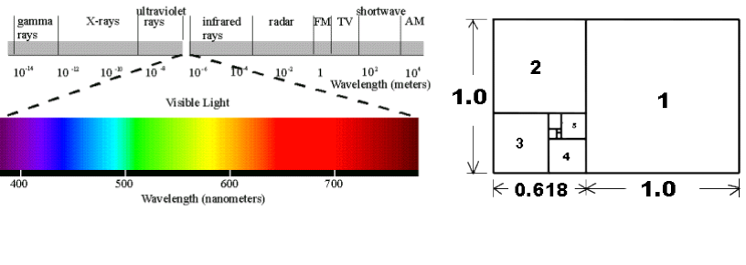
week 6: design experiences II: the "common" object
+ Mihaly Csikszentmihalyi, “Design and Order in Everyday Life”
+ Objective Visual Qualities of “Good Design”?
+ There are longstanding assumptions that certain colours, shapes, and formal elements are
universally pleasing (the Golden Ratio, Fibonacci sequence, etc.)
+ Earlier experiments in visual perception focused on scientific rationality
+ Flawed: real-life contexts are not dictated by physical properties of the light spectrum
+ Individual cultural differences and emotional responses

Slide 14
week 6: design experiences II: the "common" object
+ A. R. Luria Study (1931): Uzbekistan
+ Rational Versus Experiential Systems
+ Uzbek women refused to combine coloured skeins of wool because they are so different from
one another
+ Instead of abstract categories (brown), they referred to real-world similarities (calf dung, decayed
teeth, cotton in bloom, etc.)
+ Uzbek men referred to every colour as “blue”
+ In the West, colours are seen as rational, analytical based on physical, spectral properties
+ Creates tension and disharmony for those raised in a different tradition
+ Shepherds in Central Asia: colour is rarely an abstract dimension
+ “The quality of an object is inseparable from its concrete manifestation: the redness of the
apple is not the same as the redness of fire or the feverish cheek of a child.”
+ Derived from the practice of everyday life
+ Respondents were asked to sort circles, squares and triangles (as we understand them in
Western cultures)
+ Completed circles were referred to as rings; incomplete circles seen as moons
+ Could not be classified in the same category
+ Triangle resembled a traditional form of jewelry, and therefore sorted with the ring/circle

Slide 15
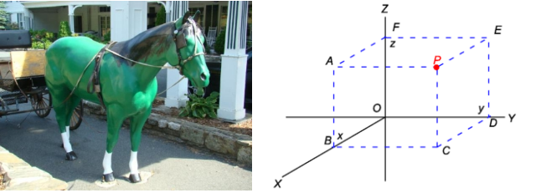
week 6: design experiences II: the "common" object
+ Mihaly Csikszentmihalyi, “Design and Order in Everyday Life”
+ Towards a Universal Visual Language?
+ It is impossible to assume a universal “law” governing human perception
+ Certain approaches can destabilize viewers (yellow sea, green horse, etc.)
+ They are wrong in an absolute sense
+ Variety and differentiation is based on the accepted symbolization in a given culture
+ “Basic patterns such as straight lines and right angles are easily isolated and recognized by
people living in a ‘carpentered world,’ but those used to a more organic environment fail to
perceive such ‘units’ as separate from the rest of the perceptual context.”
+ Cartesian rationality dictates how we respond to our built environment
+ Our systems of classification and “naming” reflect more on perception than simply receiving
visual stimuli

Slide 16
week 6: design experiences II: the "common" object
+ Mihaly Csikszentmihalyi, “Design and Order in Everyday Life”
+ Aristotle
+ Pleasure is derived through a balance between monotony and confusion (order/chaos)
+ Creates an optimal arousal of the nervous system
+ Contains basic pattern or order, but enough variation to require an active perceptual struggle
+ Problem: purely in the realm of the theoretical
+ There are no simple “rules” to apply in the design process
+ Test:
+ Individuals can be trained to recognize patterns and order according to objective criteria
+ In everyday life, we do not apply these tools of measurement

Slide 17
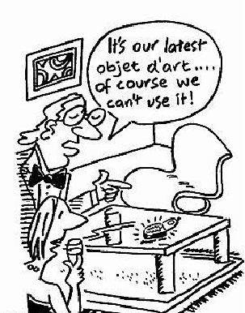
week 6: design experiences II: the "common" object
+ Mihaly Csikszentmihalyi, “Design and Order in Everyday Life”
+ Visual Values
+ Aesthetics ARE important, but they are not “natural” or inherent to our species
+ They are culturally formed through social consensus (not individual perception)
+ Critics help to shape and construct the criteria for measurement attached to visual elements
+ “Without the consensus-building efforts of the art theorist or critic, each person would evaluate
objects in terms of his or her private experiences. In each culture, however, public taste
develops as visual qualities are eventually linked with values.”
+ Visual values can be: unanimous/contested, elite/popular
+ Judith Attfield, “The Meaning of Things: design in the lower case"
+ Craft and the Maker
+ Christopher Bailey: “…there are three principal sites of craft
production: the factory, the studio and the home.”
+ Primary focus has been traditionally placed on the studio as a
location for academic study
+ Class distinctions associated with “taste”

Slide 18
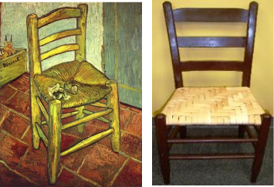
week 6: design experiences II: the "common" object
+ Judith Attfield, “The Meaning of Things: design in the lower case"
+ Designer-Makers
+ Industrial design created a division of labour—designer distanced from the act of making
+ The designer becomes an innovator: “The designer's brief was to create new types of products
for new types of manufacturing and distribution technologies as well as new types of markets
consisting of an anonymous homogeneous mass of consumers.”
+ Crafts relied on small runs and custom orders; relied on traditional manual training
+ Separation of mind/body, head/heart
+ Craft has been largely ignored since post-WWII (devalued as mere trade)
+ Museums like the Victoria and Albert use history and criticism to enhance the symbolic value of
craft—drawing connections to more lauded fine art practices
+ “To those critics who saw craft as a retreat from innovation, modernism and progressive
design, the bid was to elevate its status by redefining craftwork as a 'creative' art and
'craftsmen' as designer-makers with a right of entry into the circle of respectability enjoyed by
fine artists.”

Slide 19
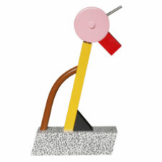
week 6: design experiences II: the "common" object
+ Judith Attfield, “The Meaning of Things: design in the lower case"
+ Stylistic Rebellion
+ Postmodern movements, like Memphis embraced anti-design: nostalgia, but without
radical transformation
+ Now, a desire to return back to reality, rethinking how things work, benefit the user
+ Donald Norman: “…people feel guilt when they are unable to use simple things,
guilt that should be not theirs but rather the designers and manufacturers of
the objects.”
+ Not simply relying on visual aesthetics to produce this “usability”
+ “…precedence [is given] to 'durability' above other qualities and assumes that
form is in fact a function of a well-designed object, although not necessarily the
result of its function.”
+ Everyday Design
+ Everyday things do not draw attention to themselves (they are givens)
+ “It is things, as opposed to design or craft, product or commodity, that make up the materialization
of the everyday. Everyday things have nothing to do with the 'low' aesthetic of 'high/low' culture
that has allowed the popular to infiltrate the prestigious art gallery in order to affiliate it to art.”
+ Things With Attitude
+ "Design as 'things with attitude' is compared against less obtrusive 'lower case' form of things
framed within the more generalised context of 'the everyday' as examples of how meaning is
objectified or made material.”

Slide 20
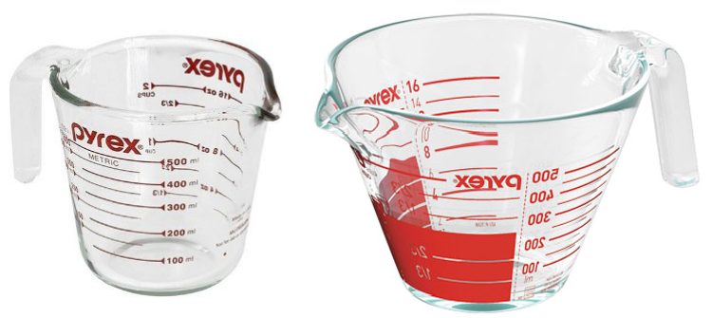
week 6: design experiences II: the "common" object
+ Mihaly Csikszentmihalyi, “Design and Order in Everyday Life”
+ “Good design is a visual statement that maximizes the life goals of the people in a given culture (or, more realistically, the goals of a certain sub-set of people in the culture) that draws on a shared symbolic expression for the ordering of such goals. If the system of symbols is relatively universal, then the design will also be judged good across time and cultures.”
+ Design DNA (HGTV)
+ Pyrex measuring cup segment

Slide 21
week 6: design experiences II: the "common" object
+ Assignment: Exhibition Review (Due March 12; 5%)
+ Prepare a written review of an exhibition (in person or online)
+ The CCA website is a good starting point
+ Highlight a few key projects and/or ideas that inspired you or challenged your understanding of the
design process
+ Reflect on your own evolving design ethos
+ How do the themes in the show reflect (or not) your personal philosophy?
+ Deliverables:
+ Approximately 500-word paper
+ Upload to Moodle

Slide 22
week 6: design experiences II: the "common" object
+ Assignment: Je me souviens (Part 2 due April 2; Groups of 3; 20%)
+ Montreal as a UNESCO City of Design
+ What makes a "design city"?
+ Select an example of what you feel to be well-designed
+ Architecture, public parks, systems, street furniture, infrastructure, etc.
+ MUST be Montreal-specific
+ "Even the city itself acknowledges that ‘design in Montreal is not simply for show but a source of
daily wellbeing.’ Not only has Montreal demonstrated that design can be a powerful tool in
promoting inclusion and plurality of values, but the city has also called upon its citizens to play a
critical and active part in mobilizing design to inspire more innovative living environments that
enhance daily life and existence.” --Koichiro Matsuura (UNESCO Director-General)
+ Not just a celebration of Montreal's attributes
+ The second part of this assignment addresses the less effective elements of the city
+ Think about inhabitation: how do these artifacts/experiences shape the daily life of citizens (for
better or for worse)?
+ Use the issues, frameworks, guiding principles explored in class
+ What contextual, semantic, and physical concerns need to be addressed/investigated?
+ Examine the patterns of use, appropriateness of material choices, and general mood/atmosphere
+ What prevents it from being workable/livable/enjoyable?
+ Why doesn't it provide a more positive contribution to the everyday experience?

Slide 23
week 6: design experiences II: the "common" object
+ Assignment: Je me souviens (April 2; Groups of 3; 20%)
+ Suggested Framework (Same criteria as Part 1)
+ Section I: Observation (500 words):
+ Ia: Briefly explain your choice; identify date/name of designer (if known); succinctly state its major
positive attributes (100 words)
+ Ib: Provide a brief history of your artifact/space, including key dates/transitions (100 words)
+ Ic: Provide a description of its visual and physical characteristics; include a map denoting its location
in the city (150 words, plus 10 photos/captions)
+ Id: Include a detailed description of its contextual environment (150 words); consider
+ Surfaces: hard/soft; changing/static
+ Size or volume: interior/exterior; confined/walled/open; reverb/echo/flat
+ Variety: balance of natural/human/manufactured phenomena; contrasts/similarities
+ Qualities: loud/quiet; harsh/sharp/soft/gentle
+ Layers: multiple simultaneous/discrete; easily-distinguished/seamless blend
+ Make sure that your photographs reveal different facets of the artifact
+ Verify that you are able to photograph in-situ (i.e. not private property)

Slide 24
week 6: design experiences II: the "common" object
+ Section II: Occupation (500 words)
+ IIa: How does the general public interact with your artifact? Who, how, when, and under what
circumstances? Does this change during the day or seasons? Is it available to all, or restricted to a
specific demographic? (250 words)
+ IIb: Consider the functionality of your artifact (perceived/purported practical functions). Is there a
discrepancy between this and the experience of the user? Can this be quantified? (250 words)
+ Section III: Analysis (500 words)
+ IIIa: Apply principles studied in DART 261/262 to justify your assessment
+ As a starting point, consider Dieter Rams' Ten Principles for Good Design
+ Consider durability of your artifact: both physical and emotional
+ Is your artifact healthy: physically, environmentally, socially?
+ Does it help the public in positive ways (not mere ornamentation)?
+ Is it responsive to human scale? Does it evoke a positive sentiment?
+ You must integrate a minimum of 3 sources from the course or elsewhere

Slide 25
week 6: design experiences II: the "common" object
+ Section IV: Proposal (400 words)
+ Propose a solution to rectify the problems identified in the analysis
+ Provide sketches, diagrams, and a 400-word written description of the changes
+ This will lead up to Part 3 of the assignment, which will entail a 3-poster set
+ You may wish to divide up the sections among your team members to make the most optimal use of
your time/energies
+ Section V: Conclusion (100 words)
+ Succinctly describe your reasoning for the positive assessment
+ How does it activate and reflect the culture of its time and place?
+ If your artifact is historical, how does it function today?
+ Oral Presentation (Week 12)
+ Each team will present their research and proposals in 10-15-minute sessions
+ 5-minute (MAX!) video presentation, followed by Q&A session
+ It is recommended that you use a video sharing site (YouTube, Vimeo, etc.) and provide a link
+ All files MUST be uploaded to Moodle prior to the class session to expedite the process
+ Order will be determined randomly
+ You MUST attend all sessions

Slide 26
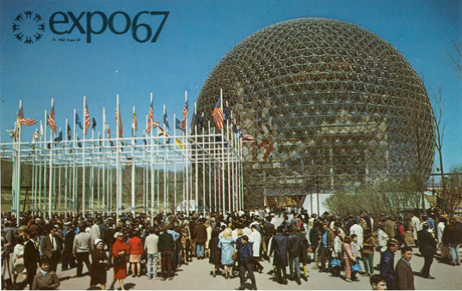
week 6: design experiences II: the "common" object
+ Deliverables:
+ Approximate length: 2000 words, plus captions (PDF FORMAT ONLY)
+ 10-minute oral presentations in week 11 (randomly selected)
+ Photographs and captions should be integrated into the body of the text
+ Upload one copy to Moodle

Slide 27
week 6: design experiences II: the "common" object
+ Ready, Set, Go!
+ For Next Week:
+ Read: Klaus Krippendorff. “Stakeholders in Design”; “Stakeholder Networks.” The Semantic Turn:
A New Foundation for Design. pp. 63-65, 181-183.
+ Read: Moggridge, Bill. “Designing Interactions”; “People.” Designing Interactions. pp. 647-681.
+ View Site: Daily tous les jours.
+ “About.” Frog Design.
+ Respond to Class Prompt (Moodle):
+ Please identify your team's example of ineffective Montreal design.
+ Elaborate on the play session and upload your response to the week 6 Moodle forum
(One per team).
+ Next Week: Reading Break
+ No classes – begin development on part 2 of the Je me souviens assignment

